Slide 1
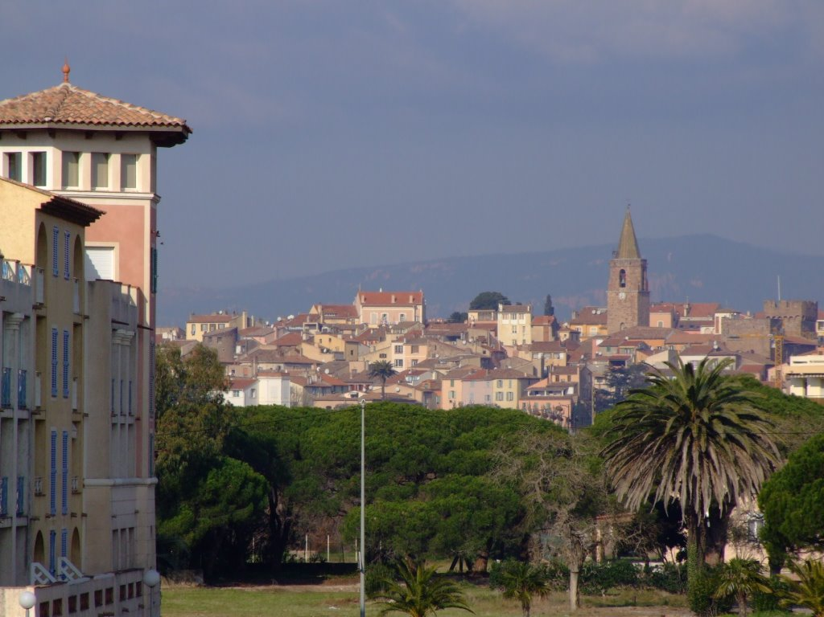
Neutron beams for nuclear data measurements
Arnd Junghans Helmholtz-Zentrum Dresden-Rossendorf Germany

Slide 2
Table of Content
Introduction of the speaker
Neutron sources (Terrestrial and radioisotope sources)
Neutron producing nuclear reactions: Monoenergetic neutrons
Kinematics e.g. ⁷Li(p,n)⁷Be
Neutron reference fields: „Big Four“ reactions for neutron production
Neutron generators: D(d,n)³He, T(d,n)⁴He reactions
Time-of-flight method and neutron sources
Spallation neutron sources using light-ion accelerators
Slowing down of neutrons to produce eV-keV neutrons
Photoneutron sources using electron accelerators

Slide 3
curriculum vitae Arnd Rudolf Junghans
1987-1994 Student of Physics at Technische Hochschule Darmstadt Diploma thesis „Influence of fission on the fragmentation of relativistic projectiles in peripheral collisions“
1994-1997 PhD Student Technische Universität Darmstadt Dissertation „Investigation of the collectivity of nuclear excitations in the fragmentation of relativistic uranium projectiles“
1998 Postdoc GSI Darmstadt „Studies of production methods of exotic nuclei“
1999-2002 Postdoc + Research Assistant Professor, CENPA, University of Washington, Seattle: ⁷Be(p,γ)⁸B S-factor measurements -> Solar neutrino problem
since 2003 Scientific Staff at Helmholtz-Zentrum Dresden-Rossendorf Group leader „Physics of Transmutation“ Development of a photoneutron source at the superconducting electron acelerator ELBE

Slide 4
Doktorgesang 1994 (This is twenty years ago)

Slide 5
CHARMS evening (this is 11 years ago)
Notes:
Collaboration for High-Accuracy Experiments on Nuclear Reaction Mechanisms with magnetic Spectrometers

Slide 6
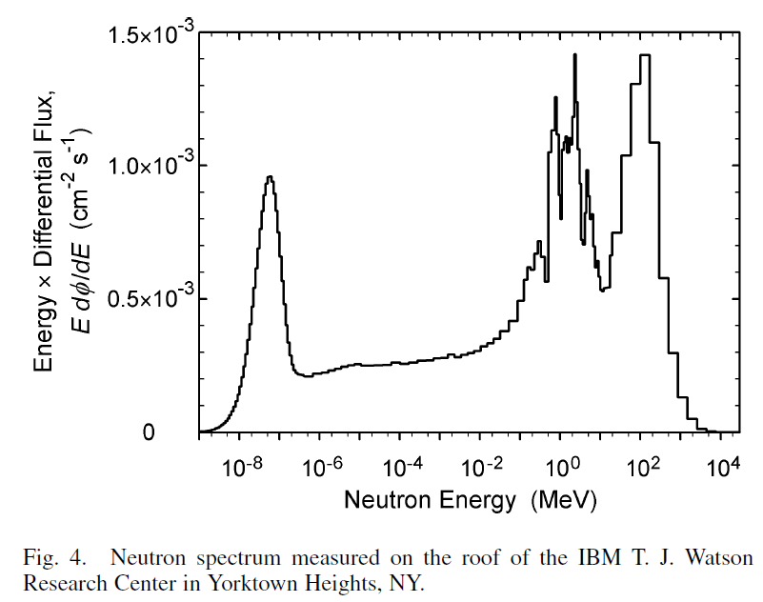
Neutron sources
Neutron sources in nature: Neutrons can be formed in nuclear reactions of high-energetic cosmic particles in the upper atmosphere. The flux is inverserly proportional to the solar activity (high solar activity deformes the earth‘s magnetic field) and strongly dependend on the geographical latitude and altitude.
Evaporation
peak
High energy
peak
Thermal peak
Gordon et. al. IEEE TNS 51 (2006) 3427
Setup:
Extended range Bonner spheres
14 different size PE moderators
with ³He proportional counters
Resonances
from N,O
due to
MCNP sim.
G. Heusser, Low-radioactivity background techniques

Slide 7
Neutron sources
Terrestrial sources: Fission neutrons from spontaneous fission of heavy nuclei Spontaneous fission has been observed on thorium and uranium (and heavier actinides that are not primordial)
Artificial neutron sources: 1. Radioisotope sources based on (α,n) reactions, e.g. (Po,Be), (Am,Be) (Cm,¹³C) or spontaneous fission, e.g. ²⁵²Cf (sf) 2. Photoneutron sources ²H(γ,n)H, ⁹Be(γ,n) 3. Accelerator based sources, e.g. (d,n) (p,n) reactions on light nuclei 4. Nuclear reactors (fission neutrons + moderation)
5. Spallation neutron sources
nuclide | λ_{f} (a⁻¹)
²³⁵U | 1.98*10⁻¹⁸
²³⁸U | 7.03*10⁻¹⁷
²³²Th | <6.9*10⁻²²

Slide 8
Radioisotope sources
(α,n) reactions on light nuclei with positive Q-value: e.g. Be, B ⁹Be(α,n)¹²C Q=5.71 MeV, E_{n} = 0 .. 13 MeV
α-emitter mixed with Be-powder
complicated neutron energy spectrum, neutron intensity also dependent on purity of the α-emitter
background from high-energy gamma emission
¹³C(α,n) is also the main source of neutrons in the astrophyiscal s-process
β-delayed neutron emission. e.g. ⁸⁷Br (t_{1/2} = 55.7 s) → ⁸⁷Kr* + β- ⁸⁷Kr* → ⁸⁶Kr + n not a practicable neutron source but important for reactor criticality control

Slide 9
Neutron source: ²⁴¹Am: ⁹Be(α,n)¹²C
typically: 5 g Be
0.37 g ²⁴¹AmO₂ = 1 Ci
Content: Mixture of α-Emitter M and Beryllium
as a fine powder or as alloy or Actinide-Boride
Yield ca. 10⁻⁴ n/α-decay
(Most α-particles are stopped without causing
a nuclear reaction.)
Lorch, Int. Jour. Appl. Rad. Iso. 24 (1973) 585
complex neutron spectrum :
depending on the individual source.

Slide 10
Neutron source: ²⁴¹Am: ⁹Be(α,n)¹²C
Transitions to discrete states from CN decay
¹³C* → ¹²C*
neutron spectrum from a thin target shows these transitions
e.g.transition to the 4.44 MeV state in ¹²C:
E_{n} = E_{α} + Q – E*(¹²C) – E_{recoil}(¹²C)
= 7.78 MeV + 5.7 MeV – 4.44 MeV – 0.588 MeV = 8.453 MeV
Proton recoils in stilbene
scintillators
INDC-NDS-0114(1980)

Slide 11
Am-Be source spectrum
Non g.s. neutron groups also lead to
high energy γ-ray emission

Slide 12
²⁵²Cf spontaneous fission neutron spectrum
²⁵²Cf T_{1/2} = 2.65 a, α = 96.908%, SF 3.092% <n> = 3.756 +- 0.005; 0.116 n/Bq; 2.30*10⁶ n/(s μg)
Fission neutron spectrum has a approximately maxwellian distribution with T = 1.42 MeV
²⁵²Cf is a very strong radioisotope neutron source
Also emitted are ≈10 prompt γ-rays per fission.

Slide 13
Photoneutron sources with radioisotopes
²H(γ,n)H, Q= -2.226 MeV ⁹Be(γ,n) Q = -1.666 MeV
negative Q-value ➔ high energetic γ-emitter is required
m – neutron mass, M residual nucleus mass
monoenergetic γ-emitter can deliver a quasimonoenergetic neutron source
dependence of E_{n} on emission angle Θ
low neutron yield ca. 10⁻⁵ – 10⁻⁶ n/ γ
high energetic γ-emitters are mostly short lived → production in reactor or accelerator facility, e.g. ²⁴Na t_{1/2} = 15 h, ⁸⁸Y t_{1/2} = 107 d

Slide 14
Neutron producing nuclear reactions
In two-body reactions monoenergetic neutrons can be produced, e.g. DT-reaction: ³H(²H,n)⁴He, Q = 17.16 MeV
Kinematics determines the angular distribution and energy spectrum
The yield (neutrons /primary particles) is determined by the differential cross section $\frac{dσ}{dΩ}(E_{p},Θ)$
Realistic yield determination by integration over the target thickness and angular range (slowing down of the beam in the target material)
$$n_{tar}$$
$${dN}_{n}$$
$$Θ$$
$$N_{p}$$

Slide 15
Relativistic two body kinematics
$m_{1}\left(m_{2},m_{3}\right)m_{4}$projectile $m_{2}$ hits target $m_{1}$ after the reaction: ejectile (e.g. a neutron) $m_{3}$, recoiling nucleus $m_{4}$
$p_{cm}$momentum of projectile and target in the center of mass frame
$p_{cm}^{′}$ momentum of ejectile and recoil in the c.m. frame
For the initial system $m_{1},m_{2}$
with $E_{i}=m_{i}+T_{i};E_{i}^{2}=p_{i}^{2}+m_{i}^{2}$
$$S={\left(\sum_{i}{E_{i}} \right)}^{2}−{\left(\sum_{i}{ \vec{p_{i}}} \right)}^{2} \\ S={\left(m_{1}+m_{2}\right)}^{2}+{2m_{1}T}_{2}$$
In the c. m. frame
$$S={\left(\sqrt{m_{1}^{2}+p_{cm}^{2}}+\sqrt{m_{2}^{2}+p_{cm}^{2}}\right)}^{2}$$
The four momentum squared $S$
is lorentz-invariant. (invariant mass)
$$v_{3}$$
$$p_{cm}^{′}/m_{3}$$
$$Θ_{3}$$
$$Θ_{cm}$$
$$Θ_{4}$$
$$v_{cm}$$
$$v_{4}$$
$$p_{cm}^{′}/m_{4}$$
$$p_{cm}=\sqrt{\begin{aligned}\frac{{\left(S−m_{1}^{2}−m_{2}^{2}\right)}^{2}−4m_{1}^{2}m_{2}^{2}}{4S} \\ \end{aligned}}$$

Slide 16
Relativistic two body kinematics
Lorentz-transformation formulated using the rapidity Y
$$\tanh{Y}≝β≝\frac{v}{c}$$
$$\cosh{Y}=γ=1/\sqrt{1−β^{2}}$$
$$\sinh{Y=γβ}$$
Boost from lab. to c.m. system
c.m. momentum of the target is $−p_{cm}$
$$\left({−p_{cm} \atop E_{cm}}\right)=\left(\begin{matrix}\cosh{Y} & −sinh{Y} \\ −sinh{Y} & \cosh{Y}\end{matrix}\right)\left({p_{1}=0 \atop m_{1}}\right)$$
$$\left({{−p}_{cm} \atop E_{cm}}\right)=\left({{−m}_{1}\sinh{Y} \atop m_{1}\cosh{Y}}\right)$$
With $e^{Y}=\sinh{Y}+\cosh{Y}$
Rapidity of the c.m. system
$$Y=ln⁡\frac{p_{cm}+\sqrt{m_{1}^{2}+p_{cm}^{2}}}{m_{1}}$$
$$\left({p \atop E}\right)=\left(\begin{matrix}\cosh{Y} & \sinh{Y} \\ \sinh{Y} & \cosh{Y}\end{matrix}\right)\left({p_{cm} \atop E_{cm}}\right)$$
„Rapidité“ Jacques Tati, Jour de Fête, 1949

Slide 17
Relativistic two body kinematics
Energy/momenta of the reaction products calculated using the invariant mass $S$and the rapidity $Y$ of the c.m. system
$p_{cm}^{′}= \sqrt{\frac{{\left(S−m_{3}^{2}−m_{4}^{2}\right)}^{2}−4m_{3}^{2}m_{4}^{2}}{4S}}$
Lorentz transformation with c.m rapidity $Y$ $$p_{3}cosΘ_{3}=p_{cm}^{′}\cos{Θ_{cm}}\cosh{Y+}\sqrt{{p_{cm}^{′}}^{2}+m_{3}^{2}}sinh Y$$
$$E_{3}=\sqrt{{p_{cm}^{′}}^{2}+m_{3}^{2}}\cosh{Y}+p_{cm}^{′}\cos{Θ_{cm}}\sinh{Y}$$
$$p_{3}\sin{Θ_{3}=p_{cm}^{′}\sin{Θ_{cm}}}$$
$$p_{4}cosΘ_{4}={−p}_{cm}^{′}\cos{Θ_{cm}}\cosh{Y+}\sqrt{{p_{cm}^{′}}^{2}+m_{4}^{2}}sinh Y$$
$$E_{4}=\sqrt{{p_{cm}^{′}}^{2}+m_{4}^{2}}\cosh{Y}−p_{cm}^{′}\cos{Θ_{cm}}\sinh{Y}$$
$$p_{4}\sin{Θ_{4}=p_{cm}^{′}\sin{Θ_{cm}}}$$
transversal momenta are lorentz-invariant
$$v_{3}$$
$$p_{cm}^{′}/m_{3}$$
$$Θ_{3}$$
$$Θ_{cm}$$
$$Θ_{4}$$
$$v_{cm}$$
$$p_{cm}^{′}/m_{4}$$
$$v_{4}$$

Slide 18
Lab. momenta as function of the lab. angles:
1. Isolate the c.m. angle terms and square them 2. sum both momentum projections $Θ_{cm}$cancels ➔ quadratic equation for $p_{3},p_{4}$
$$p_{3,4}^{2}(1+\sin^{2}{Θ_{3,4}\sinh^{2}{Y)−2p_{3,4}\cos{Θ_{3,4}\sinh{Y\sqrt{p_{cm}^{′2}+m_{3,4}^{2}}=p_{cm}^{′2}−m_{3,4}^{2}\sinh^{2}{Y}}}}} \\ p_{3,4}= \frac{\sqrt{m_{3,4}^{2}+p_{cm}^{′2} }\cos{Θ_{3,4}\sinh{Y±\cosh{Y\sqrt{p_{cm}^{′2}−m_{3,4}^{2}\sin^{2}{Θ_{3,4}\sinh^{2}{Y}}}}}}}{1+\sin^{2}{Θ_{3,4}\sinh^{2}{Y}}}$$
Two solutions of $p_{3,4}=f\left(Θ_{3,4}\right)$ !
For endothermic reactions $Q=m_{1}+m_{2}−m_{3}−m_{4}<0$MeV Forward threshold (minimum kinetic energy for the reaction to occur) derived from $E_{3,cm}+E_{4,cm }≥m_{3}+m_{4}$ $T_{f}=−Q[1+\left(\frac{m_{2}}{m_{1}}\right)−\left(\frac{Q}{2m_{1}}\right)]$
If the ejectile is slower than the c.m. velocity $E_{3}$ is a double-valued function of the lab angle $Θ_{3}$ . Equivalent: $Θ_{3}$ is a double-valued function of $Θ_{cm}$
up to the back threshold $T_{b}=−Q[1+\frac{m_{2}}{m_{1}−m_{3}}−\frac{Q}{2\left(m_{1}−m_{3}\right)}]$

Slide 19
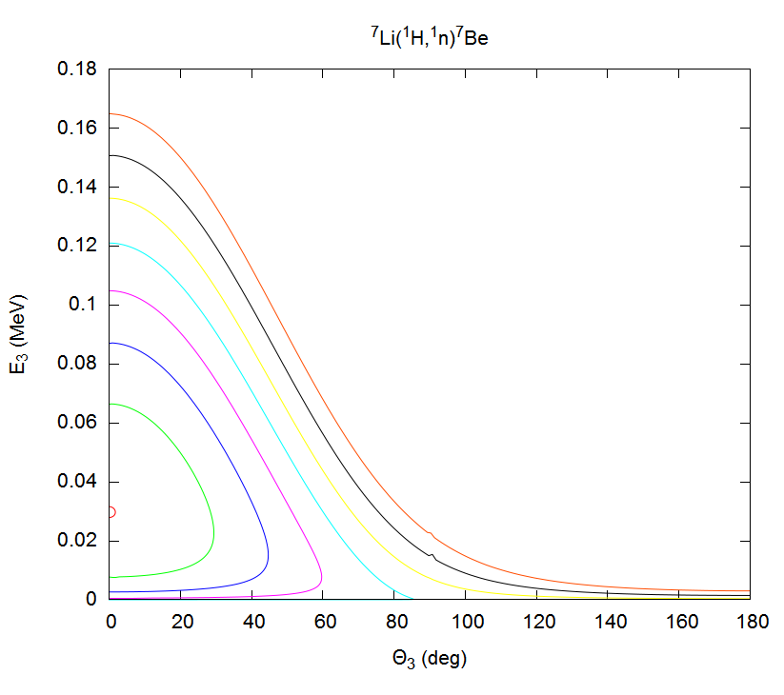
⁷Li(p,n)⁷Be : neutron energy vs. angle
$Q\text{=1.644 }$MeV ; $T_{f}=1.881$ MeV ; $T_{b}=1.920$MeV
E_{p}= 1.95 MeV
Two neutron energy
groups below $T_{b}$
1.94
Lab. neutron energy
1.93
1.92
1.91
1.90
1.89
1.8806 MeV
threshold
Lab. neutron emission angle

Slide 20
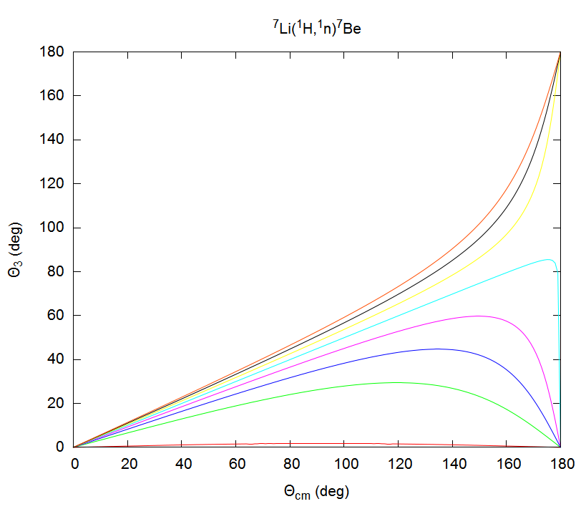
⁷Li(p,n)⁷Be: neutron angle vs. c.m. angle
Below $T_{b}=1.920$MeV the c.m. emission angle is a double-valued function of the lab. emission angle
Lab. neutron emission angle
E_{p}= 1.95 MeV
1.94
1.93
1.92
1.91
1.90
1.89
1.8806 MeV
threshold
c.m. neutron emission angle

Slide 21
⁷Li(p,n)⁷Be : recoil energy vs. angle
E_{p}= 1.95 MeV
1.94
Two recoil energy
groups
1.93
1.92
1.91
1.90
1.89
1.8806 MeV
threshold

Slide 22
⁷Li(p,n)⁷Be : recoil angle vs. c.m. angle
The c.m. emission angle is a double-valued function of the lab recoil angle
E_{p}= 1.95 MeV
1.94
1.93
1.92
1.91
1.90
1.89
1.8806 MeV
threshold

Slide 23
Conversion from center of mass to laboratory
➔ Emission angle, e.g. $\tan{Θ_{3}}= \frac{p_{cm}^{′}\sin{Θ_{cm}}}{p_{cm}^{′}\cos{Θ_{cm}\cos{Y}+E_{3,cm}\sinh{Y}}}$;
$${ Θ}_{3}\left(Θ_{cm}\right)= \tan^{−1}{(f(θ_{cm}))}$$
Jacobian matrix for conversion from c.m. to lab system:
$$\frac{dΘ_{3}}{dΘ_{cm}}=\frac{dΘ_{3}}{df}\frac{df(Θ_{cm})}{dΘ_{cm}}=\frac{p_{cm}^{′}}{p_{3}}(\cos{Θ_{cm}\cos{Θ_{3}+\sin{Θ_{cm}\sin{Θ_{3}\cosh{Y}}}})}$$
$$\frac{dΩ_{3}}{dΩ_{cm}}=\frac{ \sin{Θ_{3}dΘ_{3}}}{ \sin{Θ_{cm}dΘ_{cm}}}={\left(\frac{p_{cm}^{′}}{p_{3}}\right)}^{2}(\cos{Θ_{cm}\cos{Θ_{3}+\sin{Θ_{cm}\sin{Θ_{3}\cosh{Y}}}})}$$
For the recoil $m_{4}$ substitute : $\cos{Θ_{cm}→−\cos{Θ_{cm}}};p_{3}→p_{4};E_{3,cm}→E_{4,cm}$

Slide 24
Neutron Yield
Neutron rate $dN_{n}$emitted into solid angle $dΩ$ by a layer of a thick target by impinging projectiles with rate N_{p} $dN_{n}=N_{p}n_{tar}\frac{dσ\left(E_{p},Θ\right)}{dΩ}dxdΩ$ $n_{tar}$is the atomic density of the target
Through reaction kinematics the projectile energy $E_{p}$ is related to the energy of the neutron $E_{n}\left(Θ\right)$ emitted into the solid angle $dΩ$. $E_{p}$ decreases due to the electronic energy loss in the target material. $dx=|\frac{dx}{dE_{p}}|\left(\frac{dE_{p}}{dE_{n}}\right)dE_{n}$
The differential neutron spectrum is
$$\frac{d^{2}N}{dE_{n}dΩ}=N_{p}n_{tar}\left(\frac{dσ}{dΩ^{cm}}\right)\left(\frac{dΩ^{cm}}{dΩ}\right){\left(\frac{{dE}_{p}}{dx}\right)}^{−1}(\frac{{dE}_{p}}{{dE}_{n}})$$
Yield Y obtained by integration over the projectile energy
$$Y=\int{\frac{d^{2}N}{dE_{n}dΩ}\frac{1}{N_{p}}dE_{n}}$$
$\frac{{dE}_{p}}{dx}$ linear stopping power, $\frac{dΩ^{cm}}{dΩ}$ solid angle element ratio c.m to laborator system, $\frac{{dE}_{p}}{{dE}_{n}}$ kinematic factor

Slide 25
Real source yield
$$\frac{d^{2}N}{dE_{n}dΩ}=N_{p}n_{tar}\left(\frac{dσ}{dΩ^{cm}}\right)\left(\frac{dΩ^{cm}}{dΩ}\right){\left(\frac{{dE}_{p}}{dx}\right)}^{−1}(\frac{{dE}_{p}}{{dE}_{n}})$$
$$Y=\int{\frac{d^{2}N}{dE_{n}dΩ}\frac{1}{N_{p}}dE_{n}}$$
Neutron yield depends on target thickness and purity: Energy loss of the beam in the neutron producing target layer ➔ beam heating of the target Thermal motion of target atoms e.g. in gaseous targets
➔ neutron energy spread
Neutron scattering in target materials, backings, windows
Opening angle and source and detector counting geometry
Kinematic focussing for reactions in inverse kinematics
Monte Carlo neutron transport simulation to describe the neutron spectrum
Time correlated associated particle method ➔ neutron yield measured independent from $\frac{dσ}{dΩ^{cm}}$ (Lecture by Ralf Nolte)

Slide 26
Differential cross sections: ⁷Li(p,n)⁷Be; ⁷Li(p,n)⁷Be*(429 keV)
⁷Li(p,n)⁷Be:
very steep rise
close to threshold
Pronounced resonances:
E_{p} = 2.25 and 4.9 MeV
resonances are difficult
To predict ➔ cross section measurements
H. Liskien, A. Paulsen Atomic Data Nuclear Data Tables 15 (1975) 57

Slide 27
Energy range for neutron production
„Monoenergetic“ neutrons from reactions with only one neutron group
„Quasi-monoenergetic“ neutrons from reactions with a second group of neutrons from reactions to excited states of the recoil or nuclear break up
Example: ⁷Li(p,n)⁷Be
Energy levels of light nuclei, see http://www.tunl.duke.edu/nucldata/index.shtml
Monoenergetic neutrons from E_{p} =1.920 MeV – 2.371 MeV E_{n} = 121 keV – 649 keV
Reaction | ⁷Be* Exc. Energy (MeV) | Q-value (MeV) | Threshold (MeV)
⁷Li(p,n)⁷Be | 0 | -1.644 | 1.881 forward 1.920 backward
⁷Li(p,n)⁷Be* | 0.429 | -2.073 | 2.371 forward 2.421 backward
⁷Li(p,n³He)⁴He | break-up | -3.229 | 3.692
⁷Li(p,n)⁷Be** | 4.57 | -6.214 | -7.110 forward -7.260 backward

Slide 28
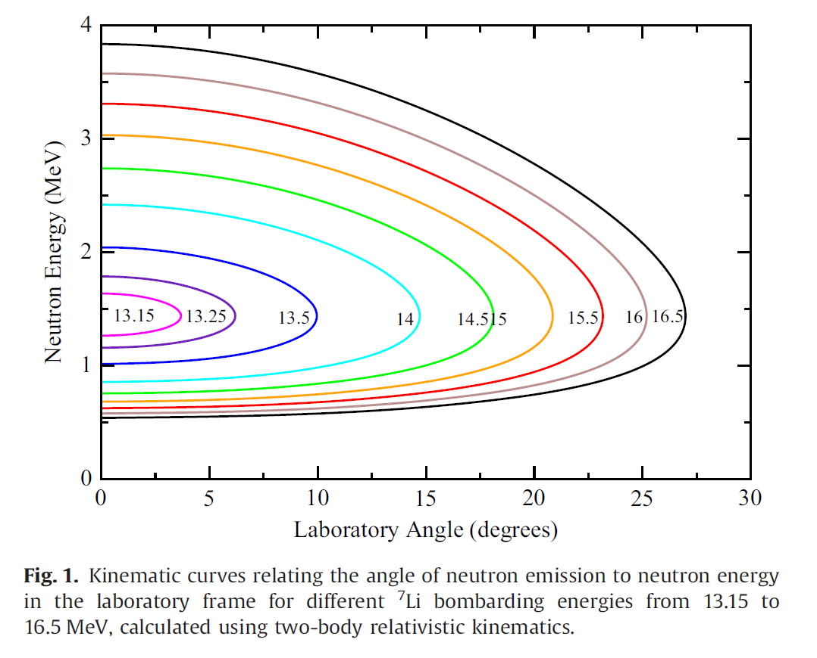
Neutron production in inverse kinematics
light-ion beam required with higher energy (beam heating) e.g. ¹H(⁷Li,n)⁷Be
Kinematical focussing increases neutron intensity in a forward cone.
Licorne Facility at IPNO
$T_{f}=13.096$MeV
M. Lebois et al. NIM A735(2014)145–151

Slide 29
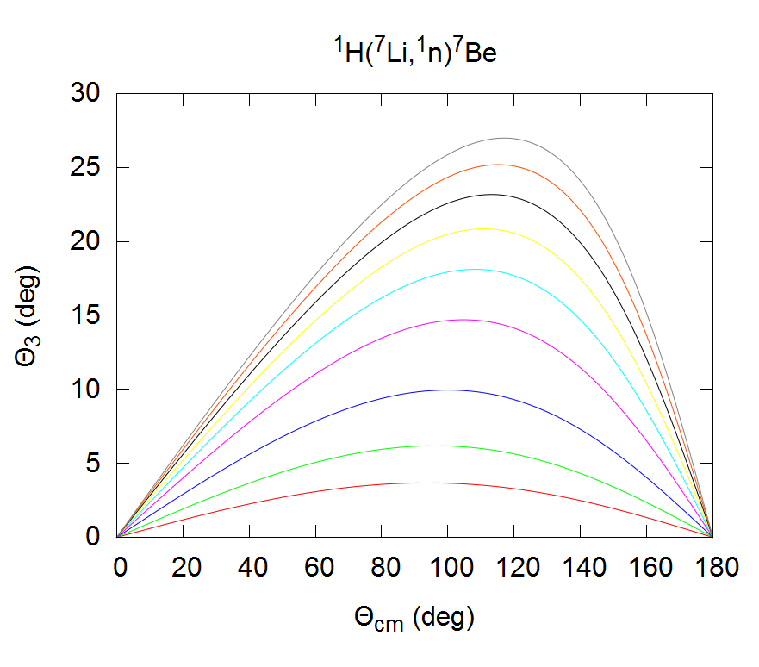
Kinematical focussing ¹H(⁷Li,n)⁷Be
16.5
16.0
15.5
15.0
14.5
14.0
13.50
13.25
E(⁷Li)=13.15 MeV
Two neutron groups
Strong forward focussing
In the laboratory
Kinematical focussing
Strong close to reaction threshold

Slide 30
„Big Four“ reactions for neutron production
 | D(d,n)³He | T(p,n)³He | T(d,n)⁴He | ⁷Li(p,n)⁷Be
Q-value(MeV) | 3.2689 | -0.7638 | 17.589 | -1.6442
Neutron emission yield at 0°
With $\frac{ΔE_{n}}{E_{n}}=1\%$
quasimonoenergetic range indicated by dashed lines
No monoenergetic neutrons in the
Gap between 7.7 – 13.2 MeV
R. Nolte, D.J. Thomas,
Metrologia 48 (2011) S263

Slide 31
Monoenergetic neutron reference fields
T(d,n)⁴He
relative Yield
Y(0°) calculated for $ΔE_{n}=10 keV$
E_{n}(0°)=
⁷Li(p,n)⁷Be
T(p,n)³He
T(d,n)⁴He:
rather isotropic
⁷Li(p,n)⁷Be:
production of keV neutrons at backward angles (reduced yield)
D(d,n)³He
neutron emission angle (lab)
E_{n}(0°)=
Parameters of reference fields (E_{n},Y, target, beam properties)
see table 2 of
R. Nolte, D.J. Thomas, Metrologia 48 (2011) S263
neutron emission angle (lab)

Slide 32
PTB neutron reference facility
Experiment: detector to be calibrated:
T. Kögler fission chambers
neutron producing target
Ti(T), ⁷Li, …
air cooled, rotating target
Neutron reference fields are produced in open geometry without collimation
Very low room return due to large free space around source and detectors
Van der Graaff Ion accelerator for 1 – 4 MeV protons, deuterons with DC beam and pulsed beam Δt = 1-2ns, ν ≈ 1 MHz

Slide 33
PTB neutron reference facility
neutron producing target
Ti(T), ⁷Li, …
air cooled, rotating target
Experiment: detector to be
calibrated
shadow cone
Characterisation of the neutron spectrum by using a pulsed beam and measurement of the neutron time-of-flight
Background of air-scattering and room-return neutrons from shadow cone measurement

Slide 34
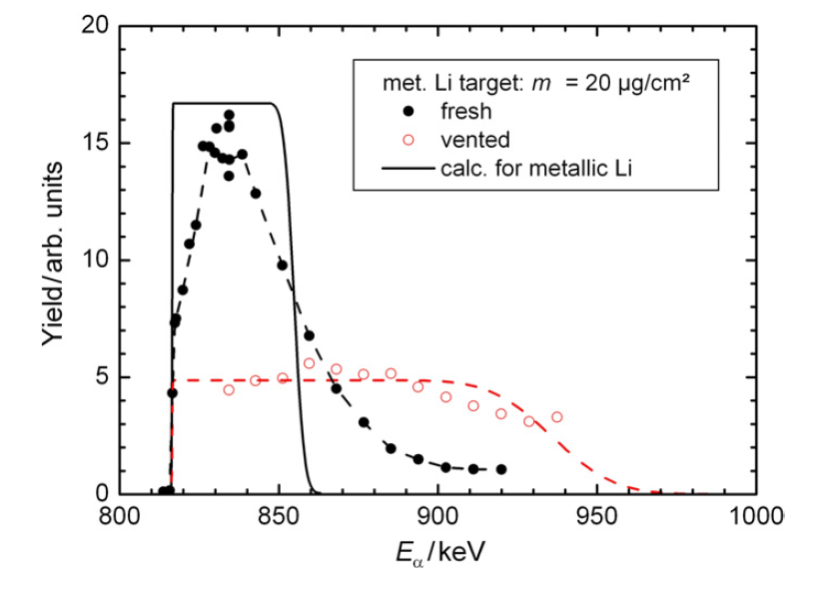
Characterization of neutron producing targets
Time of flight spectrum of neutrons (E_{n}=1.2 MeV) from a Ti(T) target 0.853 mg/cm²
bombarded with protons E_{p}=2.042 MeV
„TARGET“ simulation shows effect of
time resolution of beam and detector
Tail in ToF spectrum
➔Tritium diffusion into the Ti backing
Target depth profile measured with a narrow ⁷Li(α,γ)¹¹B* resonance (Γ_{cm} $$ 1.8 eV) at E_{α}= 814 keV (at 953 keV is the next resonance)
Detection of energetic γ-rays as a function of E_{α}
Tails show diffusion of the ⁷Li in the Ta backing and
corrosion after contact with air Li → Li(OH)
➔Lithium diffusion into the Ta backing
R. Nolte, D.J. Thomas, Metrologia 48 (2011) S263

Slide 35
Neutron generators
D-D Generator ²H(²H,n)³He Q = 3.26 MeV
D-T- Generator ³H(²H,n)⁴He Q = 17.16 MeV
positive Q-value ➔ only small deuteron accelerator required E_{D} = 100…300 keV
Thick target yield 10⁹ n/s (D-D) 10¹² n/s (D-T)
D-T Generator of TU Dresden at HZDR has a high nominal yield 10¹² n/s (D-T) up to 10 mA beam current
commercial neutron generators are available in many sizes

Slide 36
D-T und D-D Fusion Reactions
Experimental data from EXFOR data base
D-T cross section is ca. 250 times larger than DD at E= 100 keV
At 95° (lab) the neutron spectrum is quasi monoenergetic even if a thick target is used.

Slide 37
³H(d,n)⁴He S-Factor
http://pntpm3.ulb.ac.be/Nacre/nacre.htm
³H(d,n)⁴He peaked at resonance in ⁵He at E_{d} = 107 keV (64 keV E_{cm})
Removes the dominant E_{cm} dependence from the cross section σ due to the Coulomb barrier penetration and de Broglie wavelength in the entrance channel

Slide 38
Resonances in the unbound nucleus ⁵He
F.C. Barker, Phys. Rev. C56 (1997) 2646
http://www.tunl.duke.edu/nucldata/index.shtml

Slide 39
A. Domula, DPG spring meeting, Bonn, 2010

Slide 40
DT, DD neutron spectrum
E_{d}=2.682 MeV
blank Ti backing
Spectrum subtracted
„TARGET“ simulation
Neutron time of flight spectrum of Ti(T) target
Background from reactions on target contaminants ¹²C(d,n₀)¹³N, not easy to subtract
D(d,n)3He reaction on deuterium implanted in the Ti(T) target
R. Nolte, D.J. Thomas, Metrologia 48 (2011) S263

