Slide 1
TALYS: a tool to go from theoretical modeling of nuclear reactions to evaluations
Part II
EJC 2014 – S. Hilaire & The TALYS Team – 30/09/2014

Slide 2
Content
- Introduction
YESTERDAY
- General features about nuclear reactions
Time scales and associated models
Types of data needed
Data format = f (users)
- Nuclear Models
Basic structure properties
Optical model
Pre-equilibrium model
Compound Nucleus model
Miscellaneous : level densities, fission, capture
- From in depth analysis to large scale production with TALYS
General features about TALYS
Fine tuning and accuracy
Global systematic approaches
- What remains to be done ?
TODAY

Slide 3
Content
- Introduction
- General features about nuclear reactions
Time scales and associated models
Types of data needed
Data format = f (users)
- Nuclear Models
Basic structure properties
Optical model
Pre-equilibrium model
Compound Nucleus model
Miscellaneous : level densities, fission, capture
- From in depth analysis to large scale production with TALYS
General features about TALYS
Fine tuning and accuracy
Global systematic approaches
- What remains to be done ?

Slide 4
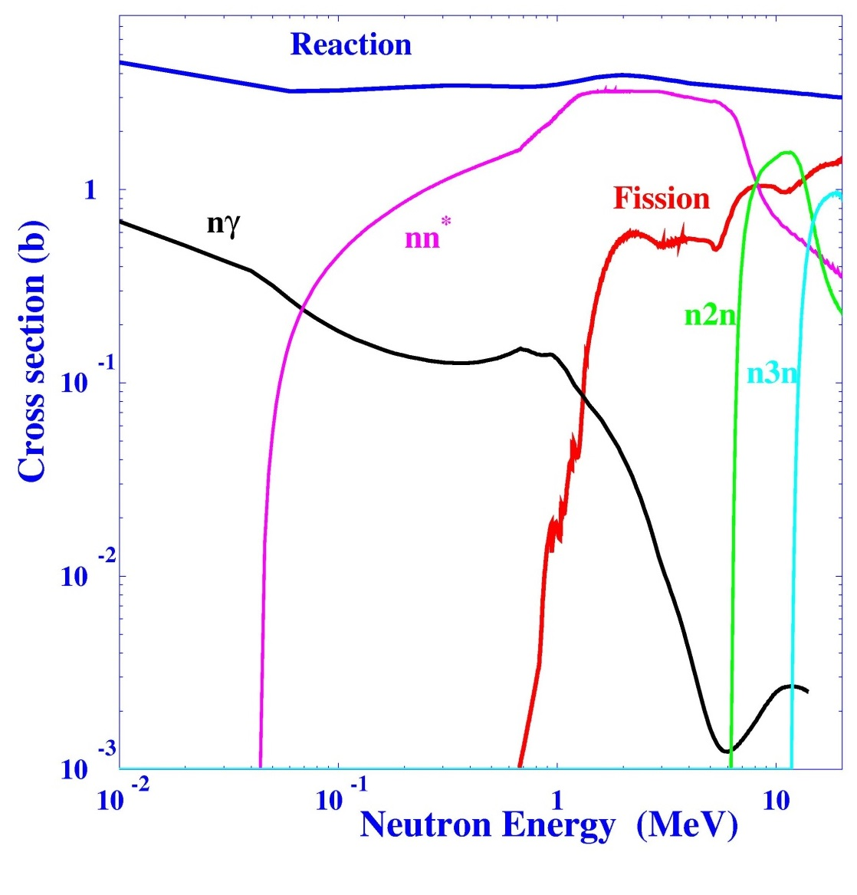
REACTION MODELS & REACTION CHANNELS
(REMINDER)
n + ²³⁸U
Optical model
+
Statistical model
+
Pre-equilibrium model
s_{R} = s_{d} + s _{PE} + s_{CN}
Cross section (barn)
= s_{nn’} + s_{nf} + s_{ng} + ...
Neutron energy (MeV)

Slide 5
THE COMPOUND NUCLEUS MODEL
(compact expression)
σ_{NC}
∑
= σ_{ab} où b = g , n, p, d, t, …, fission
b
< >
_{Jπ}
π
∑
∑
(2J+1)
_{Jπ}
T_{b} (b)
σ_{ab} =
T_{lj} (a)
W_{ab}
< >
₂
(2s+1)(2I+1)
∑
_{Jπ}
k _{a}
J,π
a,b
T_{d} (d)
_{d}
l_{a}
with
J = l_{a} + s_{a} + I_{A} = j_{a} + I_{A}
and π = (-1) π_{A}
< >
and T_{b}(b) = transmission coefficient for outgoing channel b
associated with the outgoing particle b

Slide 6
THE COMPOUND NUCLEUS MODEL
(various decay channels)
Possible decays
Emission to a discrete level with energy E_{d}
Emission in the level continuum
Emission of photons, fission
< >
Jp
T_{b}(b) = given by the O.M.P.
T_{lj}(b)
< >
∫
E +DE
T_{b}(b) =
Jp
T_{lj}(b) r(E,J,p) dE
E
r(E,J,p) density of residual nucleus’ levels (J,p) with excitation energy E
Specific treatment

Slide 7


MISCELLANEOUS : THE PHOTON EMISSION
(strength function and selection rules)
Two types of strength functions :
- the « upward » related to photoabsorption
- the « downward » related to g-decay
Spacing of states from
which the decay occurs
BUT
Standard Lorentzian (SLO)
[D.Brink. PhD Thesis(1955); P. Axel. PR 126(1962)]

Slide 8
MISCELLANEOUS : THE PHOTON EMISSION
(strength function and selection rules)
E+DE
k : transition type EM (E ou M)
∫
T^{kl}(E,e_{g}) =
2p G^{kl} (e_{g}) r(E) dE
l : transition multipolarity
E
e_{g} : outgoing gamma energy
= 2p f(k,l,e_{g}) e_{g}^{2l+1}
f(k,l, e_{g}) : gamma strength function
(several models)
Decay selection rules from a level J_{i}^{pi} to a level J_{f}^{pf}:
Pour El:
p_{f}=(-1)^{l} p_{i}
(E1 ≈ 10² M1)
|J_{i}-l| ≤ J_{f} ≤ J_{i}+l
(XL ≈ 10⁻³ XL-1)
Pour Ml:
p_{f}=(-1)^{l+1} p_{i}
experiment
Renormalisation method for thermal neutrons
∫
B_{n}
C S S S T^{kl}(e) r(B_{n}-e,J_{f},p_{f}) S(l,J_{i},p_{i}, J_{i},p_{f}) de =
1
<T_{g}>=
C
2p <G_{g}> r(B_{n})
J_{i},p_{i}
kl
J_{f},p_{f}
D₀
0

Slide 9
MISCELLANEOUS : THE PHOTON EMISSION
(strength function and selection rules)
Improved analytical expressions :
- 2 Lorentzians for deformed nuclei
- Account for low energy deviations from standard Lorentzians for E1
. Kadmenskij-Markushef-Furman model (1983)
⇒ Enhanced Generalized Lorentzian model of Kopecky-Uhl (1990)
⇒ Hybrid model of Goriely (1998)
⇒ Generalized Fermi liquid model of Plujko-Kavatsyuk (2003)
- Reconciliation with electromagnetic nuclear response theory
⇒ Modified Lorentzian model of Plujko et al. (2002)
⇒ Simplified Modified Lorentzian model of Plujko et al. (2008)

Slide 10
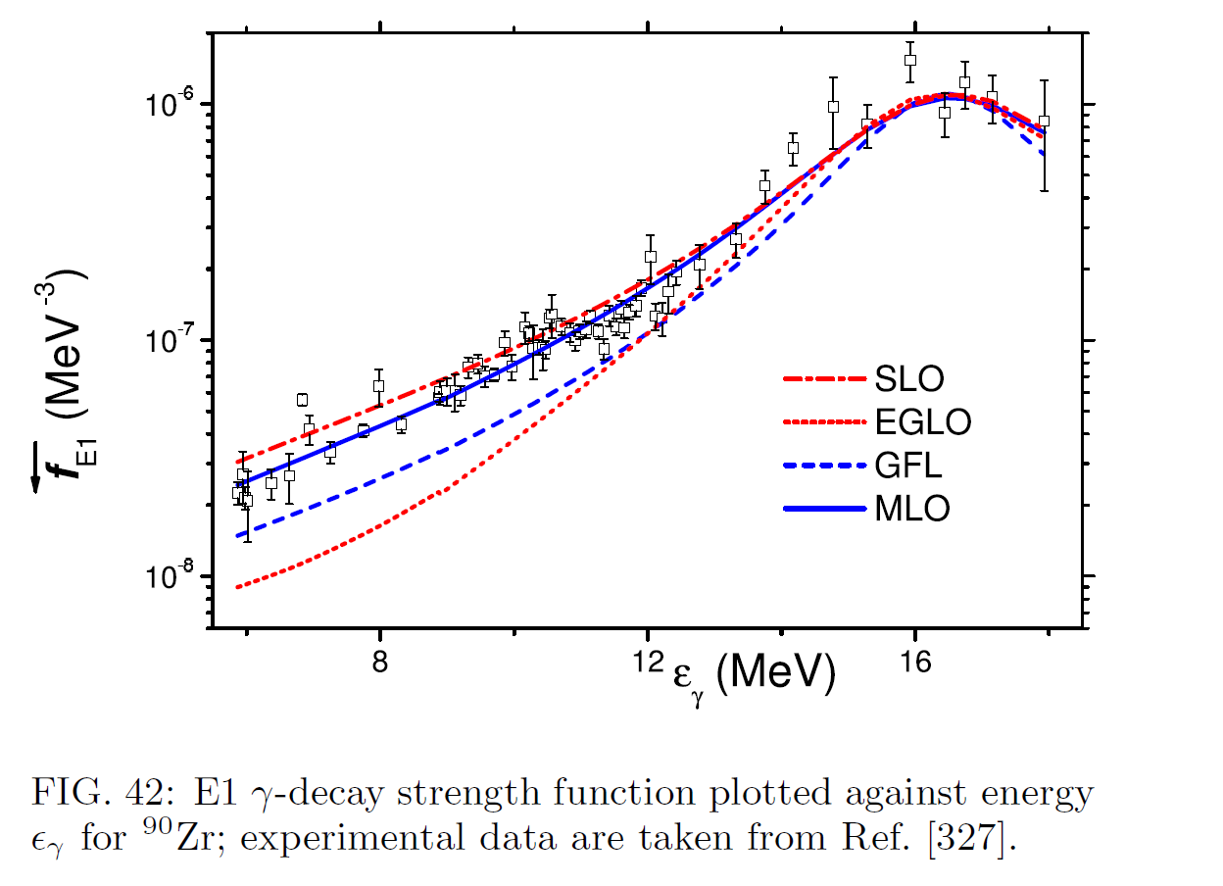
MISCELLANEOUS : THE PHOTON EMISSION
(strength function and selection rules)

Slide 11
MISCELLANEOUS : THE PHOTON EMISSION
(strength function and selection rules)
Improved analytical expressions :
- 2 Lorentzians for deformed nuclei
- Account for low energy deviations from standard Lorentzians for E1
. Kadmenskij-Markushef-Furman model (1983)
⇒ Enhanced Generalized Lorentzian model of Kopecky-Uhl (1990)
⇒ Hybrid model of Goriely (1998)
⇒ Generalized Fermi liquid model of Plujko-Kavatsyuk (2003)
- Reconciliation with electromagnetic nuclear response theory
⇒ Modified Lorentzian model of Plujko et al. (2002)
⇒ Simplified Modified Lorentzian model of Plujko et al. (2008)
Microscopic approaches : RPA, QRPA
« Those who know what is (Q)RPA don’t care about details,
those who don’t know don’t care either », private communication
⇒ Systematic QRPA with Skm force for 3317 nuclei performed
by Goriely-Khan (2002)
⇒ Systematic QRPA with Gogny force under work (300 Mh!!!)

Slide 12
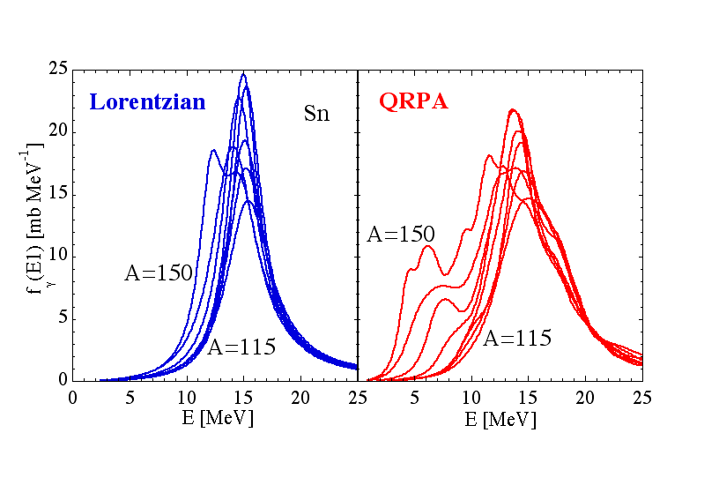
MISCELLANEOUS : THE PHOTON EMISSION
(phenomenology vs microscopic)
See S. Goriely & E. Khan, NPA 706 (2002) 217.
S. Goriely et al., NPA739 (2004) 331.

Slide 13
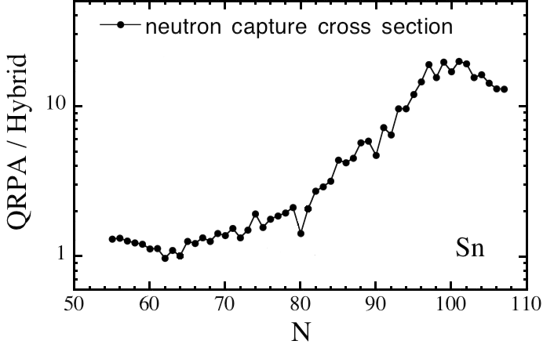
MISCELLANEOUS : THE PHOTON EMISSION
(phenomenology vs microscopic)
Capture cross section @ E_{n}=10 MeV for Sn isotopes
Weak impact close to stability but large for exotic nuclei

Slide 14
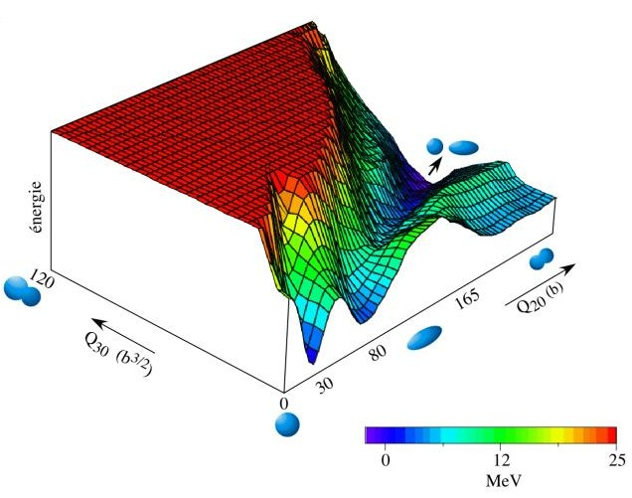
MISCELLANEOUS : THE FISSION PROCESS
(static picture exhibiting fission barriers)
Surface ²³⁸U

Slide 15
MISCELLANEOUS : THE FISSION PROCESS
(fissile or fertile ?)
Energy
Fission barrier
with height V
Energy
Fission barrier
with height V
B_{n}
B_{n}
V
V
elongation
elongation
B_{n} < V
B_{n} > V
Fertile target (²³⁸U)
Fissile target (²³⁵U)

Slide 16
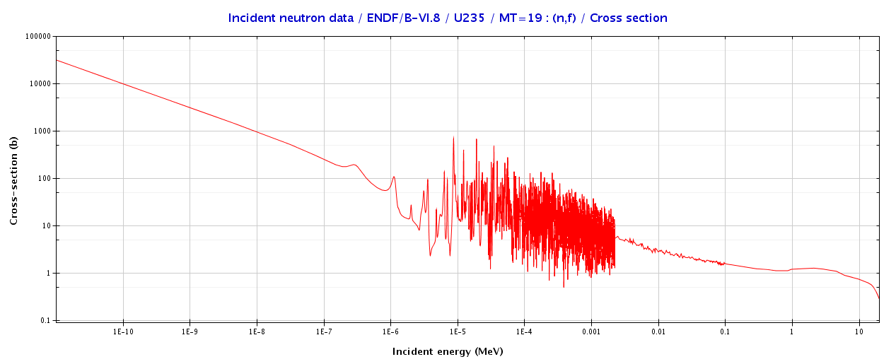
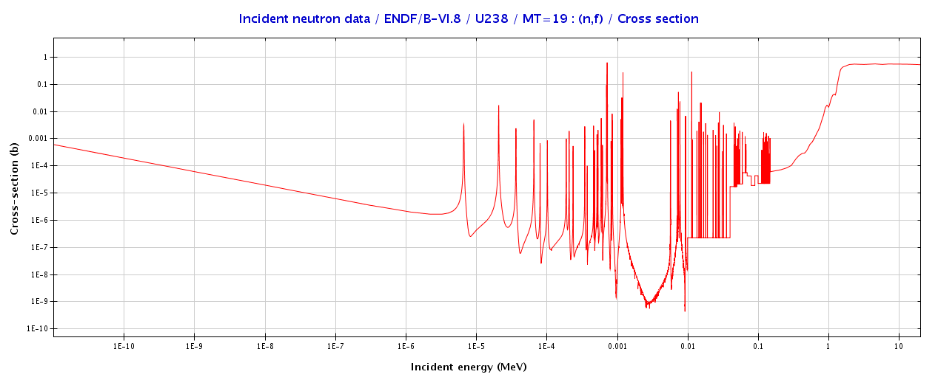
MISCELLANEOUS : THE FISSION PROCESS
(fissile or fertile ?)
Fission barrier

Slide 17
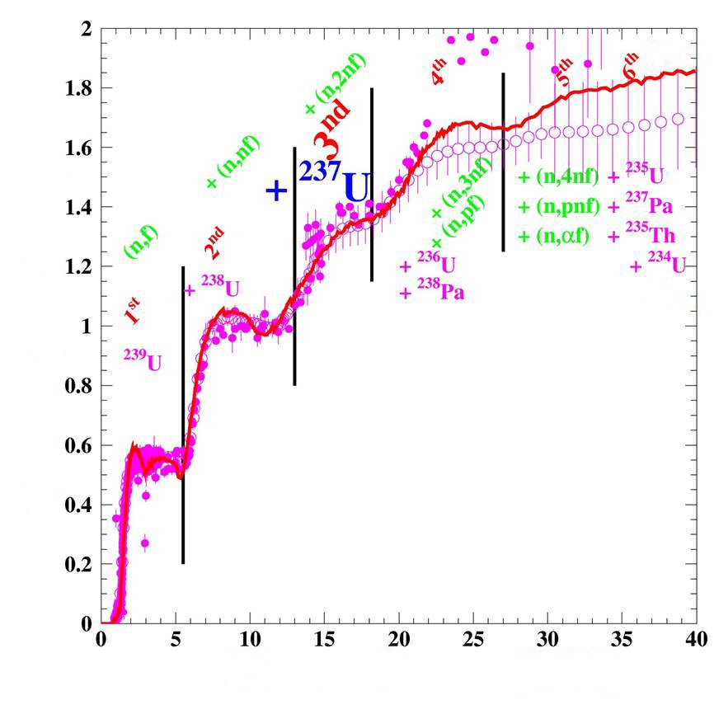
MISCELLANEOUS : THE FISSION PROCESS
(multiple chances)
Nucleus (Z,A-2)
Energy
3rd chance
B_{n}
Nucleus (Z,A-1)
2nd chance
B_{n}
Nucleus (Z,A)
V
1st chance
B_{n}
s fission (barn)
V
elongation
Incident neutron energy (MeV)

Slide 18
MISCELLANEOUS : THE FISSION PROCESS
(Fission penetrability: Hill-Wheeler)
Fission barrier
( V, ħω )
Energy
E
Transmission
B_{n}
T_{hw} (E) = 1/[1 + exp(2p(V-E)/ħw)]
Hill-Wheeler
for one barrier !
elongation
+ transition state on top of the barrier !
Bohr hypothesys

Slide 19
MISCELLANEOUS : THE FISSION PROCESS
(Fission transmission coefficients)
T_{hw} (E) = 1/[1 + exp(2p(V-E)/ħw)]
Hill-Wheeler
Energy
^{e}
E+B_{n}
Discrete transition
states with energy e_{d}
V
elongation
∫
E+B_{n}
T_{f} (E, J, p) =
S
T_{hw}(E - e_{d}) +
r(e,J,p) T_{hw}(E - e) de
_{discrets}
J, p
E_{s}

Slide 20
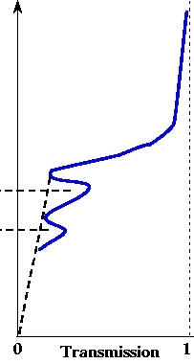
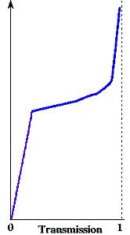
MISCELLANEOUS : THE FISSION PROCESS
(multiple humped barriers)
Energy
Barrier A
( V_{A}, ħω_{A} )
Fission barrier
( V, ħω )
Barrier B
( V_{B}, ħω_{B} )
B_{n}
elongation
+ transition states on top of the barrier !
+ transition states on top of each barrier !
+ class II states in the intermediate well !

Slide 21
MISCELLANEOUS : THE FISSION PROCESS
(multiple humped barriers)
Two barriers A et B
Resonant transmission
T_{A}
T_{B}
Energy
T_{f} =
T_{A} + T_{B}
Three barriers A, B and C
T_{A}
T_{B}
x T_{C}
T_{A} + T_{B}
T_{f} =
T_{A}
T_{B}
+ T_{C}
T_{A} + T_{B}
0
1
T_{f}
T_{A}
T_{B}
4
T_{f} =
T_{A} + T_{B}
T_{A} + T_{B}
More exact expressions in Sin et al., PRC 74 (2006) 014608

Slide 22
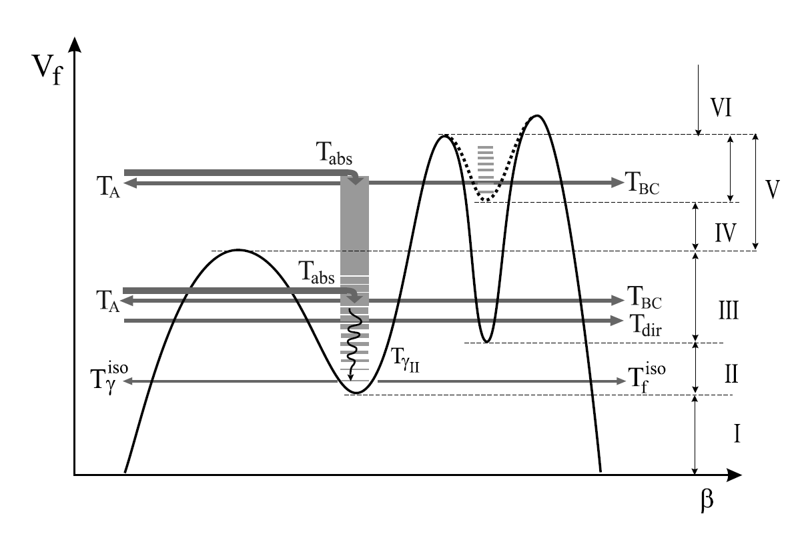
MISCELLANEOUS : THE FISSION PROCESS
(multiple humped barriers with maximum complexity)
See in Sin et al., PRC 74 (2006) 014608
Bjornholm and Lynn, Rev. Mod. Phys. 52 (1980) 725.

Slide 23
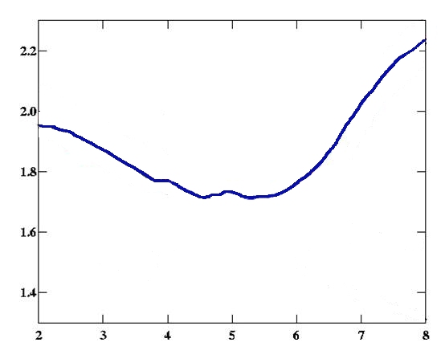
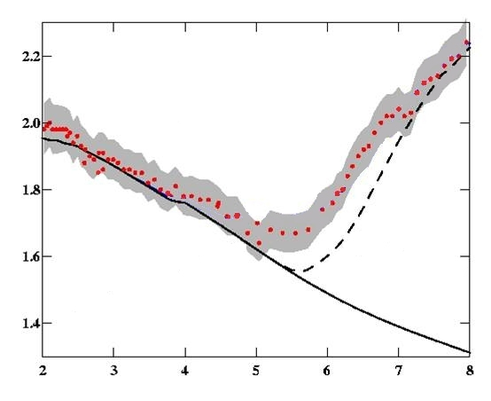
MISCELLANEOUS : THE FISSION PROCESS
(Impact of class II states)
²³⁹Pu (n,f)
With class II states
Cross section (barn)
2nd chance
1st chance
Neutron energy (MeV)

Slide 24
MISCELLANEOUS : THE FISSION PROCESS
(impact of class II and class III states)
Case of a fertile nucleus

Slide 25
MISCELLANEOUS : THE FISSION PROCESS
(impact of class II and class III states)
Case of a fertile nucleus

Slide 26
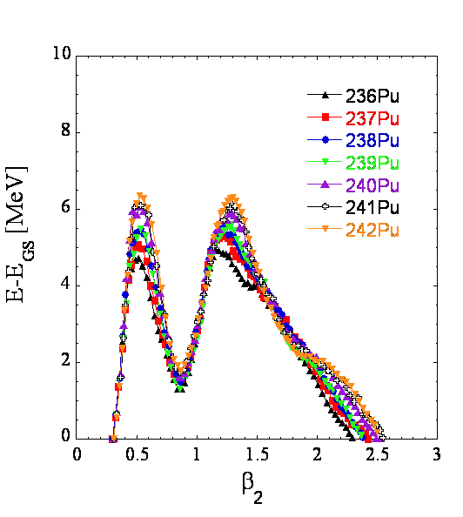
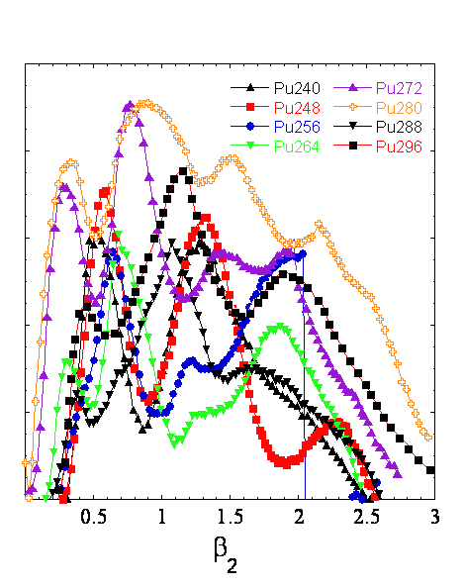
MISCELLANEOUS : THE FISSION PROCESS
(Hill-Wheeler ?)
For exotic nuclei : strong deviations from Hill-Wheeler.

Slide 27
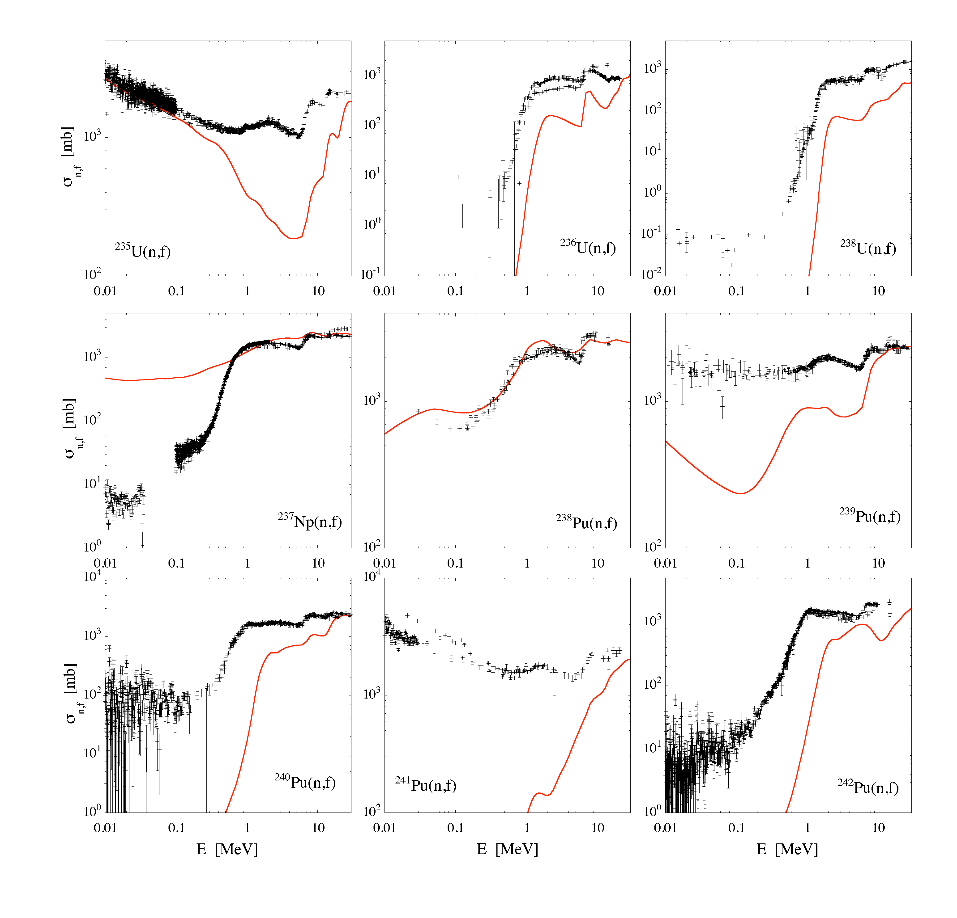
MISCELLANEOUS : THE FISSION PROCESS
(Microscopic fission cross sections)
Default calculations not sufficient for applications.

Slide 28
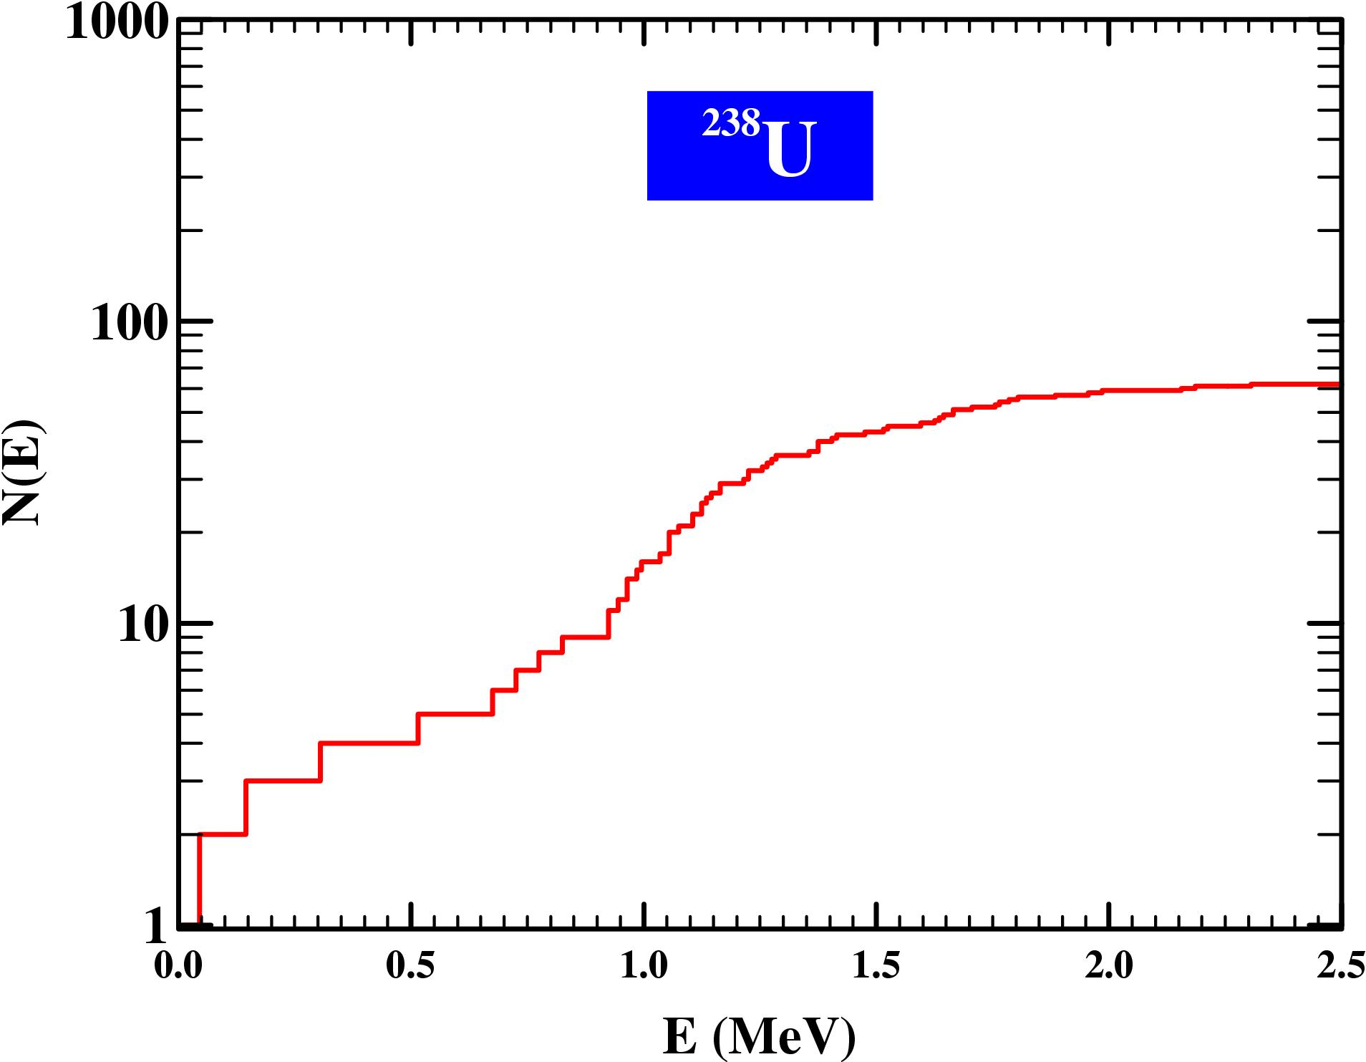
MISCELLANEOUS : THE LEVEL DENSITIES
(Principle)
?

Slide 29
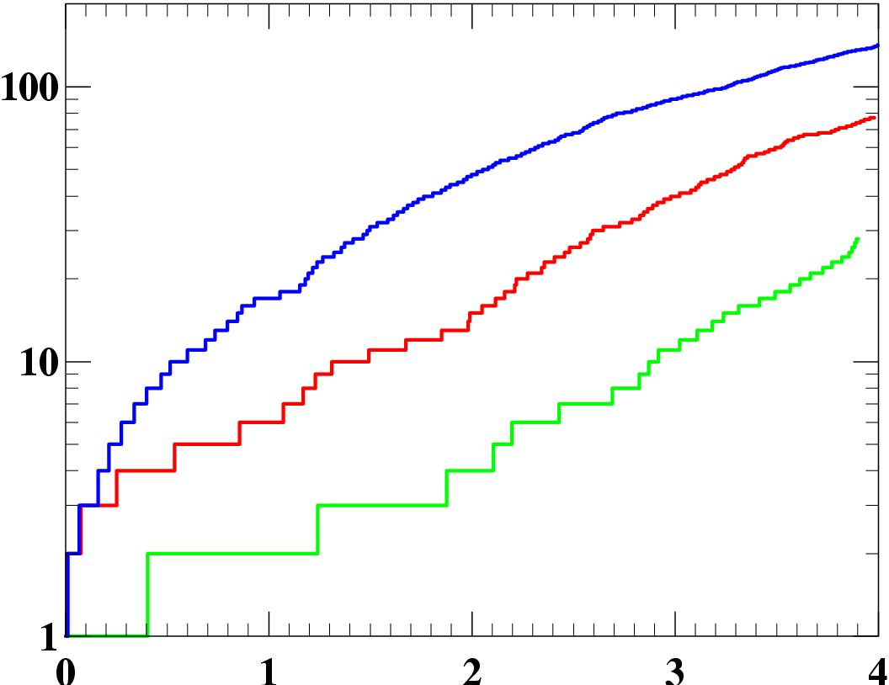
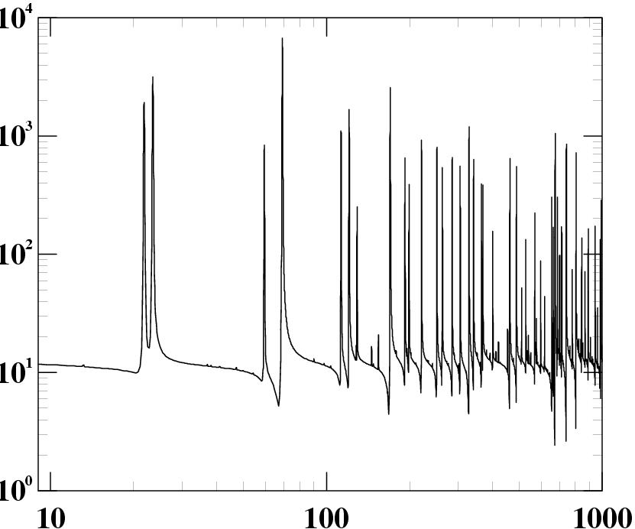
MISCELLANEOUS : THE LEVEL DENSITIES
(Qualitative aspects 1/2)
n+²³²Th
⁵⁶Mn
N(E)
Total cross section (b)
⁵⁷Fe
⁵⁸Fe
E (MeV)
Incident neutron energy (eV)
Exponential increase of the cumulated number of discrete levels N(E) with energy
  ⇒ r(E)=
  ⇒ odd-even effects
Mean spacings of s-wave neutron resonances at B_{n} of the order of few eV
  ⇒ r(B_{n}) of the order of 10⁴ – 10⁶ levels / MeV
dN(E)
dE
increases exponentially

Slide 30
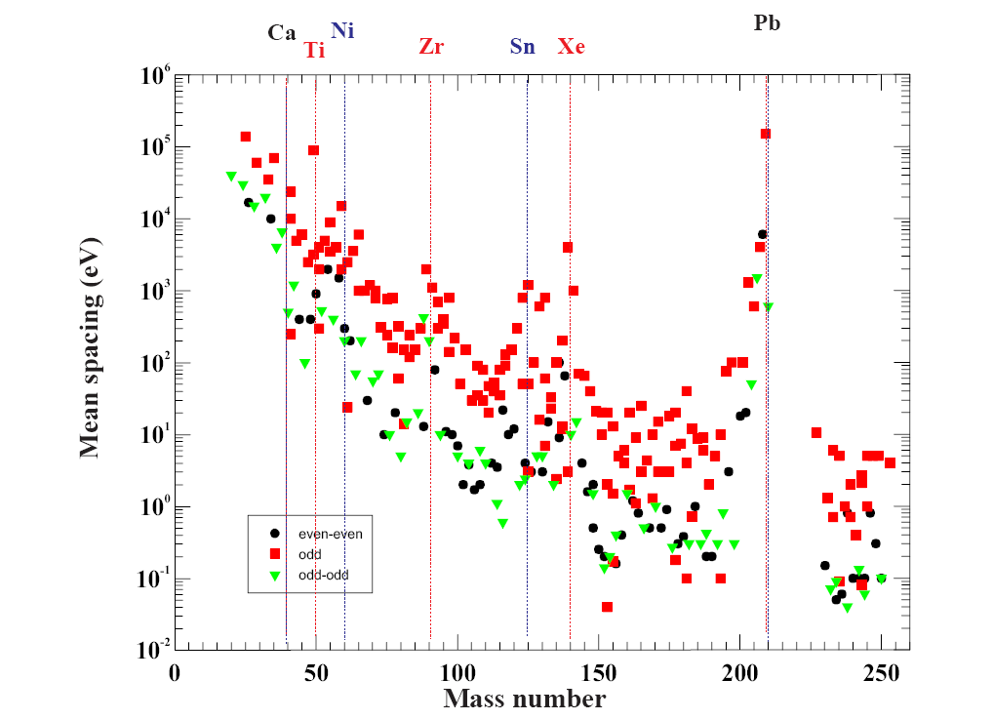
MISCELLANEOUS : THE LEVEL DENSITIES
(Qualitative aspects 2/2)
Iljinov et al., NPA 543 (1992) 517.
Mass dependency
Odd-even effects
Shell effects
1
= r (B_{n},1/2, p_{t}) for an even-even target
D₀
= r (B_{n}, I_{t}+1/2, p_{t}) + r (B_{n}, I_{t}-1/2, p_{t}) otherwise

Slide 31
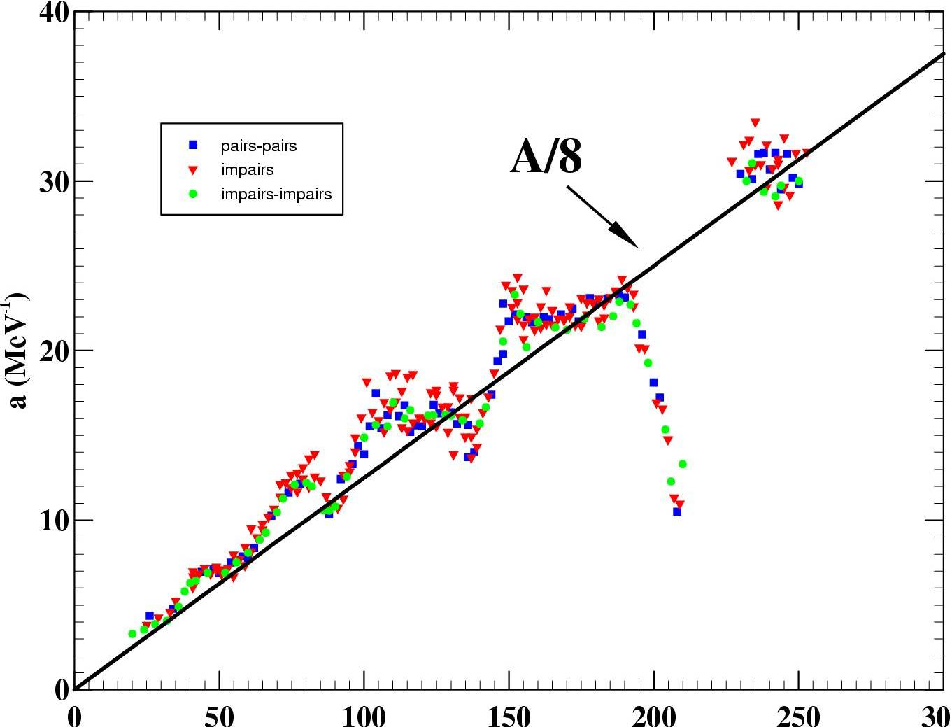
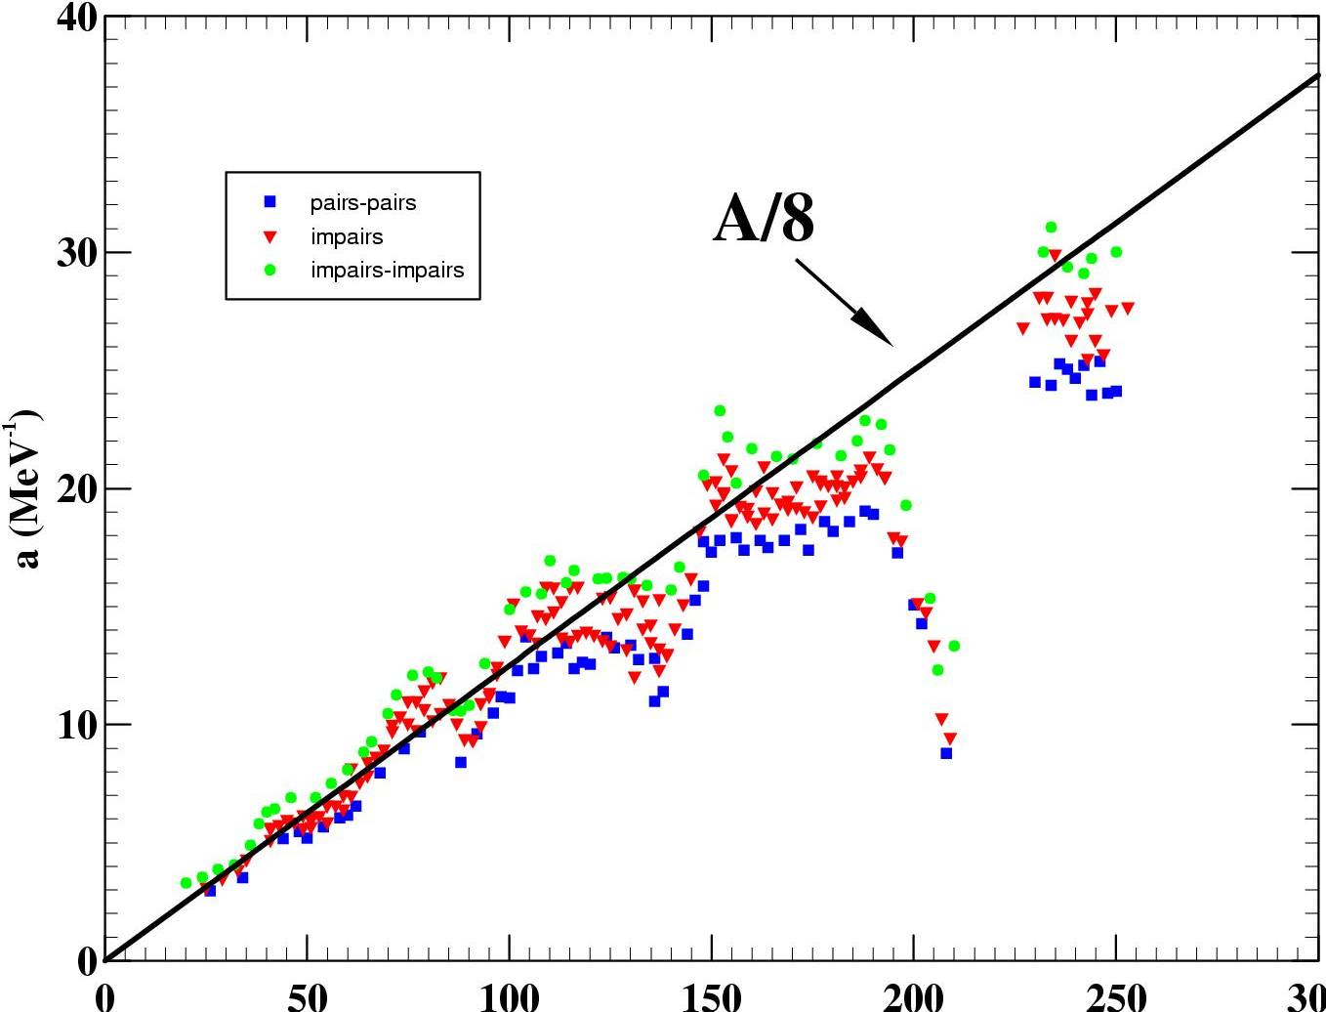
MISCELLANEOUS : THE LEVEL DENSITIES
(Quantitative analysis 1/2)
( )
²
( )
1
p
exp 2 aU
2J+1
J+½
r (U, J, p)
=
exp -
2
12
a^{1/4}U^{5/4}
2 2p s ³
2s ²
U
+ s ² = I_{rig}
Odd-even effects
accounted for
U → U*=U - D
a
⇒ odd-even effects
0
12/ A
24/ A
odd-odd
odd-even
even-even
D =
Z=50,N=82
N=50
Z=82,N=126
Z=20, N=28
Masse
Shell effects

Slide 32
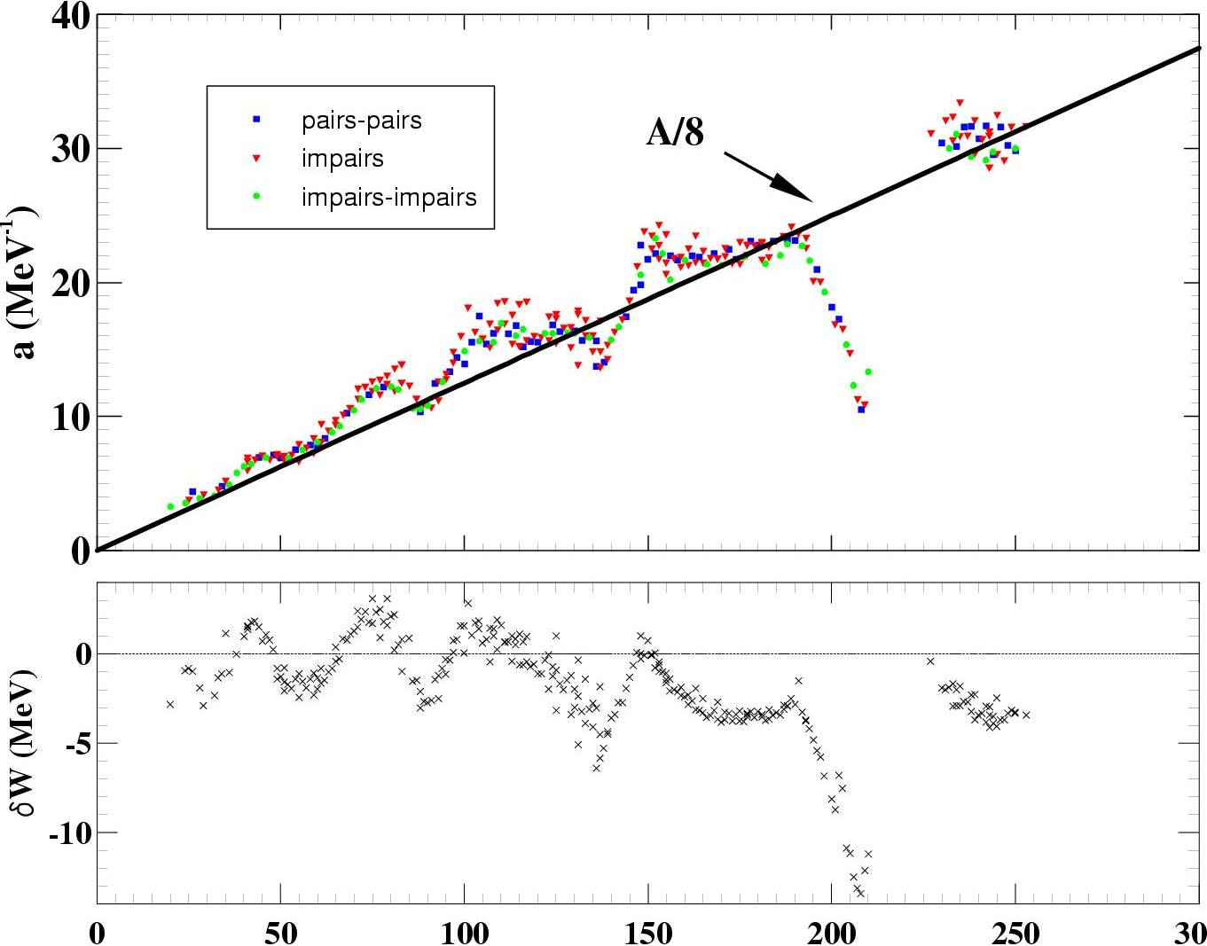
MISCELLANEOUS : THE LEVEL DENSITIES
(Quantitative analysis 2/2)
~
1 - exp ( - g U* )
a (N, Z, U*) =
a (A)
1 + dW(N,Z)
U*

Slide 33
MISCELLANEOUS : THE LEVEL DENSITIES
(Summary of most simple analytical description)
10 ⁶ -
10 ⁵ -
10 ⁴ -
N(E)
10 ³ -
10 ² -
10 -
1
1 2 3 4 5 6 7 8 9
E (MeV)
Fermi gaz (adjusted at B_{n})
Temperature law
( )
Discrete levels
(spectroscopy)
( )
exp 2 aU*
E – E₀
=
N(E)=exp
r (E) a
T
a^{1/4}U*^{5/4}

Slide 34
MISCELLANEOUS : THE LEVEL DENSITIES
(More sophisticated approaches)
Superfluid model & Generalized superfluid model
  Ignatyuk et al., PRC 47 (1993) 1504 & RIPL2 Tecdoc (IAEA)
  More correct treatment of pairing for low energies
  Fermi Gas + Ignatyuk beyond critical energy
  Explicit treatment of collective effects
Shell Model Monte Carlo approach
  Agrawal et al., PRC 59 (1999) 3109
  Realistic Hamiltonians but not global
  Coherent and incoherent excitations treated on the same footing
  Time consuming and thus not yet systematically applied
Combinatorial approach
  S. Hilaire & S. Goriely, NPA 779 (2006) 63 & PRC 78 (2008) 064307.
  Direct level counting
  Total (compound nucleus) and partial (pre-equilibrium) level densities
  Non statistical effects
  Global (tables)

Slide 35
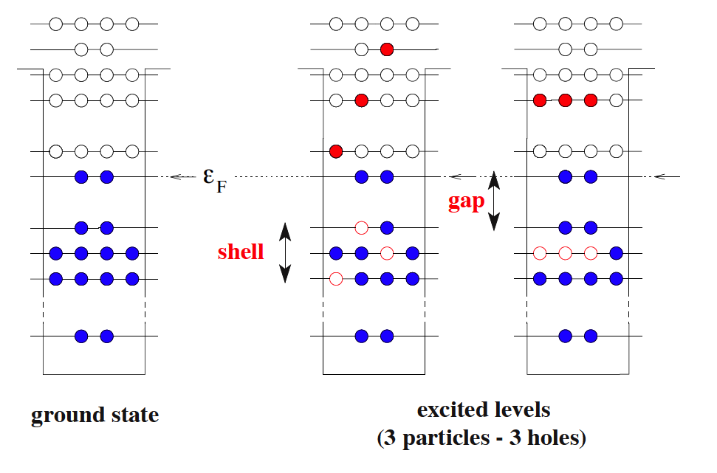
THE LEVEL DENSITIES
(The combinatorial method 1/3)
See PRC 78 (2008) 064307 for details
Level density estimate is a counting problem: ρ(U)=dN(U)/dU
N(U) is the number of ways to distribute the nucleons among the available levels for a fixed excitation energy U
- HFB + effective nucleon-nucleon interaction ⇒ single particle level schemes
- Combinatorial calculation ⇒ intrinsic p-h and total state densities ω (U, K, π)
- Collective effects ⇒ from state to level densities ρ(U, J, π)
: 1) folding of intrinsic and vibrational state densities
2) construction of rotational bands for deformed nuclei
_{JK}
Σ
ω (U-E_{rot}, K, π)
ρ(U, J, π) =
K
2) spherical nuclei
ρ(U, J, π) =
ω (U, K=J, π) - ω (U, K=J+1, π)
- Phenomenological transition for deformed/spherical nucleus

Slide 36
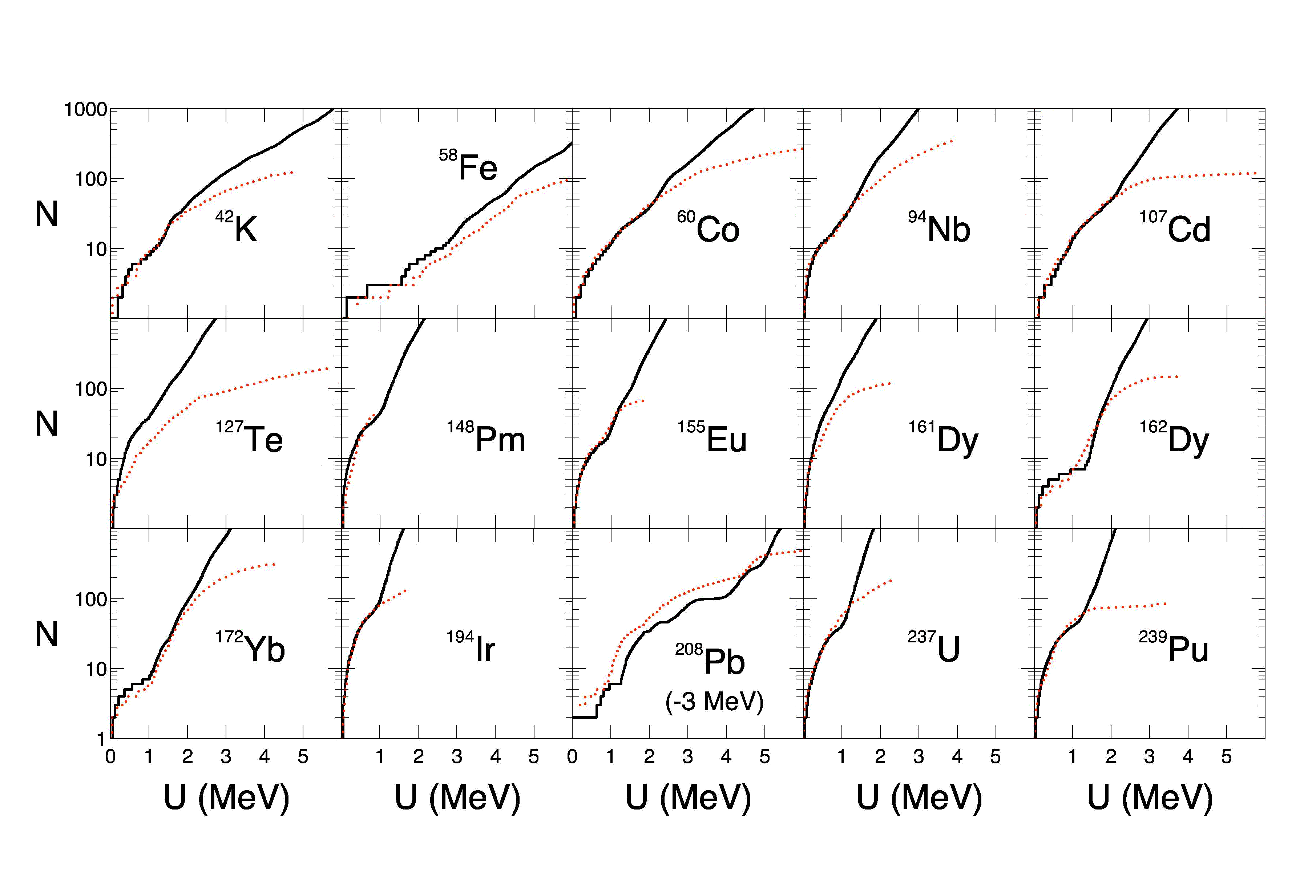
THE LEVEL DENSITIES
(The combinatorial method 2/3)
Structures typical of non-statistical feature

Slide 37
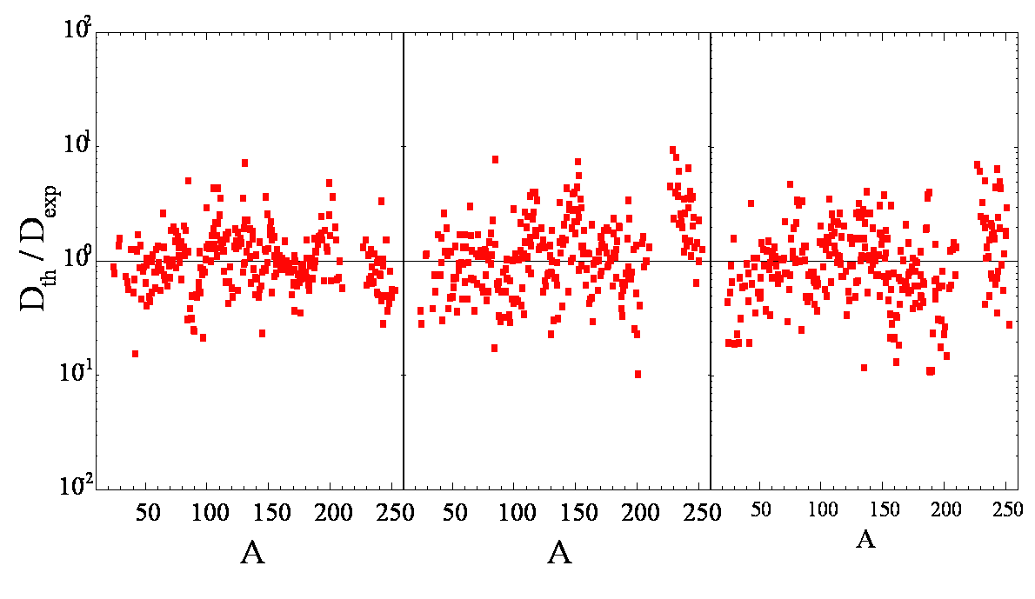
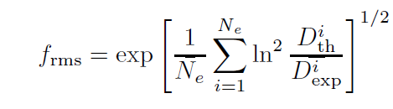
THE LEVEL DENSITIES
(The combinatorial method 3/3)
D₀ values ( s-waves & p-waves)
Back-Shifted Fermi Gas
HF+BCS+Statistical
HFB + Combinatorial
f _{rms} = 1.79 f _{rms} = 2.14 f _{rms} = 2.30
Description similar to that obtained with other
global approaches

Slide 38
FROM IN DEPTH ANALYSIS
TO LARGE SCALE PRODUCTION
WITH TALYS
CEA | 10 AVRIL 2012
| PAGE 38
4 septembre 2014

Slide 39
Content
- Introduction
- General features about nuclear reactions
Time scales and associated models
Types of data needed
Data format = f (users)
- Nuclear Models
Basic structure properties
Optical model
Pre-equilibrium model
Compound Nucleus model
Miscellaneous : level densities, fission, capture
- From in depth analysis to large scale production with TALYS
General features about TALYS
Fine tuning and accuracy
Global systematic approaches
- What remains to be done ?

Slide 40
GENERAL FEATURES
Situation in 1998 !
ALICE – LLNL – 1974 – Blann
(Mc-)GNASH – LANL – 1977 – Young, Arthur & Chadwick
TNG – ORNL – 1980 – Fu
STAPRE – Univ. Vienna – 1980 – Uhl
UNF,MEND – CIAE, Nanking Univ. – 1985 – Cai, Zhang
EXIFON – Univ. Dresden – 1989 – Kalka
EMPIRE – ENEA/IAEA/BNL – 1980 – Herman
TALYS – NRG/CEA – 1998 – Koning, Hilaire & Duijvestijn
Modern computers (i.e. speed and memory)
available when the code conception was started

Slide 41
GENERAL FEATURES
GNASH Input file before 1998

Slide 42
GENERAL FEATURES
Ideas behind TALYS conception
- TALYS mantra : “ First Completeness then Quality”
No NaNs
No Crash
Warnings to identify malfunctions
Default « simple » models which will then be improved (anticipation)
All ouput channels smoothly described
- Transparent programming
No unnecessary assumption
No equation simplification (one can recognize a general expression)
Many comments
No implicit definition of variables
The variable are defined following the order of appearance in subroutines

Slide 43
GENERAL FEATURES
What TALYS does !
- Simulates a nuclear reaction
projectiles : n,p,d,t,³he, ⁴he and gamma
targets : 3 ≤ Z ≤ 110 or 5 ≤ A ≤ 339 (either isotopic or natural)
- Incident projectile energy from a few keV up to 200 MeV
code works up to1 Gev but physics ??
- TALYS can be used :
. In depth single reaction analysis
. Global nuclear reaction network calculation (eg astrophysics)
. Within a more global code system (reactor physics)
. Without reaction calculation (only structure data provided)
- TALYS is still under development (improvement)

Slide 44
GENERAL FEATURES
Technical details
- Fortran 77
- ≈ 80000 lines (+ 20000 lines of ECIS)
- Modern programming
- modular (270 subroutines)
- Explicit variable names and many comments (30% of total number of lines)
- Transparent programming (few exceptions)
- Flexible use and extensive validation
- Flexibility : default ⇒ 4 line idiot proof input (element, mass, projectile, energy)
adjustment ⇒ 300 keywords
- Random input generation to check stability
- Drip-line to drip-line calculations help removing bugs
- >500 pages manual
- Compiled and tested with several compilers and OS

Slide 45

GENERAL FEATURES
Typical calculation times
Numbers based on a single Intel Xeon X5472 3.0 GhZ processor
Time needed to get all cross sections, level densities, spectra, angular distributions. gamma production etc.:
  14 MeV neutron on non-deformed target: 3 sec.
  60 incident energies between 0 and 20 MeV:1 min. (Al-27)
        4 min. (Pb-208)
        10 min. (U-238)
  100 incident energies between 0 and 200 MeV:20 min. (Al-27)
        3-100 hours (U-238) depending on OMP
  60 incident energies between 0 and 20 MeV for all 2430 nuclides, stable or with t> 1 sec: about 200 hours
  To obtain credible Monte Carlo based covariance data: multiply the above numbers by 50-500.

Slide 46
GENERAL FEATURES
TALYS versions online
http://www.talys.eu
TALYS 1.0 (ND 2007)
TALYS 1.2 (End of 2010)
- new keywords (mainly to improve fitting possibilities)
- bugs corrected to solve crashes or unphysical results
- inclusion of ph level densities
- inclusion of Skm-HFB structure information (def., masses, g strengths)
- inclusion of D1M
TALYS 1.4 (End of 2012)
- new keywords (mainly to improve fitting possibilities)
- bugs corrected to solve unphysical results or crashes
- new alpha and deuteron OMP
- URR extension
TALYS 1.6 (End of 2013)
- bugs corrected to solve unphysical results or crashes
- non-equidistant excitation energy binning possible (extension to energies > 200 MeV)
- direct and semi-direct capture added
- new microscopic lds from D1M
- medical isotope production implemented
- coupling to GEF done

Slide 47
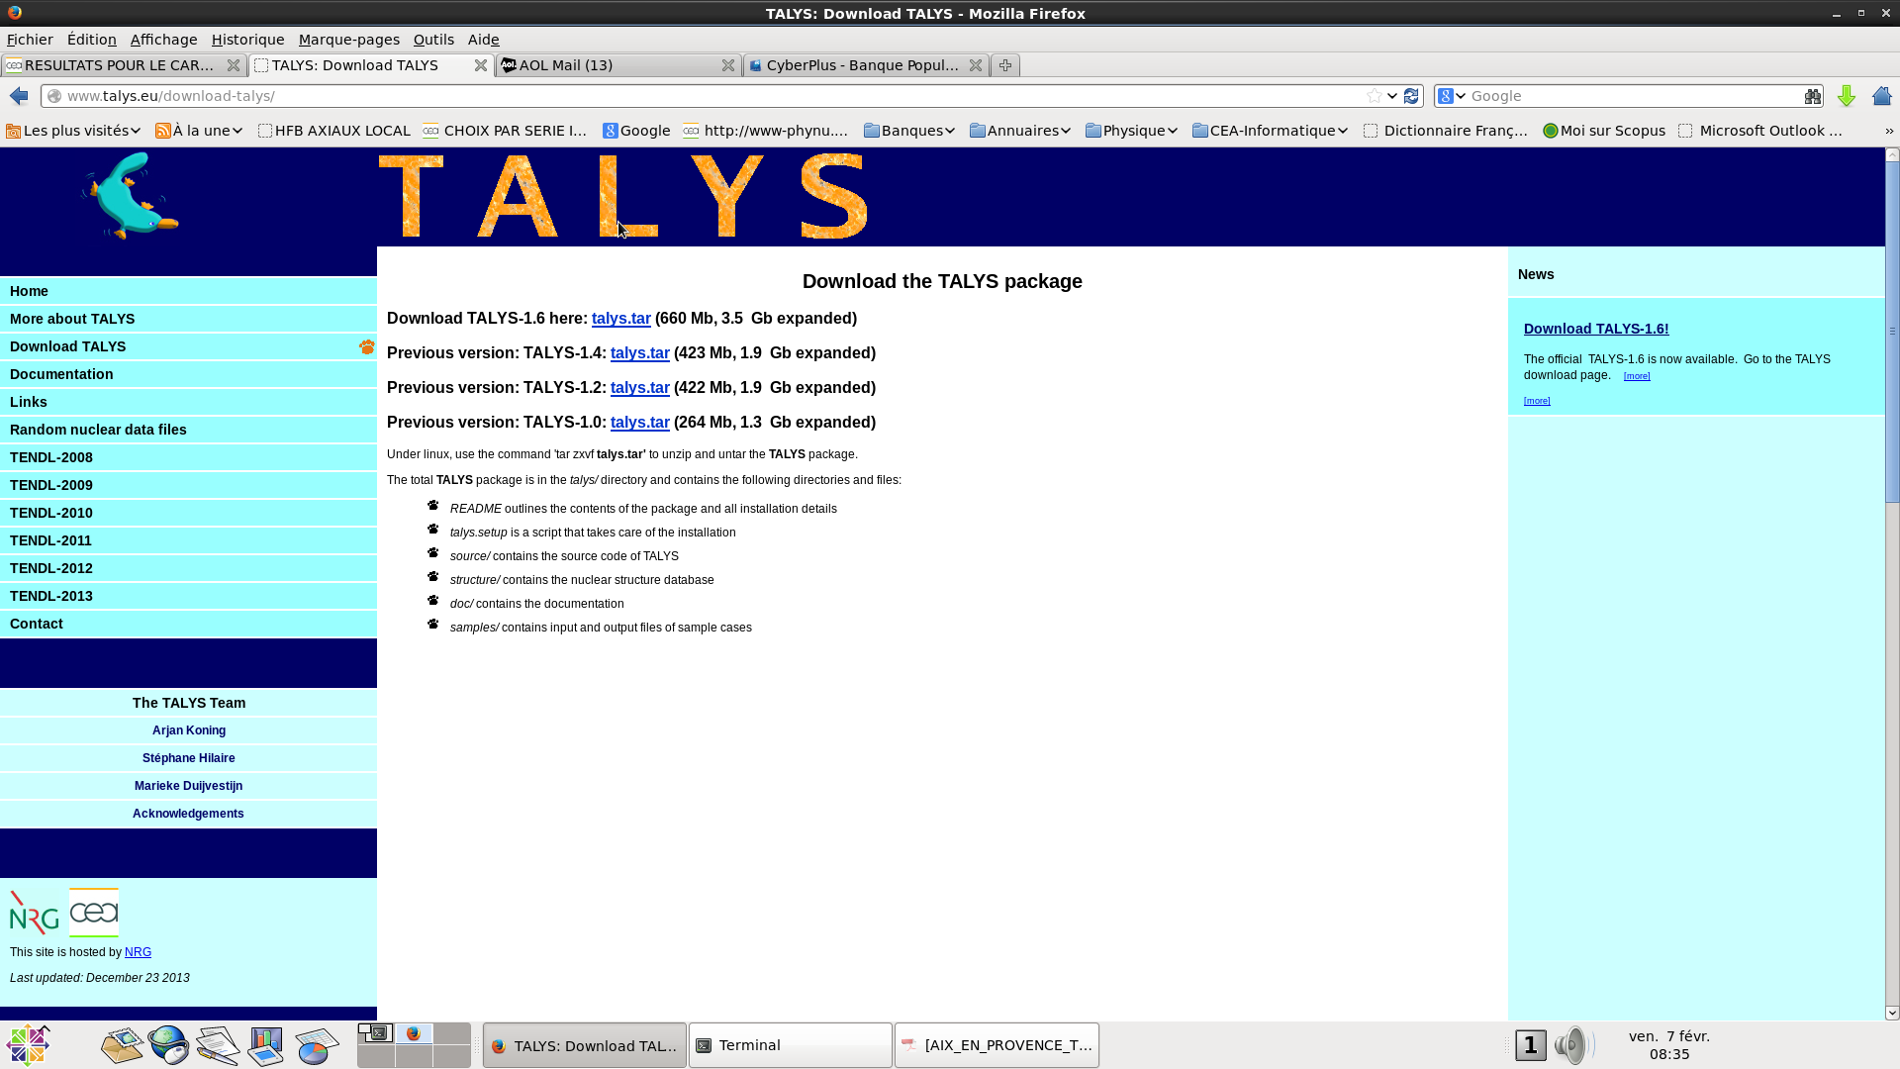
GENERAL FEATURES
TALYS versions online
http://www.talys.eu

Slide 48
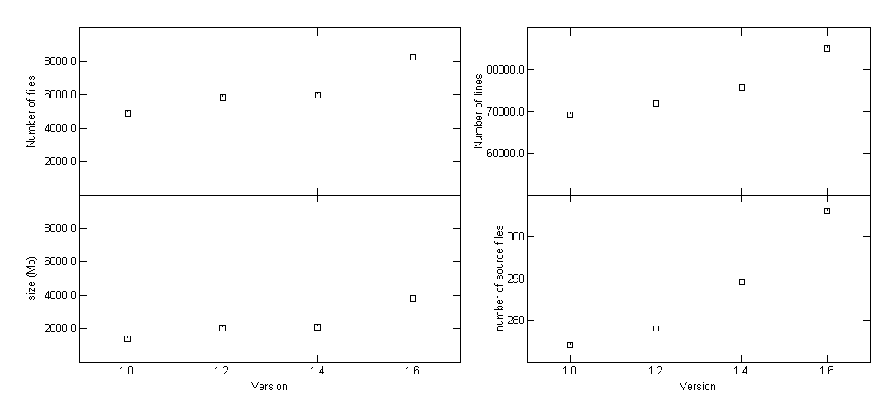
GENERAL FEATURES
TALYS statistics (1/2)
Inclusion
of ph lds
Inclusion
of 1p1h lds
function of (J,p)

Slide 49
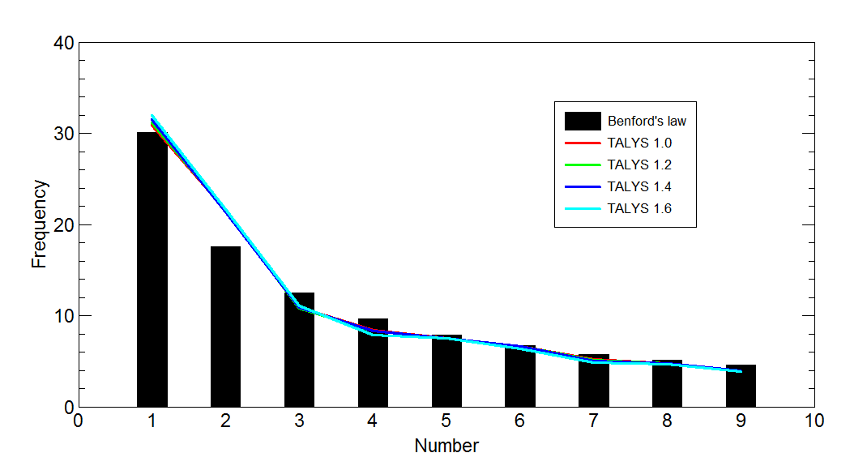
GENERAL FEATURES
TALYS statistics (2/2)
TALYS obeys the Benford’s law : no intentional scientific fraud

Slide 50
GENERAL FEATURES
TALYS users and publications
User feedback via talys mailing list : info@talys.eu to be added to mailing list
: talys-l@nrg.eu to inform mailing list
PUBLICATIONS

Slide 51
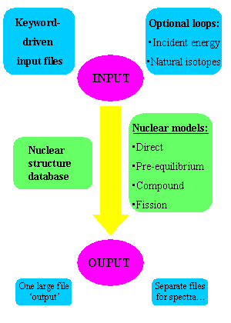
GENERAL FEATURES
TALYS Scheme

Slide 52
GENERAL FEATURES
What TALYS yields
Cross sections :
total, reaction, elastic (shape & compound), non-elastic, inelastic (discrete levels & total)
total particle production
all exclusive reactions (n,nd2a)
all exclusive isomer production
all exclusive discrete and continuum g-ray production
Spectra :
elastic and inelastic angular distribution or energy spectra
all exclusive double-differential spectra
total particle production spectra
compound and pre-equilibrium spectra per reaction stage.
Fission observables :
cross section (total, per chance)
fission fragment mass and isotopic yields
Miscellaneous :
recoil cross sections and ddx
particle multiplicities
s and p wave functions and potential scattering radius r’
nuclear structure only (levels, Q, ld tables, …)
specific pre-equilibrium output (ph lds, decay widths …)
astrophysical reaction rates

Slide 53
GENERAL FEATURES
TALYS validation
- Validation with the drip code
Drip (not released) performs drip line to drip line calculation
⇒ No Crash
⇒ Checking results smoothness
- Validation with the monkey code
Monkey (not released) creates random input for TALYS
⇒ No Crash
⇒ Checking robustness with respect
to crazy input (within allowed ranges) values
- Validation of level density models with the kh05 code
kh05 (not released) automatically adjust level densities to data
⇒ global and local level density models
TALYS has then be used to perform extensive comparisons between theoretical and experimental
cross sections for (n,g), (n,2n), (n,p), (n,d) and (n,a) with all possible ld models
- Statistical analysis of cross sections - SACS (J. Kopecky)
Extensive comparison of cross section with data from EXFOR
⇒ C/E values
⇒ Shape analysis (maximum xs, energy of maximum, half width at maximum)

Slide 54
FINE TUNING AND ACCURACY
Non statistical effects in nuclear level densities
Decay spin selection rules at work
Coherent modeling of fission cross sections
Predictions for unstable target
Microscopic modeling of fission cross sections
Coherent microscopic modeling of fission cross sections

Slide 55
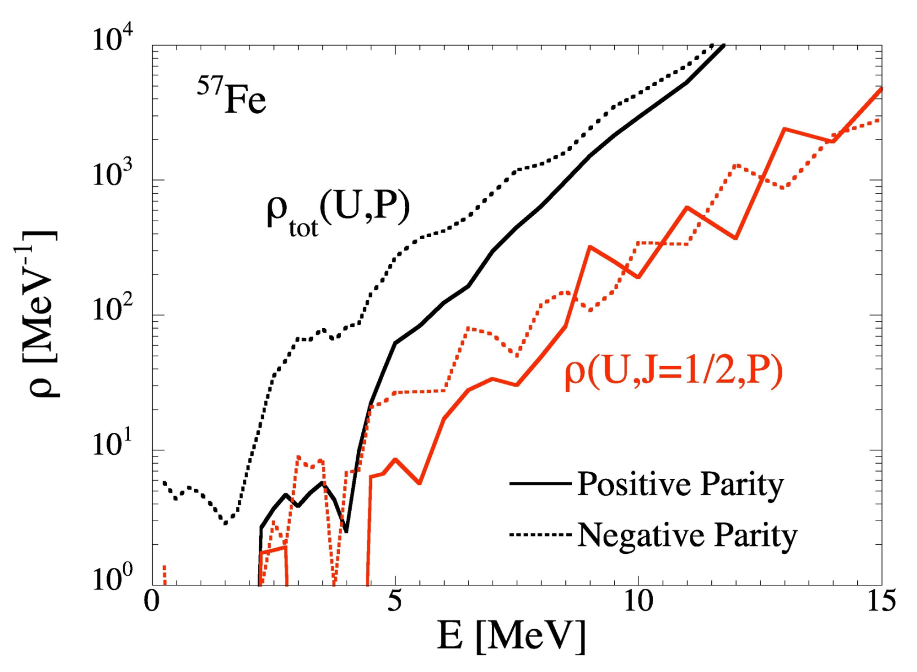
FINE TUNING AND ACCURACY
Non statistical effects in nuclear level densities (1/4)
Talys deals with realistic (non statistical) spin & parity distributions

Slide 56
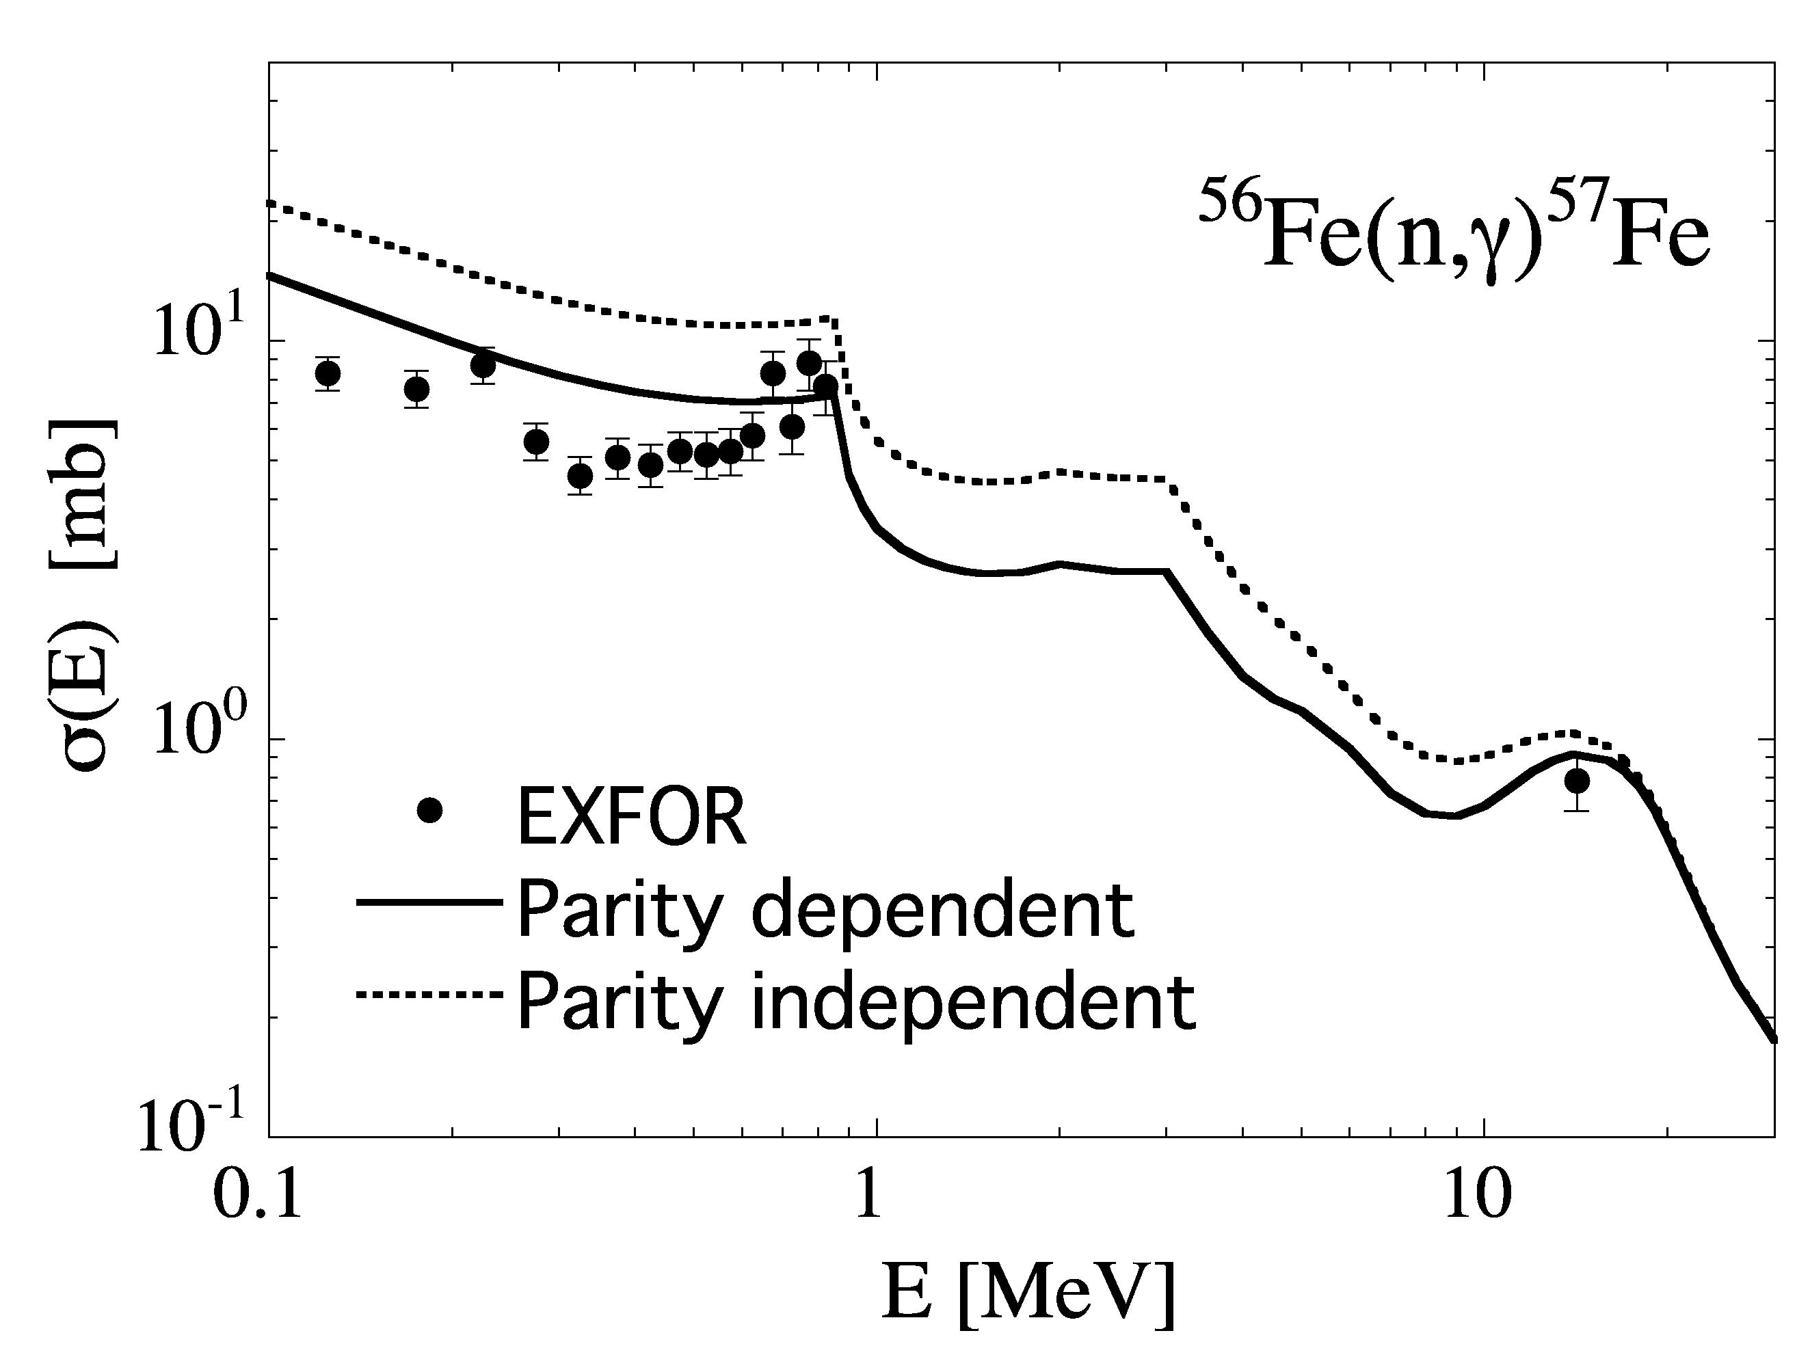
FINE TUNING AND ACCURACY
Non statistical effects in nuclear level densities (2/4)
Talys deals with realistic (non statistical) spin & parity distributions

Slide 57
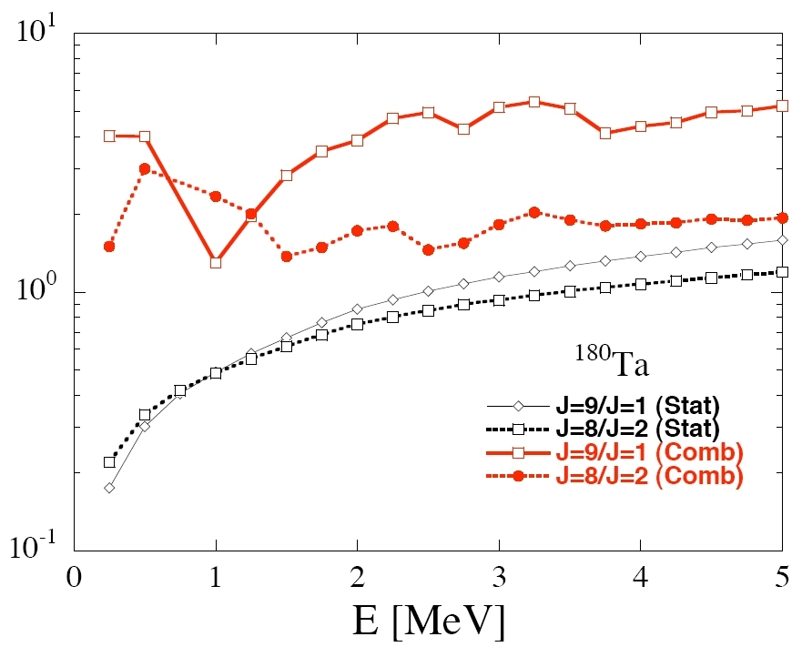
FINE TUNING AND ACCURACY
Non statistical effects in nuclear level densities (3/4)
Talys deals with realistic (non statistical) spin & parity distributions
Non-statistical feature imply significant deviations from the usual gaussian spin dependence

Slide 58
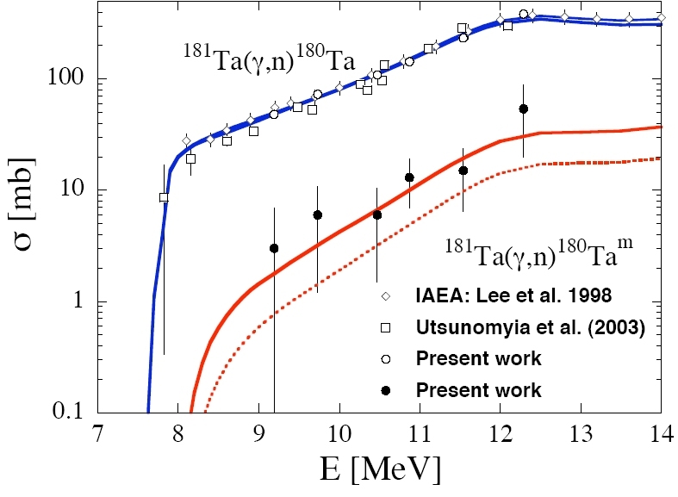
FINE TUNING AND ACCURACY
Non statistical effects in nuclear level densities (4/4)
Talys deals with realistic (non statistical) spin & parity distributions
Combinatorial
distribution
Gaussian
distribution
Non-statistical feature imply significant deviations from the usual gaussian spin dependence which have significant impact on isomeric production
See PRL 96 (2006) 192501 for details

Slide 59
FINE TUNING AND ACCURACY
Decay spin selection rules at work (1/1)
⁸⁹Y Ground state : 1/2⁺
⁸⁹Y (p,n) ⁸⁹Zr threshold = 3,65 MeV
Transmission coefficients incident proton at 4.5 MeV :
60 % l=0 ⇒ CN spin 0⁺, 1⁺
35 % l=1 ⇒ CN spin 0⁻, 1⁻, 2⁻
Transmission coefficients outgoing neutron at 1.0 MeV :
70 % l=1 ⇒ CN spin 1/2⁻, 3/2⁻, 5/2⁻,1/2⁺, 3/2⁺, 5/2⁺, 7/2⁺
25 % l=0 ⇒ CN spin 1/2⁻, 3/2⁻, 5/2⁻, 1/2⁺, 3/2⁺
⁸⁹Zr Level scheme
3/2⁻
1.094 MeV
1/2⁻
0.587 MeV
9/2⁺
0.0 MeV

Slide 60
FINE TUNING AND ACCURACY
Coherent modeling of fission cross sections (1/3)
Nucleus (Z,A-2)
Energy
3rd chance
B_{n}
Nucleus (Z,A-1)
2nd chance
B_{n}
Nucleus (Z,A)
V
1st chance
B_{n}
s fission (barn)
V
elongation
Incident neutron energy (MeV)

Slide 61
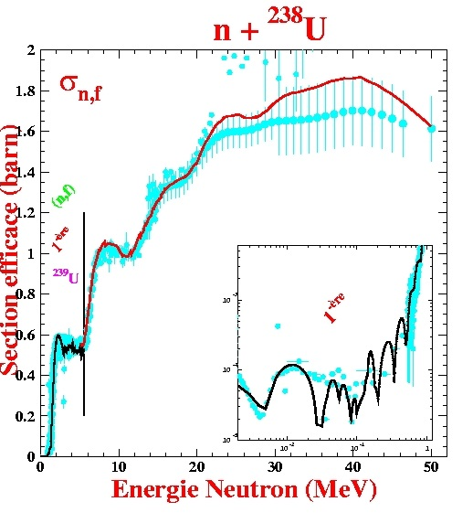
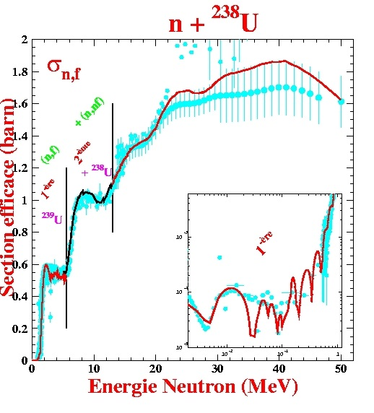
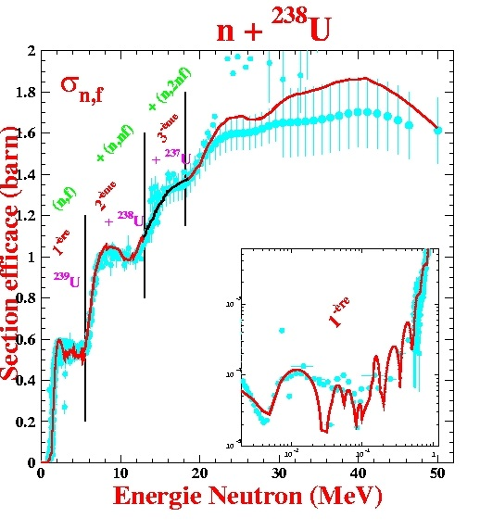
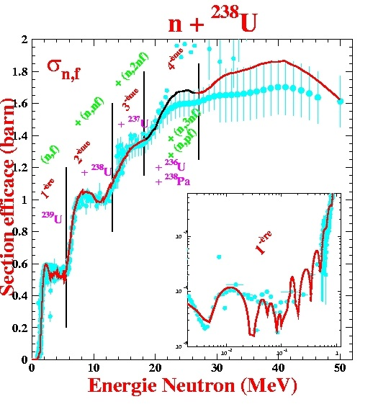
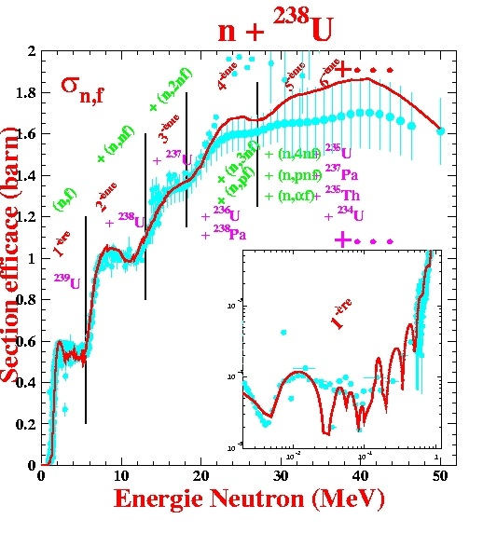
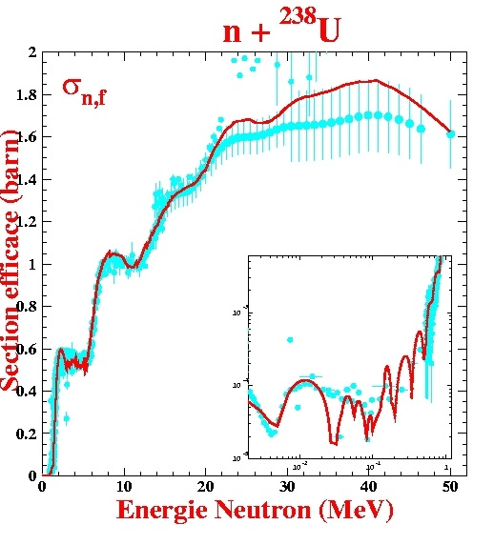
FINE TUNING AND ACCURACY
Coherent modeling of fission cross sections (2/3)
(n,pf)
Pa8
U5
(n,4nf)
4n
p
(n,af)
U6
(n,3nf)
Th5
3n
a
U7
(n,2nf)
2n
U8
(n,nf)
n
n + U8
U9
(n,f)
MeV
6
12
24
32

Slide 62
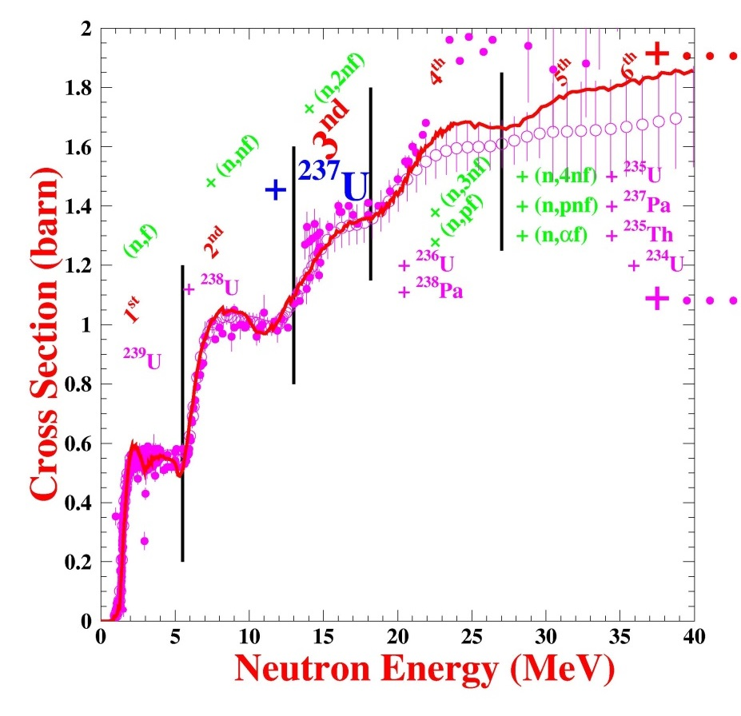
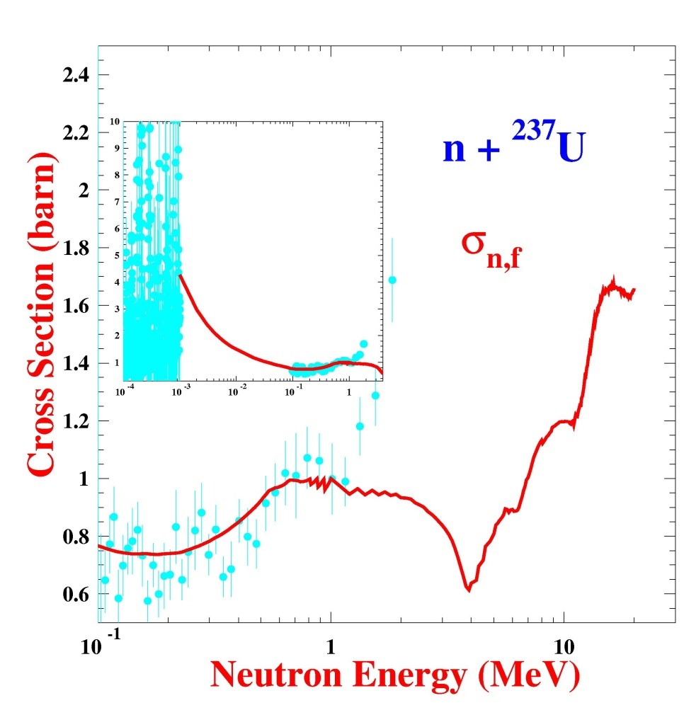
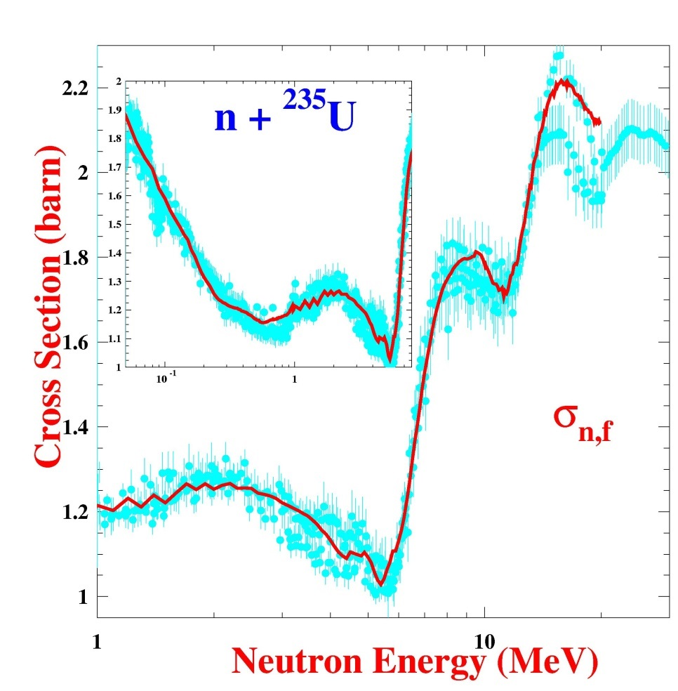
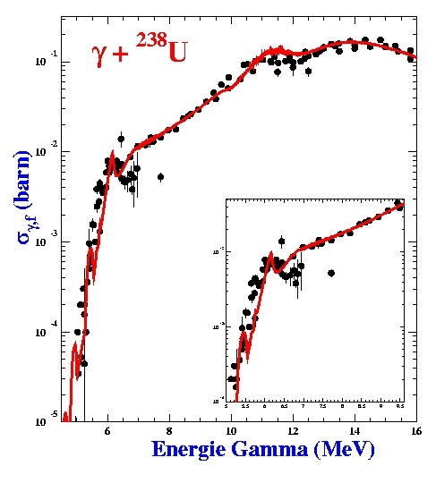
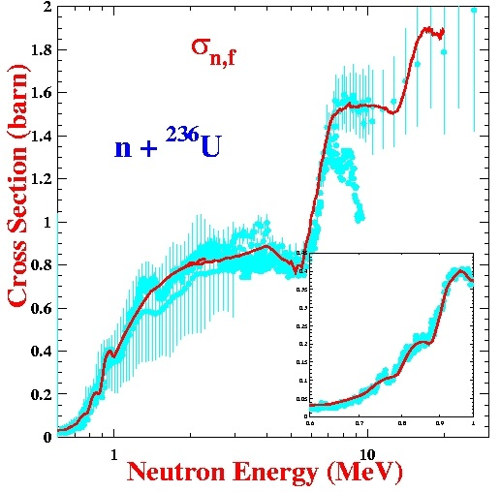
FINE TUNING AND ACCURACY
Coherent modeling of fission cross sections (3/3)
n + U4
U5

Slide 63
FINE TUNING AND ACCURACY
Predictions for unstable target (1/1)
⁹⁰⁻⁹⁶Zr(n,γ) & (γ,n)
cross sections
γ-ray strength
constrained on (γ,n) xs
E1 HFB+QRPA + M1 GR
versus
LORENTZIAN
Prediction for short-lived ⁹⁵Zr

Slide 64
FINE TUNING AND ACCURACY
Microscopic modeling of fission cross sections (1/2)
Microscopic fission barrier shapes
For exotic nuclei : strong deviations from Hill-Wheeler.

Slide 65
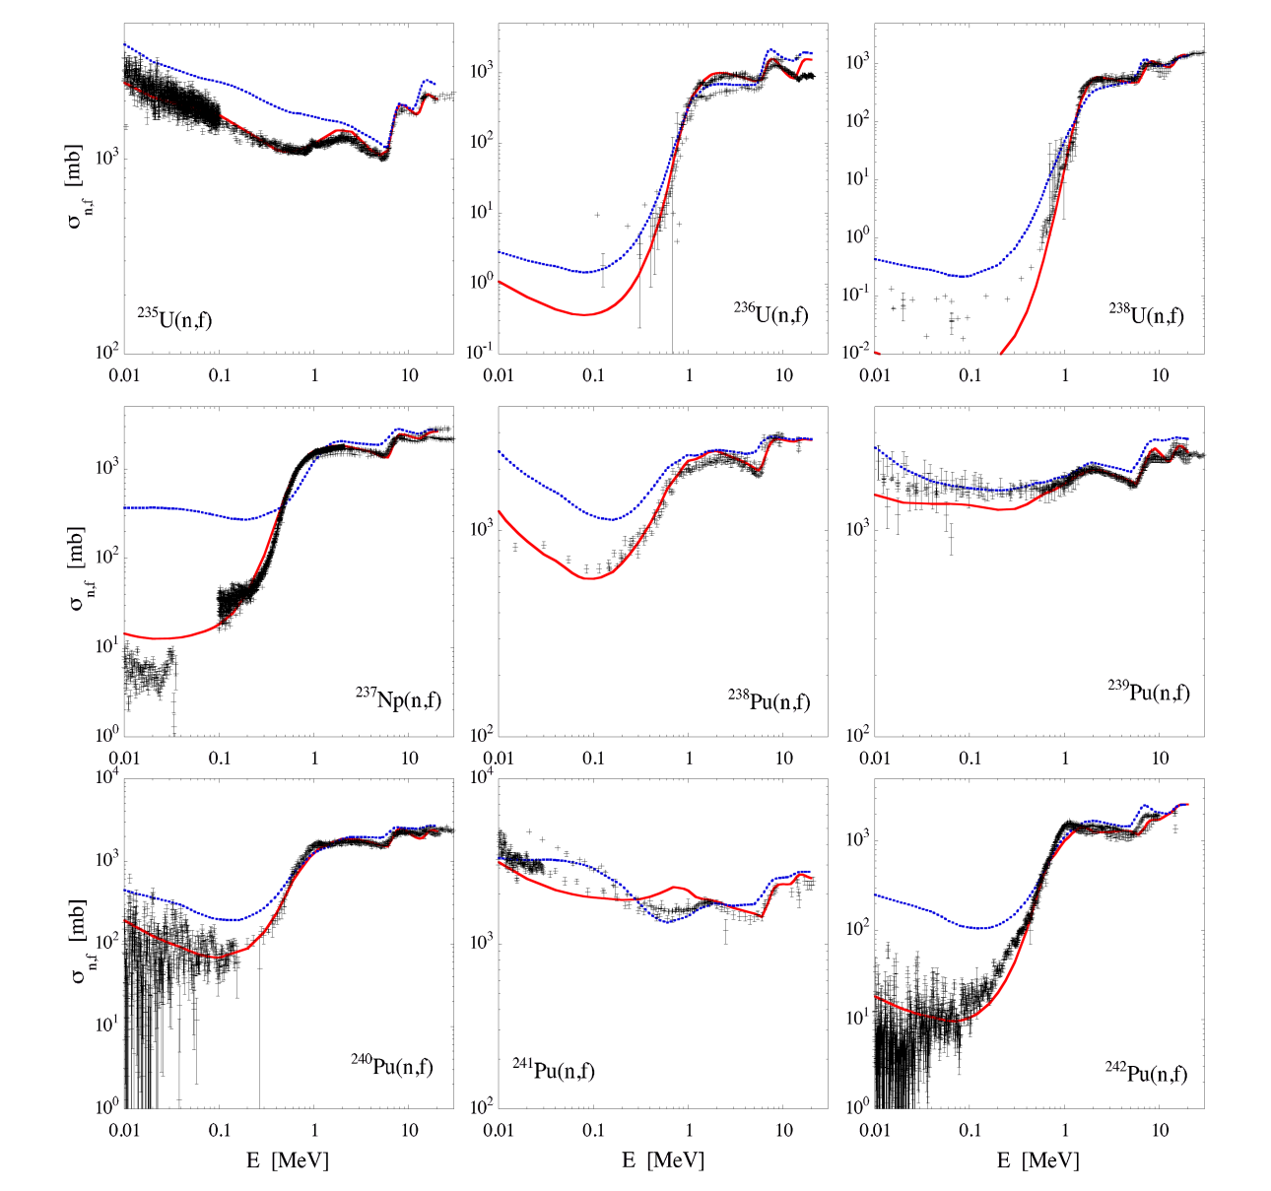
FINE TUNING AND ACCURACY
Microscopic modeling of fission cross sections (2/2)
Microscopic fission cross sections
Fission barriers
adjusted for
each target
Fission barriers
adjusted for
each type of target
- odd-odd
- odd-even
- even-odd
- even-even
Default calculations not sufficient for applications.
Not ridiculous after few adjustments.

Slide 66
FINE TUNING AND ACCURACY
Coherent microscopic modeling
of fission cross sections (1/4)
Coherent fission cross sections
with phenomenological approach
Neutron induced fission on ²³⁸U
- several hundreds of parameters
- unique set for all fission chances or U targets

Slide 67
FINE TUNING AND ACCURACY
Coherent microscopic modeling
of fission cross sections (2/4)
n + U4
U5

Slide 68
FINE TUNING AND ACCURACY
Coherent microscopic modeling
of fission cross sections (3/4)
Can we do the same
with microscopic ingredients ?

Slide 69
FINE TUNING AND ACCURACY
Coherent microscopic modeling
of fission cross sections (4/4)

Slide 70
GLOBAL SYSTEMATIC APPROACHES
Adjusting Nuclear level densities
Astrophysical r-process
Global trends in cross sections : isolating/solving problems
Total Monte Carlo and covariances
TENDL

Slide 71
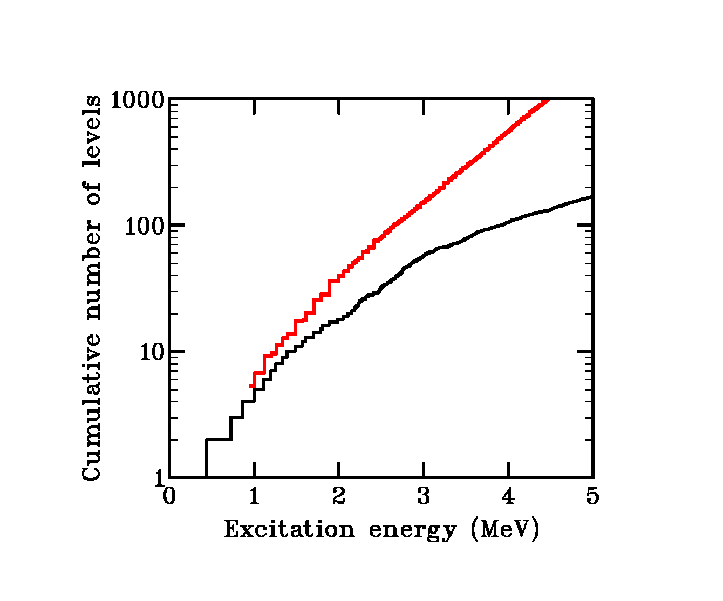
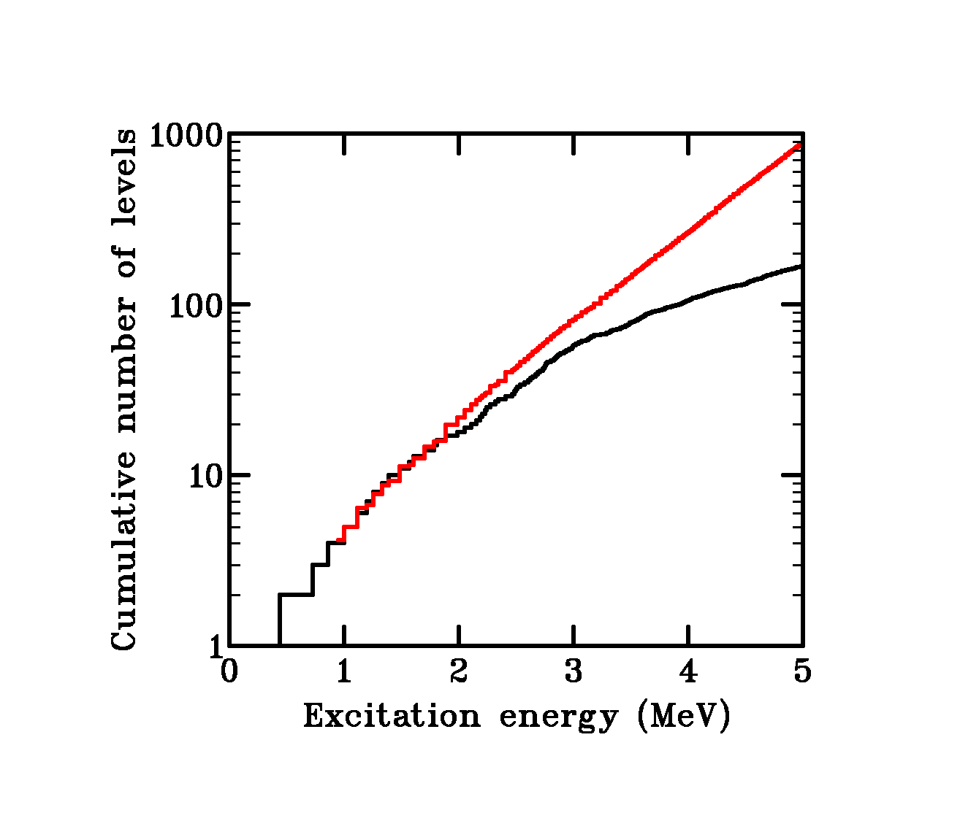
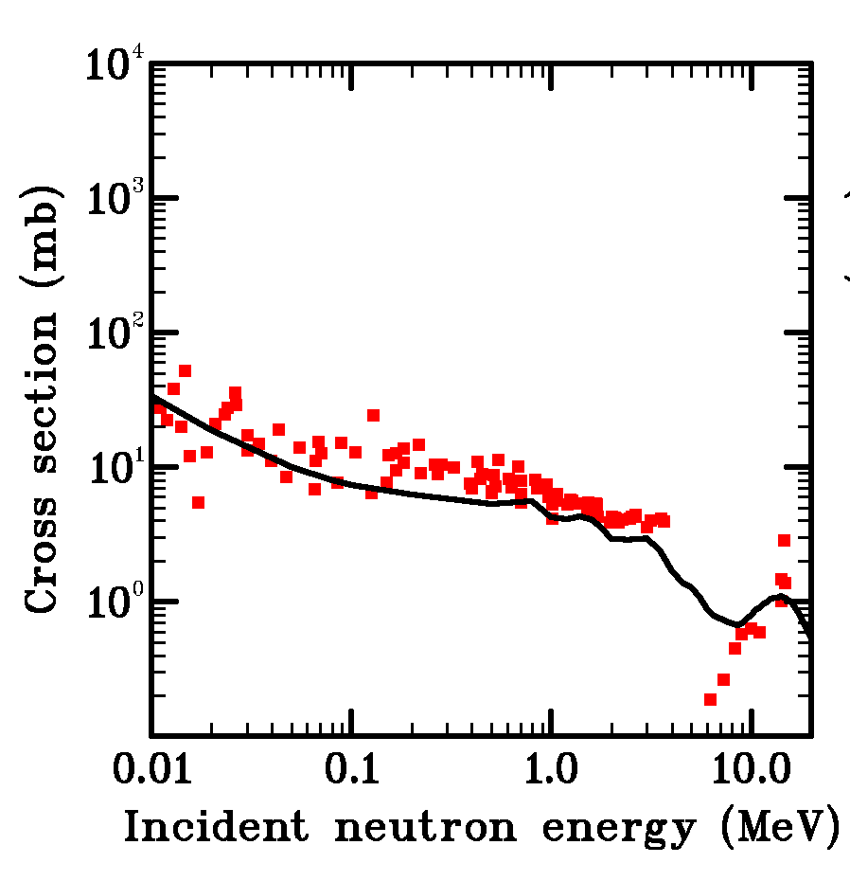


GLOBAL SYSTEMATIC APPROACHES
Adjusting level densities (1/4)
√
a ( U - d )
ρ _{renorm} (U) = e ρ _{global} (U - δ)
⁸⁹Y(n,g)
⁸⁹Y(n,g)
⁸⁹Y(n,g)
⁸⁹Y(n,2n)
⁸⁹Y(n,n′)

Slide 72
GLOBAL SYSTEMATIC APPROACHES
Adjusting level densities (2/4)
See NPA 810 (2008) 13 for details
a and d adjusted to fit discrete levels (≈ 1200 nuclei) and D₀’s (≈ 300 nuclei) using the TALYS code

Slide 73
GLOBAL SYSTEMATIC APPROACHES
Adjusting level densities (3/4)
Levels density models implemented/adjusted in TALYS
Gilbert-Cameron model + Ignatyuk
  Default
Back-Shifted Fermi Gas model + Ignatyuk
  Less accurate than GC at low energy
(Generalized) Superfluid model
  More rigourous treatment of pairing correlation at low energy
  Fermi gas + Ignatyuk law above some critical energy
  (Explicit treatment of collective effects)
Combinatorial approach
  Using Skyrme or Gogny single particle levels
  ⇒ Using Gogny temperature dependent treatment

Slide 74
GLOBAL SYSTEMATIC APPROACHES
Adjusting level densities (4/4)
Microscopic NLD formula based on HF-BCS
vs
Analytical shell-corrected Back-Shifted Fermi Gas
U=50 MeV

Slide 75
GLOBAL SYSTEMATIC APPROACHES
Astrophysical r-process (1/4)
Solar abundancies for 140 < A < 200 : r-nuclei ?
Two options :
- Supernovae :
Matter ejection without any problem +++
Great sensitivity to thermodynamical conditions - - -
No clearly identified astrophysical site - - -
Failure of explosion models - - -
- Neutron stars collisions :
Enough neutrons +++
Binary systems abundancies ? - - -
Matter ejection ? - - -
Grosse sensibilité aux modèles de fission - - -
Recently solved +++

Slide 76

GLOBAL SYSTEMATIC APPROACHES
Astrophysical r-process (2/4)
Solar abundancies for 140 < A < 200 : situation before 2013 ?

Slide 77
GLOBAL SYSTEMATIC APPROACHES
Astrophysical r-process (3/4)
AMEDEE
(HFB+D1S)
Fission
fragment
yields
Binary systems
hydrodynamic
TALYS
(SKM)
r-process
nucleosynthesis

Slide 78
GLOBAL SYSTEMATIC APPROACHES
Astrophysical r-process (4/4)
Solar abundancies for 140 < A < 200 : situation before 2013 ?
Solar abundancies for 140 < A < 200 : situation in 2013

Slide 79

GLOBAL SYSTEMATIC APPROACHES
Astrophysical r-process (4/4)
More details for discussions/explanations in PRL 111, 242502 (2013)

Slide 80
GLOBAL SYSTEMATIC APPROACHES
Global trends in cross sections (1/2)
Testing TALYS trends: (n,p) (J. Kopecky)
Trend line
Discrepant reactions

Slide 81

GLOBAL SYSTEMATIC APPROACHES
Global trends in cross sections (2/2)
Global comparison with experiment
Can we compare all existing experimental data with nuclear models?
Nuclear model codes are ready: TALYS + smart script: 1 day (20 MeV) – 1 week (200 MeV) calculation time
…but the experimental data collection (EXFOR) is not.
A working group of the NEA has helped for this: Turn EXFOR into a database
This will help to improve nuclear models + parameters
This will help to clean up (bugs) in EXFOR
Current situation: 16000 exp. data sets (400 000 points) can be automatically
compared with TALYS

Slide 82
GLOBAL SYSTEMATIC APPROACHES
Covariances (1/2)
+Uncertainties
Determ.
code
Resonance
Parameters
.
TARES
+Covariances
+Covariances
Output
ENDF
Gen. purpose
file
NJOY
MCNP
K-eff
Neutron flux
Etc.
Experimental
data
(EXFOR)
TEFAL
+Covariances
Output
ENDF/EAF
Activ. file
PROC.
CODE
FIS-
PACT
- activation
- transmutation
+Covariances
+(Co)variances
+Covariances
Nucl. model
parameters
TALYS
Other
codes
+Uncertainties
Monte Carlo: 1000 runs of TALYS
TASMAN

Slide 83
GLOBAL SYSTEMATIC APPROACHES
Covariances (2/2)
Uncertainties from random TALYS parameters
+ covariances for the same price

Slide 84
GLOBAL SYSTEMATIC APPROACHES
Covariances (1/2) : reminder
+Uncertainties
Determ.
code
Resonance
Parameters
.
TARES
+Covariances
+Covariances
Output
ENDF
Gen. purpose
file
NJOY
MCNP
K-eff
Neutron flux
Etc.
Experimental
data
(EXFOR)
TEFAL
+Covariances
Output
ENDF/EAF
Activ. file
PROC.
CODE
FIS-
PACT
- activation
- transmutation
+Covariances
+(Co)variances
+Covariances
Nucl. model
parameters
TALYS
Other
codes
+Uncertainties
Monte Carlo: 1000 runs of TALYS
TASMAN

Slide 85
GLOBAL SYSTEMATIC APPROACHES
Total Monte Carlo (1/2)
+Uncertainties
Determ.
code
Resonance
Parameters
.
TARES
Output
ENDF
Gen. purpose
file
NJOY
MCNP
K-eff
Neutron flux
Etc.
Experimental
data
(EXFOR)
TEFAL
+Covariances
Output
ENDF/EAF
Activ. file
PROC.
CODE
FIS-
PACT
- activation
- transmutation
+Covariances
Nucl. model
parameters
TALYS
Other
codes
+Uncertainties
Monte Carlo: 1000 runs of all codes
TASMAN

Slide 86

GLOBAL SYSTEMATIC APPROACHES
Total Monte Carlo(2/2)
TMC Application: criticality benchmarks
Total of 60000 random ENDF-6 files
Sometimes deviation from Gaussian shape
D. Rochman, A.J. Koning and S.C. van der Marck,
``Uncertainties for criticality-safety benchmarks and keff
distributions'', Ann. Nuc. En. 36 810-831 (2009).
Yields uncertainties on benchmarks !

Slide 87
TENDL
Talys Evaluated Nuclear Data Library (1/2)
TALYS Evaluated Nuclear Data Library: TENDL-2008, …, TENDL-2014
Neutron, proton, deuteron, triton, Helium-3, alpha and gamma libraries: ENDF-6 format and x-y tables
2430 targets (all with lifetime > 1 sec.)
Neutron library: complete covariance data
For all nuclides processed MCNP-libraries (“ACE-files”) (n,p and d), PENDF files and processed multi-group covariances (neutrons only)
Strategy:
Always ensure completeness, global improvement, production time: 2 months for 150 processors
Extra effort for important nuclides, especially when high precision is required (e.g. actinides): Fitted model calculations and direct inclusion of experimental/evaluated data. Keep the input files.
All libraries are always reproducible from scratch
All libraries based on compact reaction info: default TALYS input file or input file with adjusted parameters, parameter uncertainties, resonance parameters + uncertainties, “rescue” file with adoption from other libraries
Started with 350 nuclei (2008), now 2600 (2014)

Slide 88
TENDL
Talys Evaluated Nuclear Data Library (2/2)
http://www.talys.eu

Slide 89
CONCLUSIONS & PROPECTS
Conclusions
TALYS Fortran-95/2003 upgrade in two phases:
  2013: standard issues (arrays, output, etc.)
  2014: advanced issues (derived data types, OOP, etc.)
  Huge computation time decrease targeted for multiple Hauser-Feshbach decay
Catch up on the TENDL delay
Couple TALYS with GEF (Schmidt, Jurado) for fission yields, nubar, fission neutron spectrum
Further develop Total Unified Monte Carlo
Apply automatic optimization to integral benchmarks for all nuclides
Extend Total Monte Carlo uncertainty propagation to full core reactor calculations

Slide 90
CONCLUSIONS & PROPECTS
Generally speaking prospects
Nuclear reaction modeling complex and no yet fully satisfactory
    pre-equilibrium phenomenon must be improved
    fission related phenomena (fission, FF yields & decay) must be improved
Formal and technical link between structure and reactions has to be pushed further
    pre-equilibrium and OMP efforts already engaged
    computing time is still an issue
Fundamental ν-ν interaction knowledge (and treatment) has to be improved
    Ab-initio not universal (low mass or restricted mass regions)
    Relativistic aspects not included systematically
    Human & computing time is still an issue

Slide 91
CONCLUSIONS & PROPECTS
TALYSly speaking prospects
TALYS Fortran-95/2003 upgrade
Couple TALYS with GEF (Schmidt, Jurado) for fission yields, nubar, fission neutron spectrum
Further develop Total Unified Monte Carlo
Apply automatic optimization to integral benchmarks for all nuclides
Extend Total Monte Carlo uncertainty propagation to full core reactor calculations
Include or (couple to) new models

