Slide 1
TALYS: a tool to go from theoretical modeling of nuclear reactions to evaluations
Part I
EJC 2014 – S. Hilaire & The TALYS Team – 30/09/2014

Slide 2
Content
- Introduction
TODAY
- General features about nuclear reactions
Time scales and associated models
Types of data needed
Data format = f (users)
- Nuclear Models
Basic structure properties
Optical model
Pre-equilibrium model
Compound Nucleus model
Miscellaneous : level densities, fission, capture
- From in depth analysis to large scale production with TALYS
General features about TALYS
Fine tuning and accuracy
Global systematic approaches
- What remains to be done ?
TOMORROW

Slide 3
INTRODUCTION

Slide 4
Why do we need nuclear data and how much accurate ?
Nuclear data needed for
Understanding basic reaction mechanism between particles and nuclei
Astrophysical applications (Age of the Galaxy, element abundances …)
Good accuracy if possible ⇒ good understanding or room for improvements
Existing or future nuclear reactor simulations
Medical applications, oil well logging, waste transmutation, fusion, …
Finite number of experimental data (price, safety or counting rates)
Complete measurements restricted to low energies ( < 1 MeV)
to scarce nuclei
Predictive & Robust Nuclear models
(codes) are essential

Slide 5
Why do we need nuclear data and how much accurate ?
Nuclear data needed for
Understanding basic reaction mechanism between particles and nuclei
Astrophysical applications (Age of the Galaxy, element abundances …)
Existing or future nuclear reactor simulations
Good accuracy if possible ⇒ good understanding or room for improvements
Medical applications, oil well logging, waste transmutation, fusion, …
Predictive power important ⇒ sound physics (first principles)
Finite number of experimental data (price, safety or counting rates)
Complete measurements restricted to low energies ( < 1 MeV)
to scarce nuclei
Predictive & Robust Nuclear models
(codes) are essential

Slide 6
Why do we need nuclear data and how much accurate ?
Nuclear data needed for
Understanding basic reaction mechanism between particles and nuclei
Astrophysical applications (Age of the Galaxy, element abundances …)
Existing or future nuclear reactor simulations
Medical applications, oil well logging, waste transmutation, fusion, …
Good (Excellent) accuracy required ⇒ reproduction of data, safety
Predictive power less important ⇒ Reproductive power
Finite number of experimental data (price, safety or counting rates)
Complete measurements restricted to low energies ( < 1 MeV)
to scarce nuclei
Predictive & Robust Nuclear models
(codes) are essential

Slide 7
Why do we need nuclear data and how much accurate ?
Nuclear data needed for
Understanding basic reaction mechanism between particles and nuclei
Astrophysical applications (Age of the Galaxy, element abundances …)
Existing or future nuclear reactor simulations
Medical applications, oil well logging, waste transmutation, fusion, …
Finite number of experimental data (price, safety or counting rates)
Good accuracy required ⇒ reproduction of data
Predictive power less important ⇒ Reproductive power
Complete measurements restricted to low energies ( < 1 MeV)
to scarce nuclei
Predictive & Robust Nuclear models
(codes) are essential

Slide 8
Why do we need nuclear data and how much accurate ?
Nuclear data needed for
Understanding basic reaction mechanism between particles and nuclei
Astrophysical applications (Age of the Galaxy, element abundances …)
Existing or future nuclear reactor simulations
Medical applications, oil well logging, waste transmutation, fusion, …
But
Finite number of experimental data (price, safety or counting rates)
Complete measurements restricted to low energies ( < 1 MeV)
to scarce nuclei
Predictive & Robust Nuclear models
(codes) are essential

Slide 9
GENERAL FEATURES ABOUT
NUCLEAR REACTIONS
CEA | 10 AVRIL 2012
| PAGE 9
2 septembre 2014

Slide 10
Content
- Introduction
- General features about nuclear reactions
Time scales and associated models
Types of data needed
Data format = f (users)
- Nuclear Models
Basic structure properties
Optical model
Pre-equilibrium model
Compound Nucleus model
Miscellaneous : level densities, fission, capture
- From in depth analysis to large scale production with TALYS
General features about TALYS
Fine tuning and accuracy
Global systematic approaches
- What remains to be done ?

Slide 11
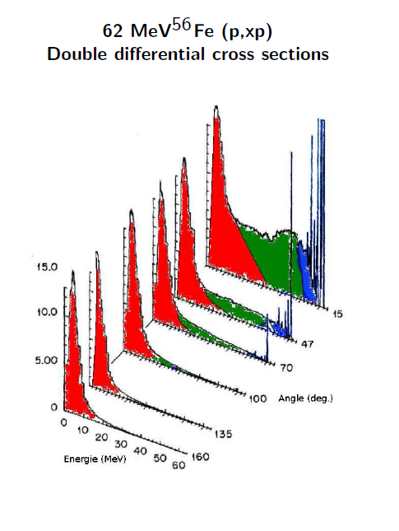
TIME SCALES AND ASSOCIATED MODELS (1/4)
Typical spectrum shape
Always evaporation peak
Discrete peaks at forward angles
Flat intermediate region

Slide 12
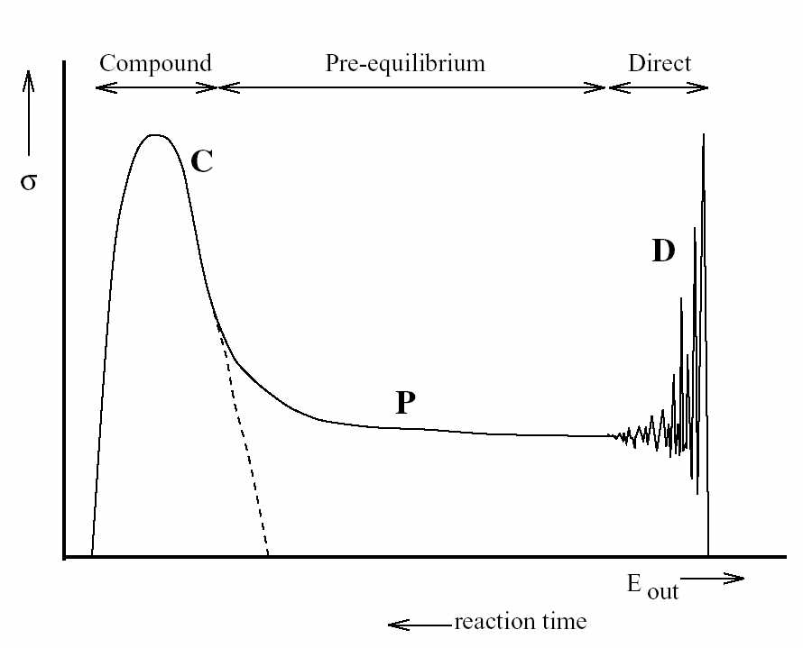
TIME SCALES AND ASSOCIATED MODELS (2/4)
d²σ / dΩdE
Compound
Nucleus
Direct
components
Pre-equilibrium
MSC
MSD
Low emission energy
Reaction time ≈ 10⁻¹⁸ s
Isotropic angular distribution
Intermediate emission energy
Intermediate reaction time
Anisotropic angular distribution smoothly
increasing to forward peaked shape
with outgoing energy
High emission energy
Reaction time ≈ 10⁻²² s
Anisotropic angular distribution
- forward peaked
- oscillatory behavior
⇒ spin and parity of
residual nucleus
Emission energy
Reaction time

Slide 13
TIME SCALES AND ASSOCIATED MODELS (3/4)
Direct (shape) elastic
Elastic
σ_{Reaction}
σ_{NC}
OPTICAL
MODEL
PRE-EQUILIBRIUM
COMPOUND
NUCLEUS
Fission
T_{lj}
Inelastic
Direct components
(n,n’), (n,α),
(n,γ), etc…

Slide 14
TIME SCALES AND ASSOCIATED MODELS (4/4)

Slide 15
TYPES OF DATA NEEDED
Cross sections :
total, reaction, elastic (shape & compound), non-elastic, inelastic (discrete levels & total)
total particle (residual) production
all exclusive reactions (n,nd2a)
all exclusive isomer production
all exclusive discrete and continuum g-ray production
Spectra :
elastic and inelastic angular distribution or energy spectra
all exclusive double-differential spectra
total particle production spectra
compound and pre-equilibrium spectra per reaction stage.
Fission observables :
cross sections (total, per chance)
fission fragment mass and isotopic yields
fission neutrons (multiplicities, spectra)
Miscellaneous :
recoil cross sections and ddx
particle multiplicities
astrophysical reaction rates
covariances informations

Slide 16
DATA FORMAT
Trivial for basic nuclear science : x,y,(z) file
Complicated (even crazy) for data production issues : ENDF file

Slide 17
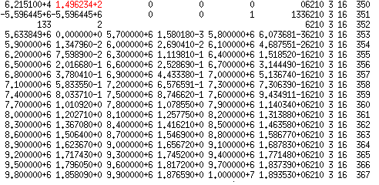
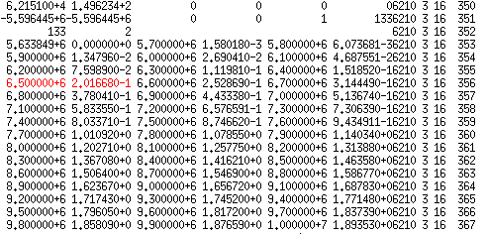
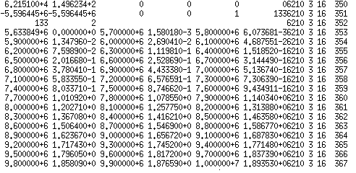
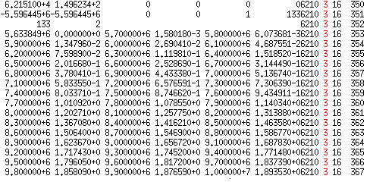
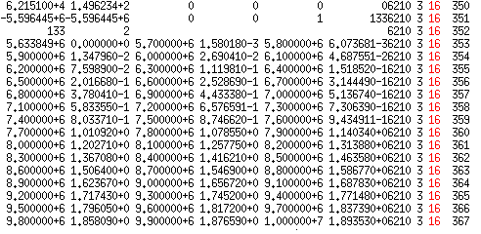
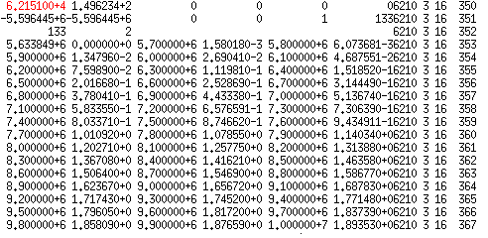
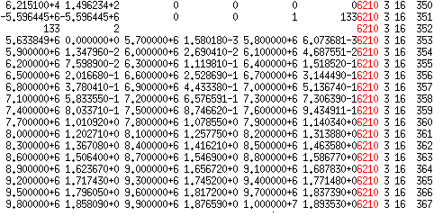
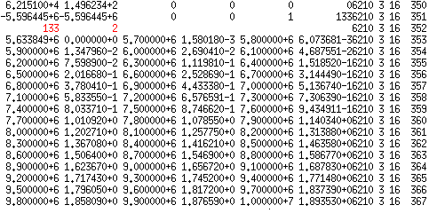
DATA FORMAT : ENDF file
Content nature (σ)
Target mass
Trivial for basic nuclear science : x,y,(z) file
Complicated (even crazy) for data production issues : ENDF file
Target identification (¹⁵¹Sm)
Values
Number of values
Content type (n,2n)
Material number

Slide 18
NUCLEAR MODELS
CEA | 10 AVRIL 2012
| PAGE 18
2 septembre 2014

Slide 19
Content
- Introduction
- General features about nuclear reactions
Time scales and associated models
Types of data needed
Data format = f (users)
- Nuclear Models
Basic structure properties
Optical model
Pre-equilibrium model
Compound Nucleus model
Miscellaneous : level densities, fission, capture
- From in depth analysis to large scale production with TALYS
General features about TALYS
Fine tuning and accuracy
Global systematic approaches
- What remains to be done ?

Slide 20
BASIC STRUCTURE PROPERTIES (1/5)
What is needed
Nuclear Masses :
⇒ basic information to determine reaction threshold
Excited levels :
⇒ Angular distributions (depend on spin and parities)
⇒ Decay properties (branching ratios)
⇒ Excitation energies (reaction thresholds)
Target levels’ deformations :
⇒ Required to select appropriate optical model
⇒ Required to select appropriate coupling scheme
Many different theoretical approaches if
experimental data is missing
Recommended databases (RIPL !)

Slide 21
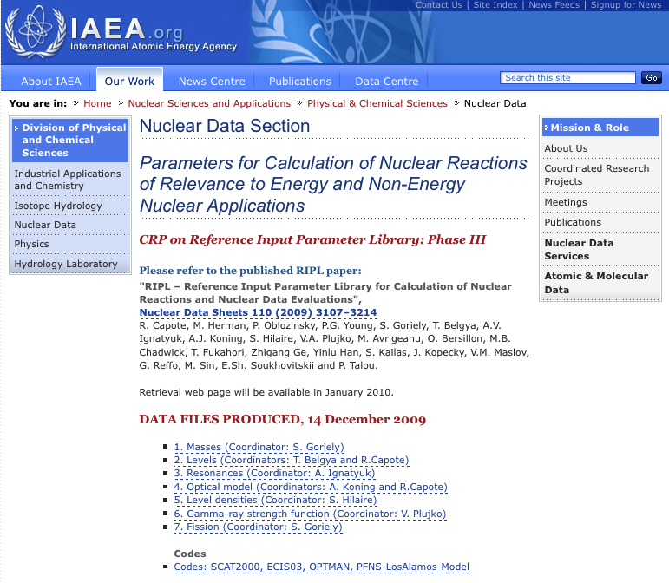
RIPL-3

Slide 22
BASIC STRUCTURE PROPERTIES (2/5)
Mass models
Reliability Accuracy
Macroscopic-Microscopic Approaches
Liquid drop model (Myers & Swiateki 1966) – – + +
Droplet model (Hilf et al. 1976) – – + +
FRDM model (Moller et al. 1995) + – + +
KUTY model (Koura et al. 2000) + – + +
Approximation to Microscopic models
Shell model (Duflo & Zuker 1995) + +++
ETFSI model (Aboussir et al. 1995) + + +
Mean Field Model
Hartree-Fock-BCS model + + + +
Hartree-Fock-Bogolyubov model + + + + +
EDF, RHB, Shell model + + + – –
Typical deviations for the best mass formulas:
rms(M) = 600-700 keV on 2149 (Z ≥ 8) experimental masses

Slide 23
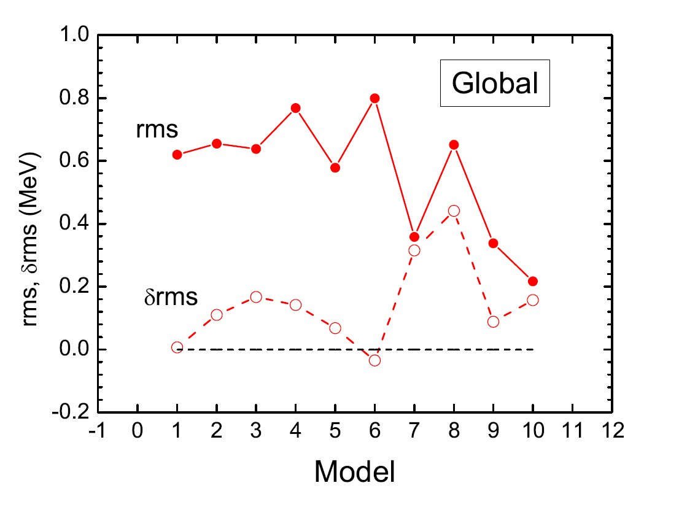
BASIC STRUCTURE PROPERTIES (3/5)
Mass models predictive power
Comparison between several mass models adjusted with 2003 exp and tested
with 2012 exp masses
Current status
rms < 1 MeV (masses ≈ GeV)
micro ∼ macro
micro more predictive
Microscopic models

Slide 24
BASIC STRUCTURE PROPERTIES (4/5)
HFB Mass models
Most advanced theoretical approach = multireference level
Methodology : E = E_{mf} + dE∞+ dE_{bmf}
* Additional filters
1 month
4-5 years
Acceptable description
of masses, radii
and nuclear
matter
properties
Good description
of masses, radii
& nuclear matter props, using consistent
dE∞ values
The good
properties
obtained
using D1S
are nearly
unchanged
Automatic
fit on
650 known
masses
Correct
rms
with respect
to masses
New
corrections
dE∞
New
corrections
dE_{quad}
Initial
force
New
force
New
constraints
Final
force
Mean field level
Beyond
mean field
Collective properties (0+,2+, BE2), RPA modes, backbending properties, pairing properties, fission properties, gamma strength functions, level densities

Slide 25
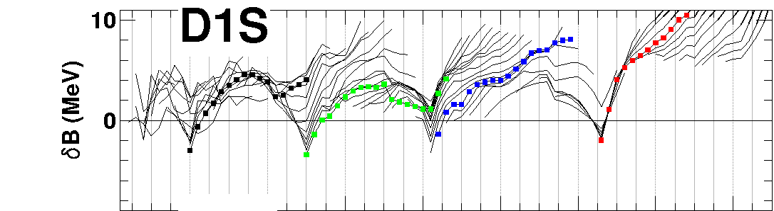

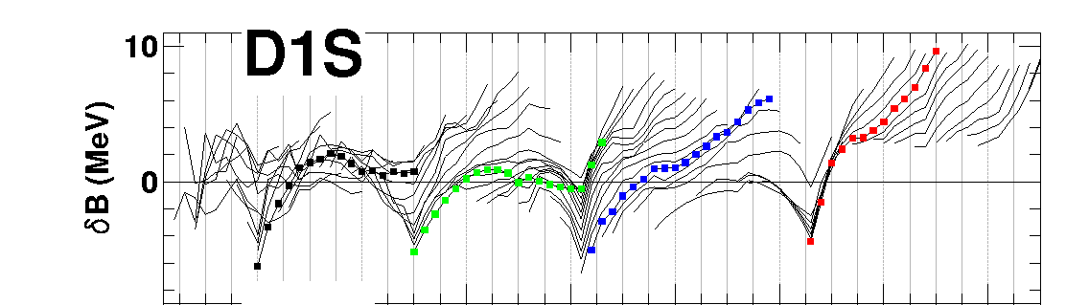
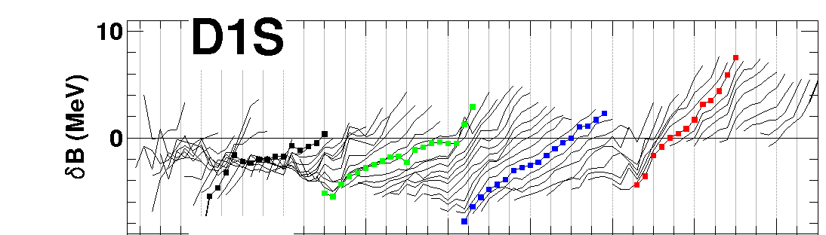
BASIC STRUCTURE PROPERTIES (5/5)
HFB-Gogny Mass model
D1S
Comparison with 2149 Exp. Masses
E_{th} = E_{HFB}
r.m.s ~ 4.4 MeV
E_{th} = E_{HFB} - Δ∞
r.m.s ~ 2.6 MeV
E_{th} = E_{HFB} - Δ∞ - Δ_{quad}
r.m.s ~ 2.9 MeV

Slide 26
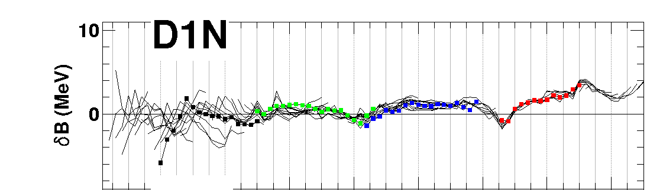
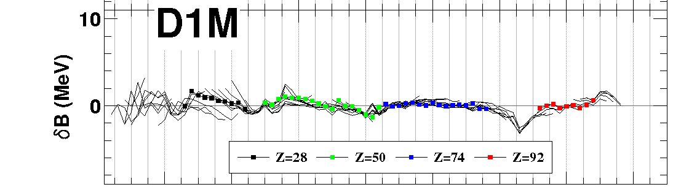
BASIC STRUCTURE PROPERTIES (5/5)
HFB-Gogny Mass model
Comparison with 2149 Exp. Masses
r.m.s ~ 2.5 MeV
r.m.s ~ 0.95 MeV
ε = 0.126 MeV
r.m.s = 0.798 MeV

Slide 27
THE OPTICAL MODEL
Direct (shape) elastic
Elastic
σ_{Reaction}
σ_{NC}
OPTICAL
MODEL
PRE-EQUILIBRIUM
COMPOUND
NUCLEUS
Fission
T_{lj}
Inelastic
Direct components
(n,n’), (n,α),
(n,γ), etc…

Slide 28
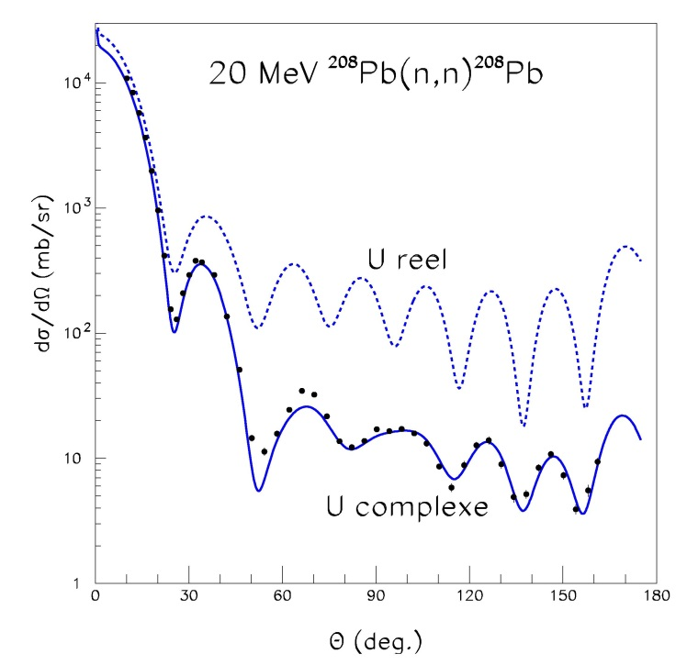
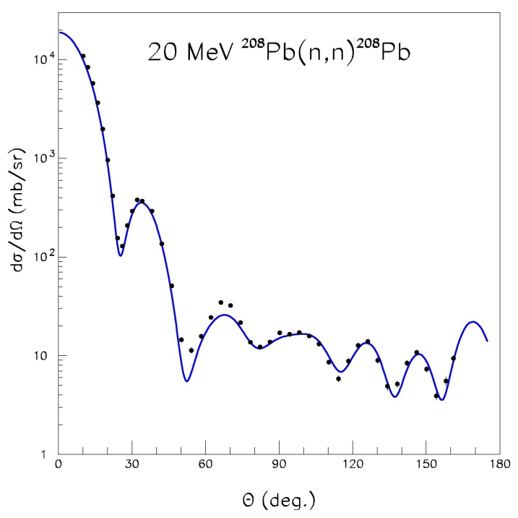
THE OPTICAL MODEL
Direct interaction of a projectile with a target nucleus considered as a whole
Quantum model → Schrödinger equation
U
Complex potential:
U = V + iW
Refraction
Absorption

Slide 29
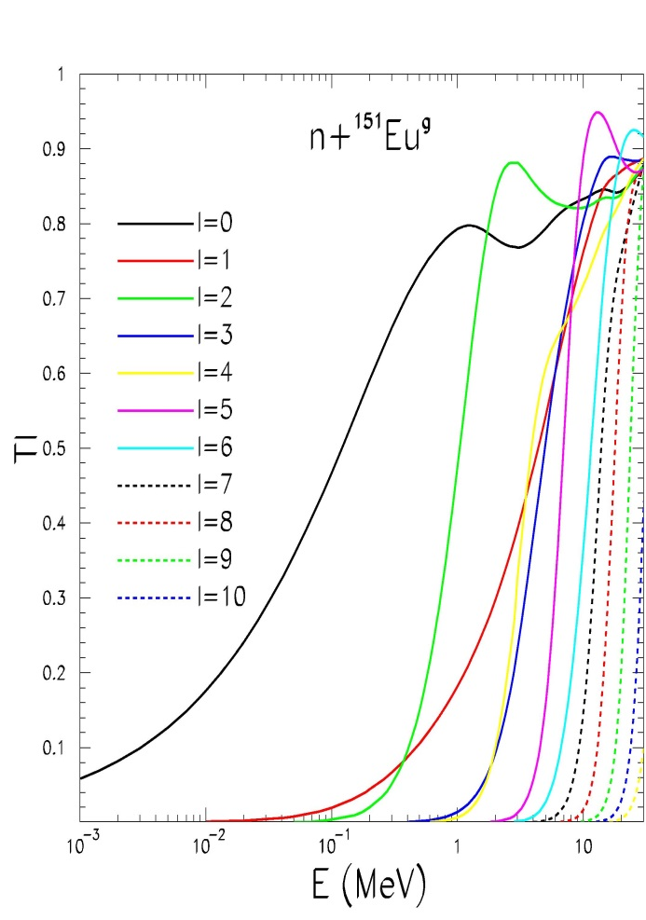
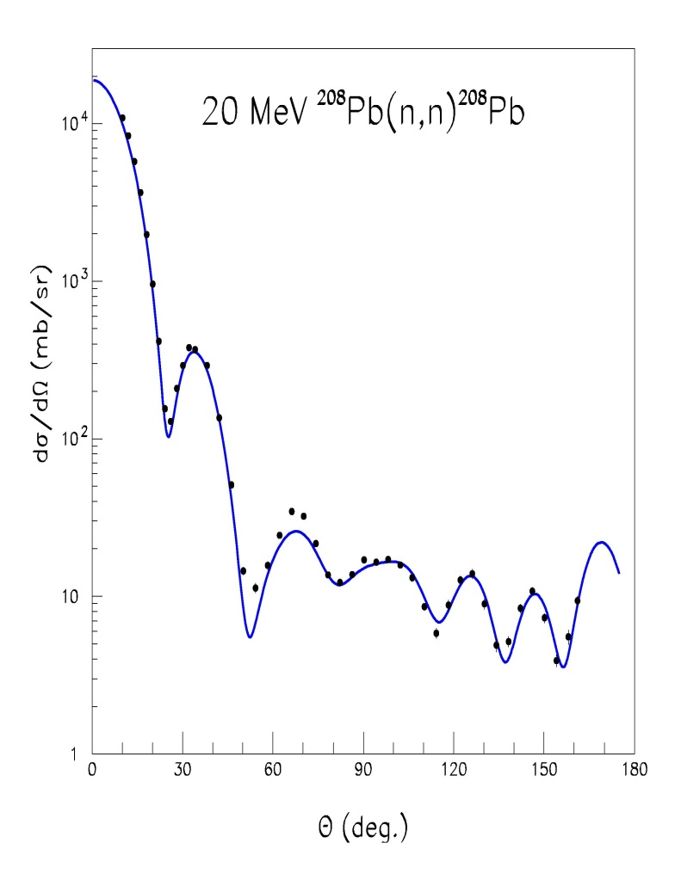
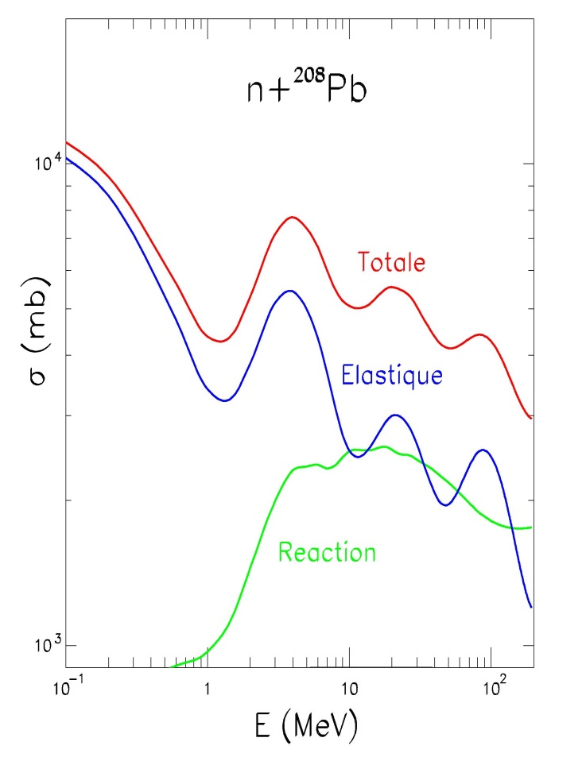
THE OPTICAL MODEL
The optical model yields :
Integrated cross sections
Transmission coefficients
Angular distributions

Slide 30
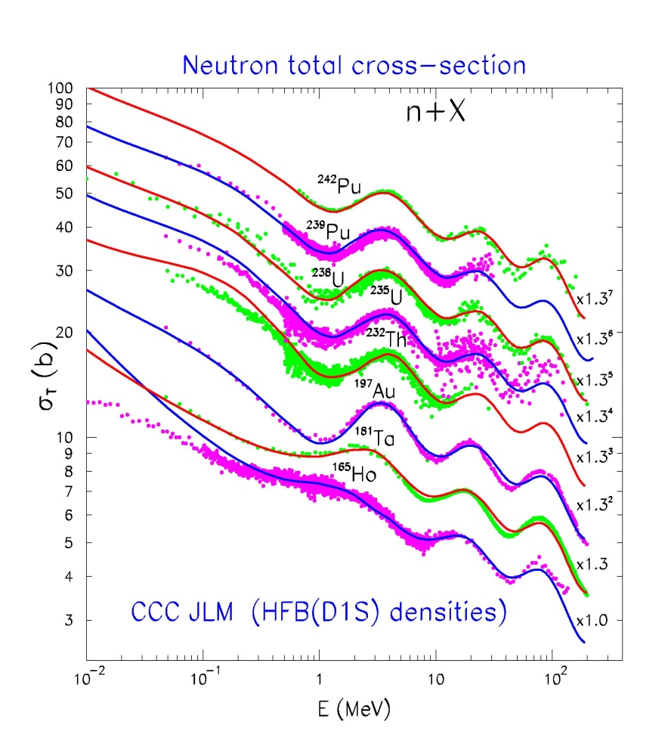
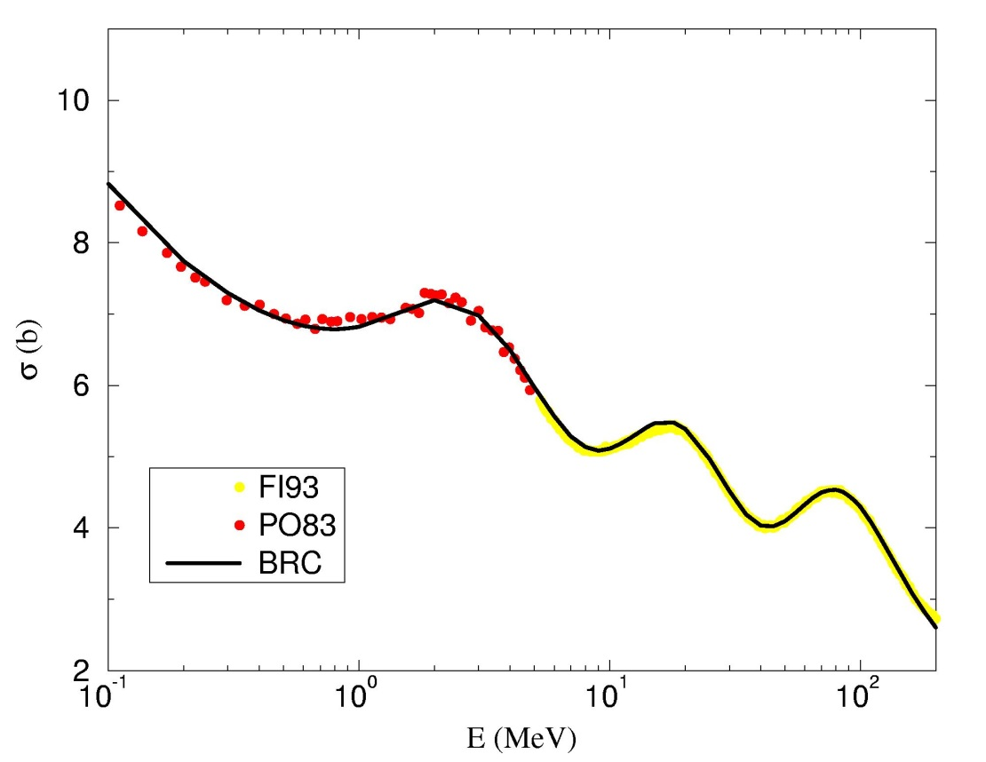
TWO TYPES OF APPROACHES
Phenomenological
(Semi-)microscopic
Adjusted parameters
Weak predictive power
Very precise ( ≈ 1%)
Important work
No adjustable parameters
Usable without exp. data
Less precise ( ≈ 5-10 %)
Quasi-automated
Total cross sections

Slide 31
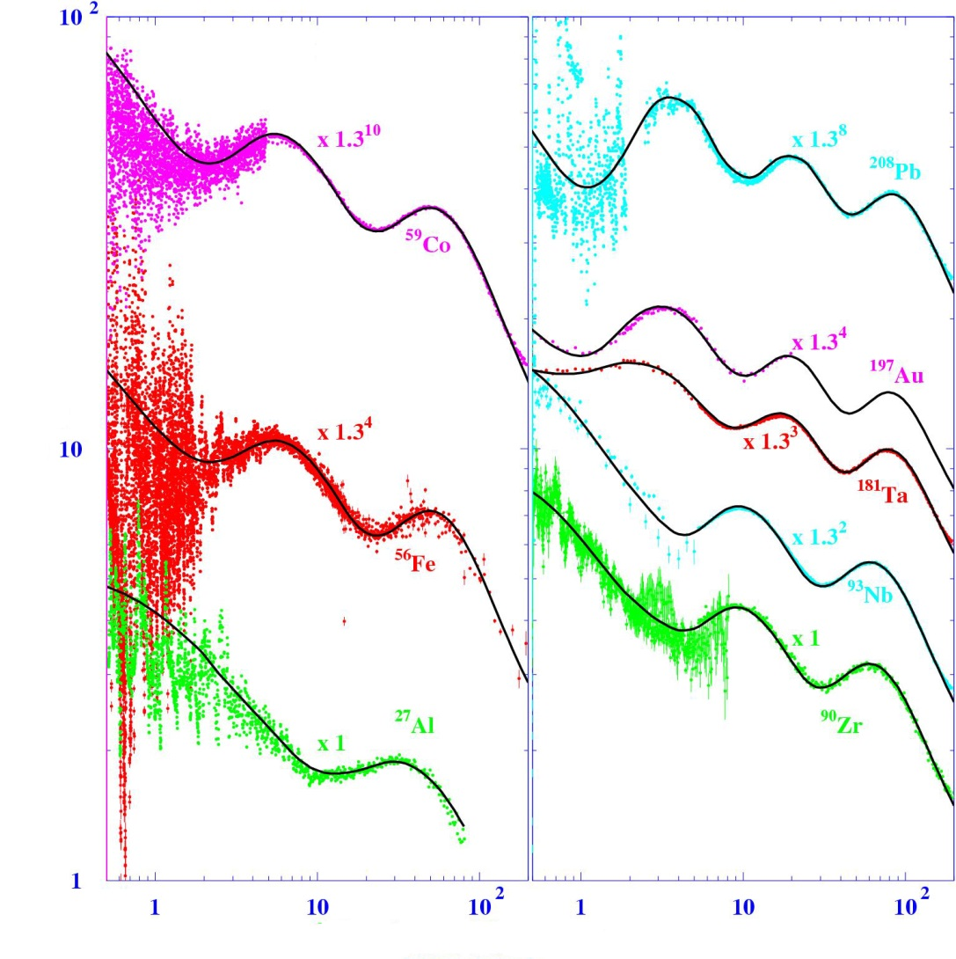
PHENOMENOLOGICAL OPTICAL MODEL
≈ 20 adjusted parameters
Very precise (1%)
Weak predictive power
Total cross section (barn)
Neutron energy (MeV)

Slide 32
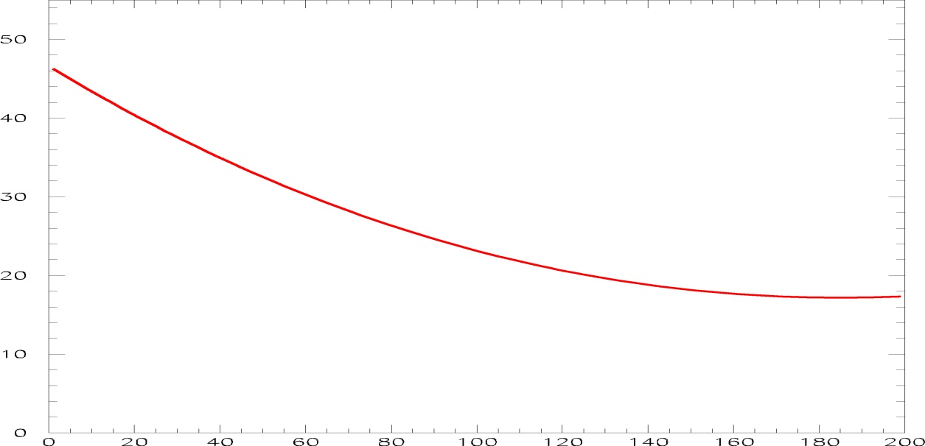
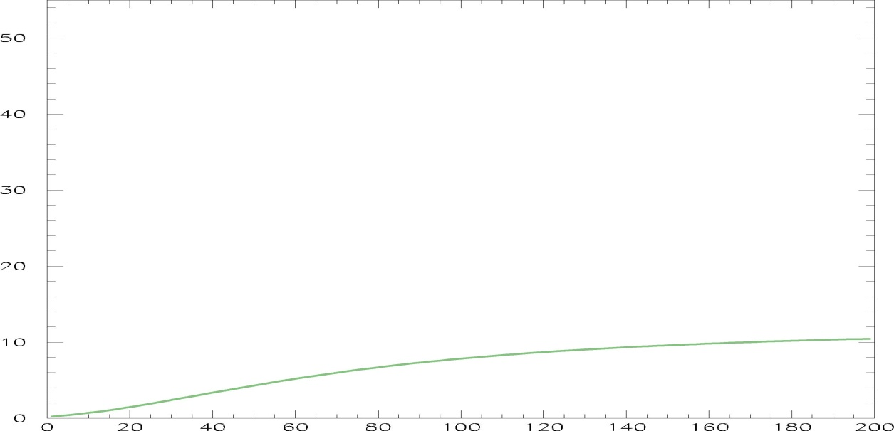
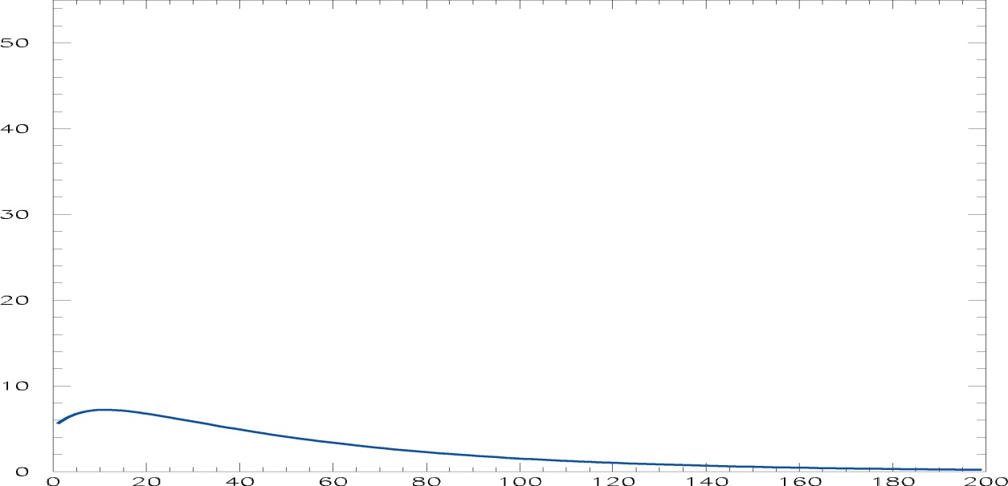
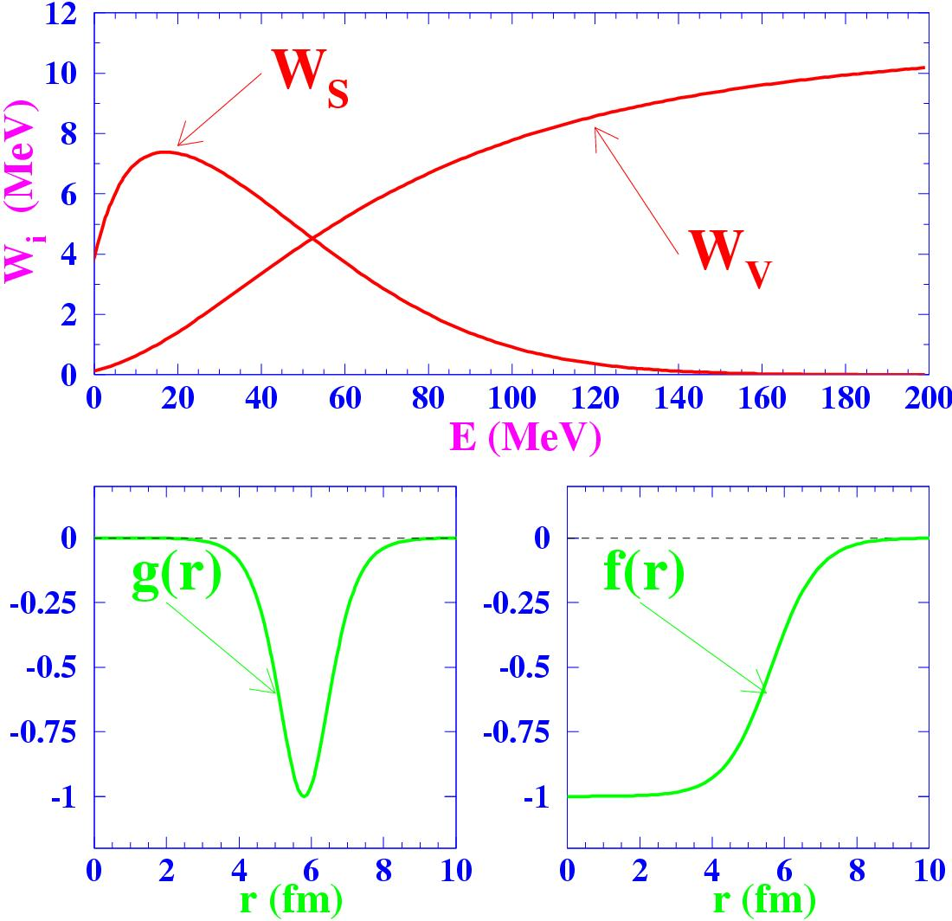
PHENOMENOLOGICAL OPTICAL MODEL
[ ]
U(r,E) =
U(r,E) = V(E,r) + i W(E,r)
U(r,E) = V_{V}(E) f(r, R_{V},a_{V}) + V_{S}(E) g(r,R_{S},a_{S})
[ ]
+ i W_{V}(E) f(r,R_{V},a_{V}) + W_{S}(E) g(r,R_{S},a_{S})
Well depths (MeV)
Incident energy (MeV)
-1
f(r,R,a)=
g(r,R,a) = - df/dr
1+exp((r-R)/a)

Slide 33
PHENOMENOLOGICAL OPTICAL MODEL
OMP
&
its parameters
Solution of the
Schrödinger equation
Calculated observables
σ_{el-inl} (θ), A_{y}(θ), σ_{tot}, σ_{reac}, S₀,S₁
Experimental data
σ_{el-inl}(θ), A_{y}(θ), σ_{tot}, σ_{reac} , S₀,S₁
σ_{Reaction}, T_{lj}, σ_{direct}

Slide 34
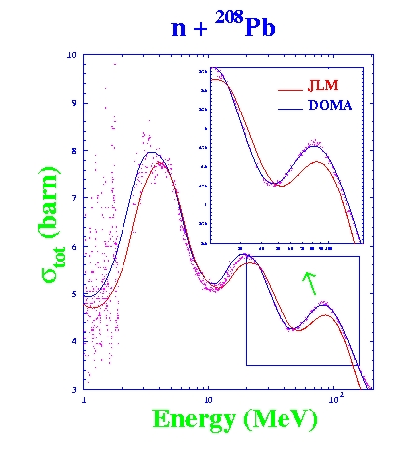
SEMI-MICROSCOPIC OPTICAL MODEL
No adjustable parameters
Based on nuclear structure properties
⇒ usable for any nucleus
Less precise than the
phenomenological approach

Slide 35
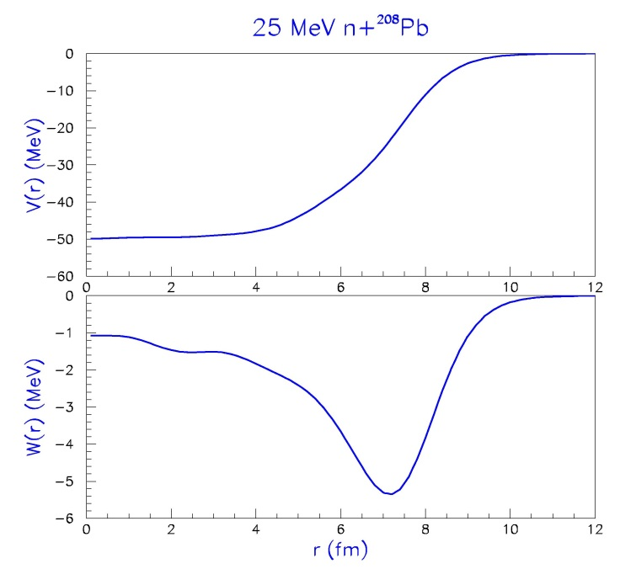
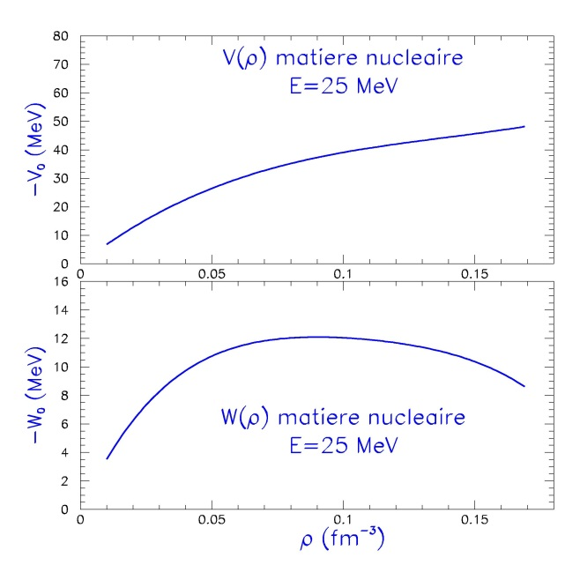
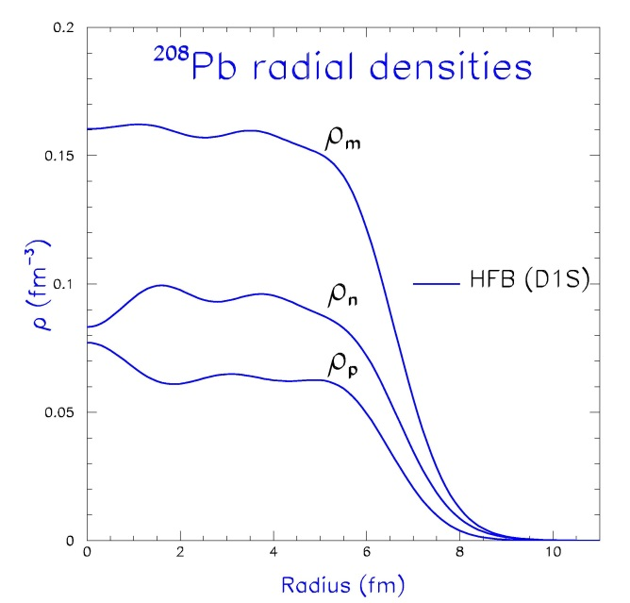
SEMI-MICROSCOPIC OPTICAL MODEL
Effective
Interaction
Optical potential
=
⊗
Radial densities
=
⊗
U(ρ(r’),E)
U(r,E)
=
⊗
ρ(r)
ρ(r’)
Depends on the nucleus
Independent of the nucleus
Depends on the nucleus

Slide 36
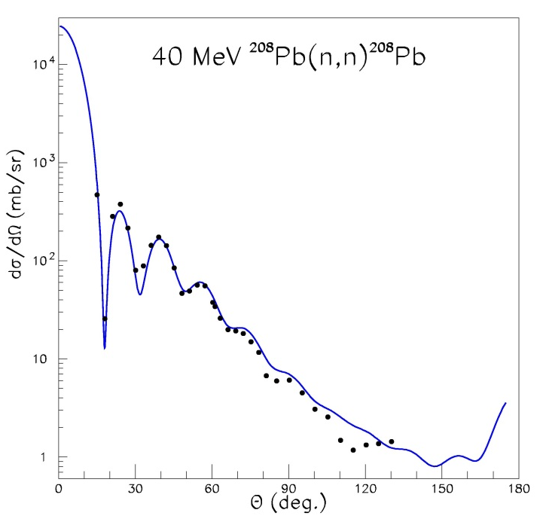
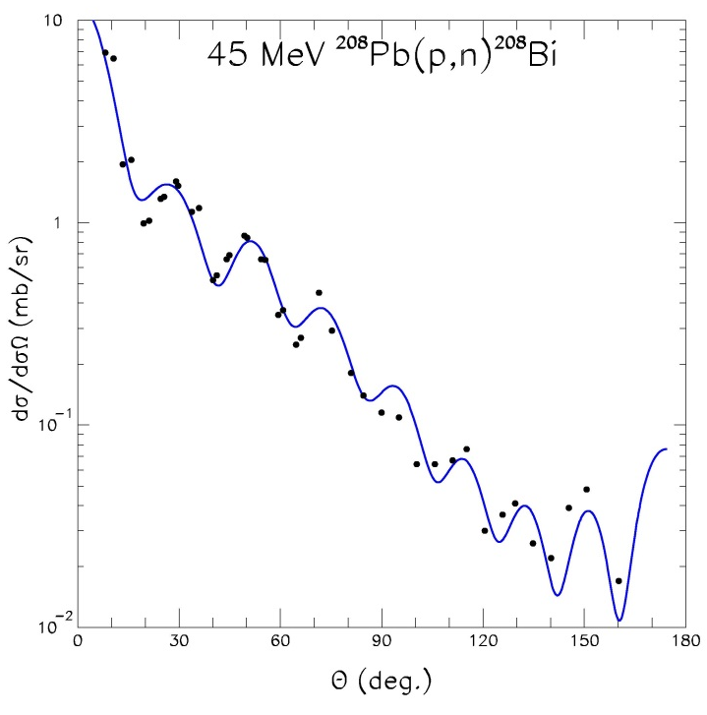
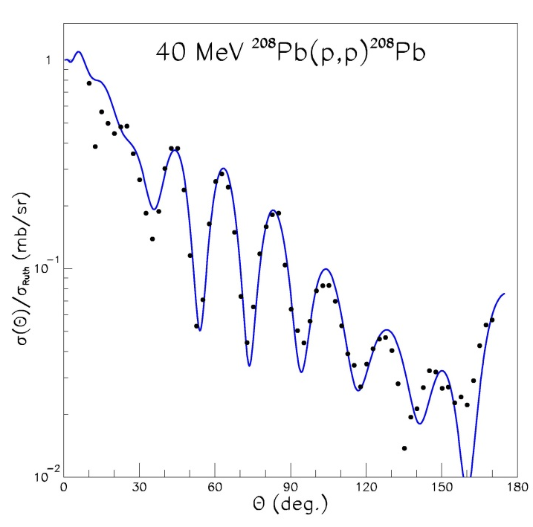
SEMI-MICROSCOPIC OPTICAL MODEL
Unique description of elastic scattering
(n,n)
, (p,p)
and (p,n)

Slide 37
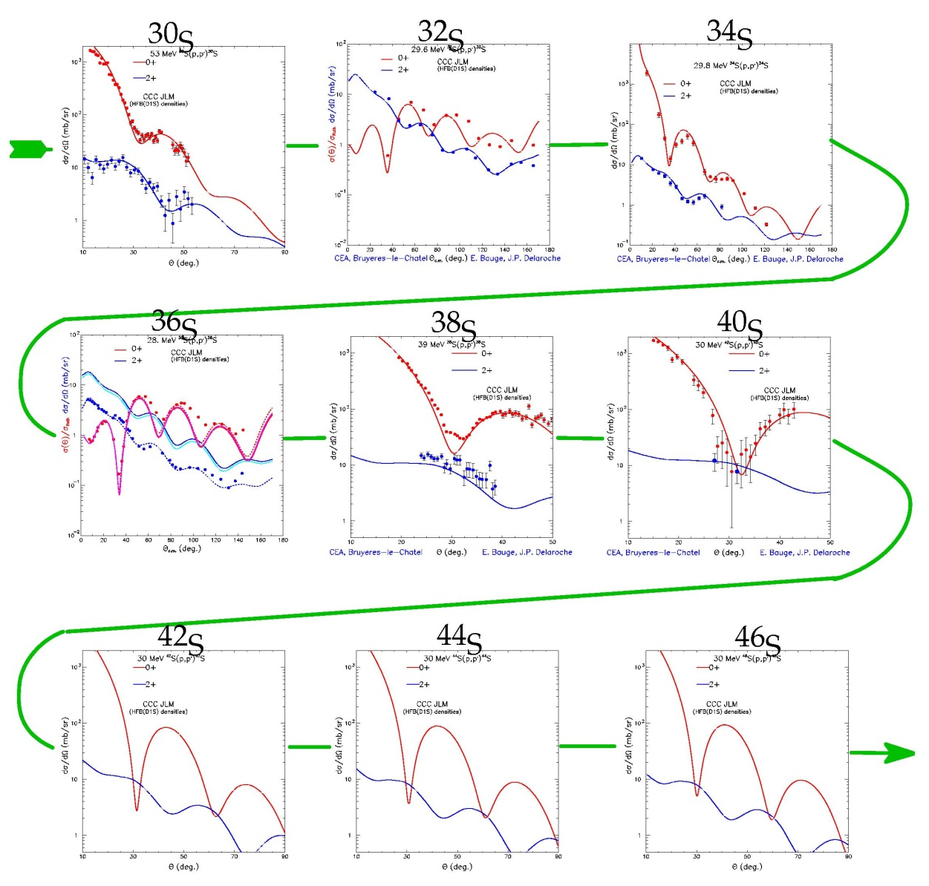
SEMI-MICROSCOPIC OPTICAL MODEL
Enables to give predictions for very exotic nuclei for which
there exist no experimental data
Experiment
performed
after calculation

Slide 38
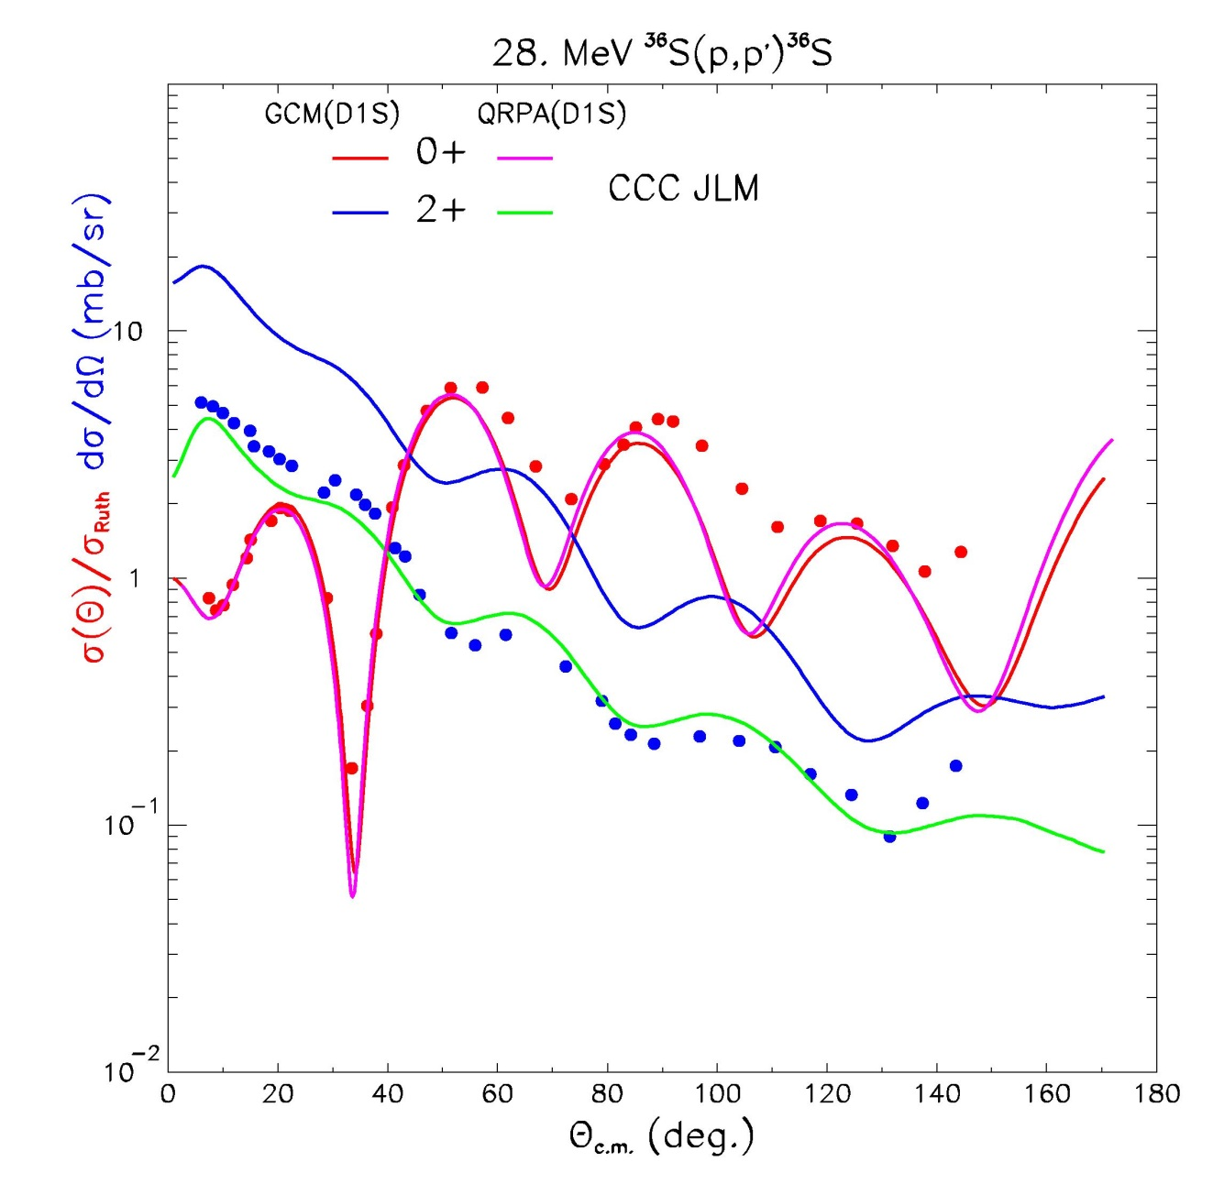
SEMI-MICROSCOPIC OPTICAL MODEL
Great sensitivity to nuclear structure

Slide 39
THE PRE-EQUILIBRIUM MODEL
Shape elastic
Elastic
σ_{Reaction}
σ_{NC}
OPTICAL
MODEL
PRE-EQUILIBRIUM
COMPOUND
NUCLEUS
Fission
T_{lj}
Inelastic
Direct components
(n,n’), (n,α),
(n,γ), etc…

Slide 40
TIME SCALES AND ASSOCIATED MODELS (1/4)
Typical spectrum shape
Always evaporation peak
Discrete peaks at forward angles
Flat intermediate region

Slide 41
THE PRE-EQUILIBRIUM MODEL
(quantum vs semi-classical approaches)
Semi-classical approaches
- called « exciton model »
- « simple » to implement
- initially only able to describe angle integrated spectra (1966 & 1970)
- extended to ddx spectra in 1976
- link with Compound Nucleus established in 1987
- systematical underestimation of ddx spectra at backward angles
- complemented by Kalbach systematics (1988) to improve ddx description
Quantum mechanical approaches
- distinction between MSC and MSD processes
MSC = bound p-h excitations, symetrical angular distributions
MSD = unbound configuration, smooth forward peaked ang. dis.
- MSD dominates pre-equ xs above 20 MeV
- 3 approaches : FKK (1980)
- 3 approaches : TUL (1982)
- 3 approaches : NWY (1986)
- ddx spectra described as well as with Kalbach systematics

Slide 42
THE PRE-EQUILIBRIUM MODEL
(Exciton model principle)
E
0
E_{F}
Compound
Nucleus
1p
2p-1h
3p-2h
4p-3h
time
1n
3n
5n
7n

Slide 43
THE PRE-EQUILIBRIUM MODEL
(Master equation exciton model)
P(n,E,t) = Probabilité to find for a given time t the composite system with an energy E and an exciton number n.
Probability
λ _{a, b} (E) = Transition rate from an initial state a towards a state b for a given energy E.
Evolution equation
dP(n,E,t)
=
P(n-2, E, t) λ _{n-2, n} (E)
+ P(n+2, E, t) λ _{n+2, n} (E)
Apparition
dt
[
]
-
P(n, E, t)
λ _{n, n+2} (E)
+ λ _{n, n-2} (E)
+ λ _{n, emiss} (E)
Disparition
Emission cross section in channel c
∫
∞
Σ
dσ_{c} (E, ε_{c}) = σ_{R}
P(n, E, t) λ _{n, c} (E) dt dε_{c}
0
n, Δn=2

Slide 44
THE PRE-EQUILIBRIUM MODEL
(Initialisation & transition rates)
Initialisation
P(n,E,0) = δ_{n,n0} with n₀=3 for nucleon induced reactions
Transition rates
2π
⟨M²⟩
λ _{n, n-2} (E) =
ω(p,h,E) with p+h=n-2
ℏ
2π
λ _{n, n+2} (E) =
⟨M²⟩
ω(p,h,E) with p+h=n+2
Original
formulation
ℏ
2s_{c}+1
ω(p-p_{b},h,E- ε_{c}- B_{c})
λ _{n, c} (E) =
µ_{c} ε_{c} σ_{c,inv} (ε_{c})
Q_{c}(n) F_{c}
π² ℏ³
ω(p,h,E)
State densities
Corrections for
proton-neutron
distinguishability
&
complex particle
emission
ω(p,h,E) = number of ways of distributing p particles and h holes on among accessible single particle levels with the available excitation energy E

Slide 45
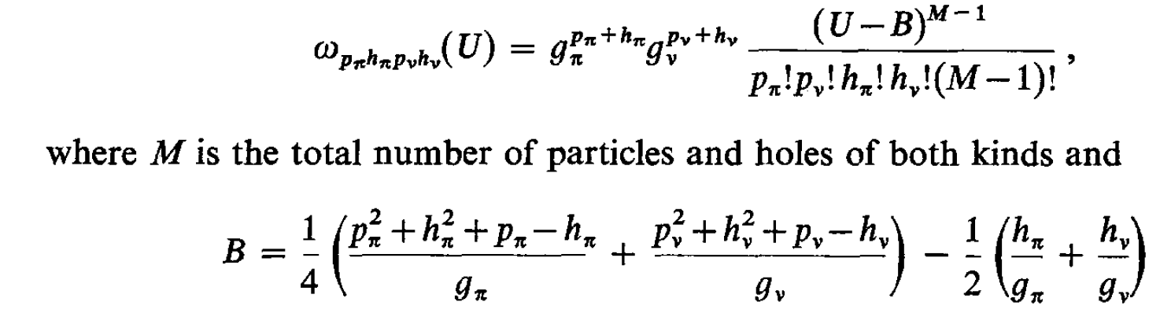
THE PRE-EQUILIBRIUM MODEL
(State densities)
State densities in ESM
Ericson 1960 : no Pauli principle
Griffin 1966 : no distinction between particles and holes
Williams 1971 : distinction between particles and holes as well as between neutrons and protons but infinite number of accessible states for both
particle and holes
Běták and Doběs 1976 : account for finite number of holes’ states
Obložinský 1986 : account for finite number of particles’ states (MSC)
Anzaldo-Meneses 1995 : first order corrections for increasing number of p-h
Hilaire and Koning 1998 : generalized expression in ESM

Slide 46
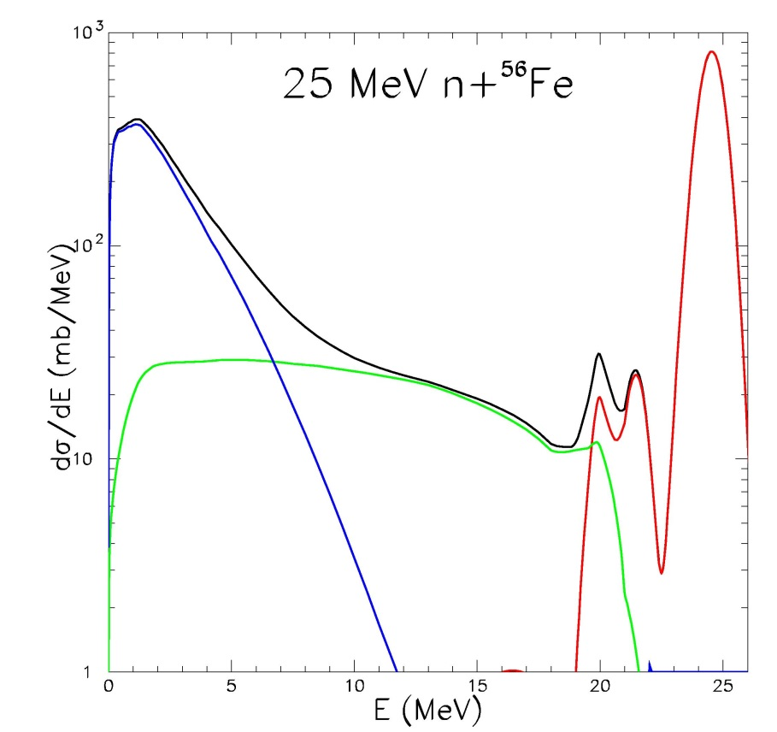
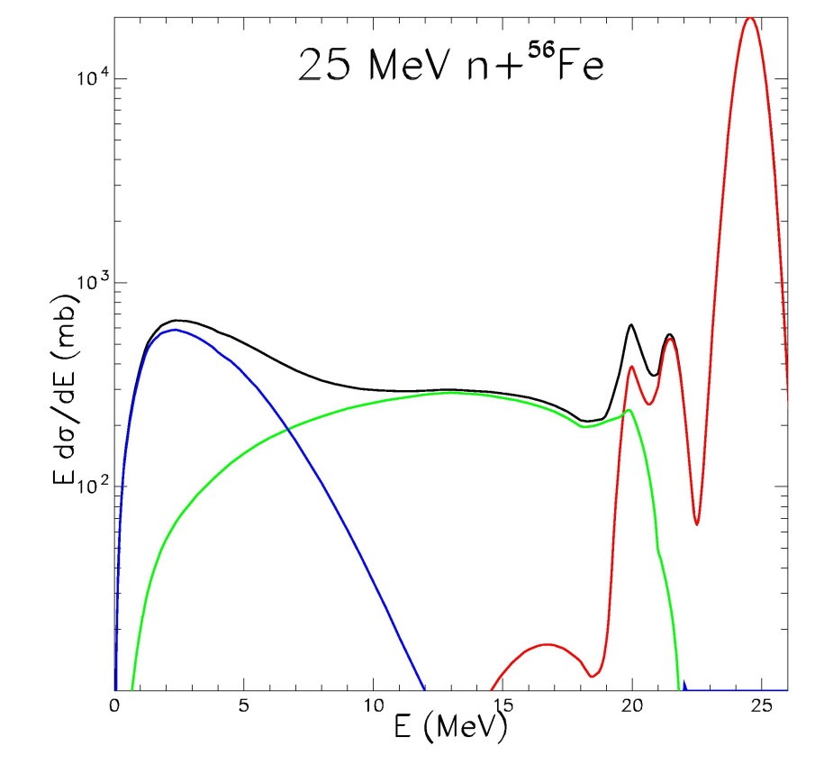
THE PRE-EQUILIBRIUM MODEL
Cross section
Outgoing energy
Total
Direct
Pre-equilibrium
Statistical
9%
39%
45%
79%
16%
12%
<E_{Tot}>= 12.1
<E_{Dir}>= 24.3
<E_{PE}>= 9.32
<E_{Sta}>= 2.5
(MeV)

Slide 47
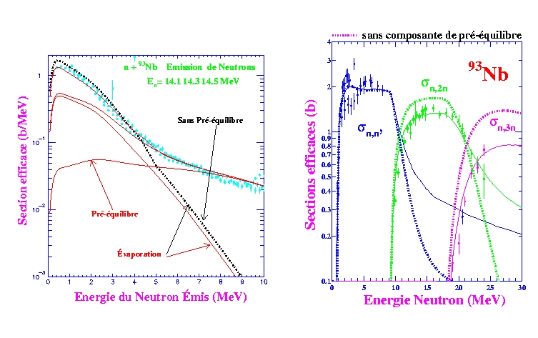
THE PRE-EQUILIBRIUM MODEL
14 MeV neutron + ⁹³ Nb
without pre-equilibrium
without pre-equilibrium
dσ/dE(b/MeV)
σ(barn)
pre-equilibrium
Compound nucleus
Outgoin neutron energy (MeV)
Iincident neutron energy (MeV)

Slide 48
THE COMPOUND NUCLEUS MODEL
Shape elastic
Elastic
σ_{Reaction}
σ_{NC}
OPTICAL
MODEL
PRE-EQUILIBRIUM
COMPOUND
NUCLEUS
Fission
T_{lj}
Inelastic
Direct components
(n,n’), (n,α),
(n,γ), etc…

Slide 49
THE COMPOUND NUCLEUS MODEL
(initial population)
After direct and pre-equilibrium emission
+ σ_{NC}
σ_{reaction} =
σ_{dir} + σ_{pre-equ}
N₀
Z₀
E*₀
J₀
N₀-dN_{D}
Z₀-dZ_{D}
E*₀-dE*_{D}
J₀-dJ_{D}
N₀-dN_{D}-dN_{PE}
Z₀-dZ_{D}-dZ_{PE}
E*₀-dE*_{D}-dE*_{PE}
J₀-dJ_{D}-dJ_{PE}
= E
= Z
= E*
= J
E
Z
E*
J
N,Z,E*,J
N’,Z’,E’*,J’
N’’,Z’’,E’’*,J’’
…
r(N,Z,E*)
r(N’,Z’,E’*)
r(N’’,Z’’,E’’*)

Slide 50
THE COMPOUND NUCLEUS MODEL
(basic formalism)
Compound nucleus hypothesys
Continuum of excited levels
Independence between incoming channel a and outgoing channel b
σ_{ab}
σ^{(CN)} P_{b}
=
σ_{a}
T_{b}
p
σ^{(CN)} = T_{a}
P_{b}=
σ_{a}
₂
S T_{c}
k_{a}
_{c}
⇒ Hauser- Feshbach formula
T_{a} T_{b}
p
σ_{ab}
=
₂
S T_{c}
k_{a}
_{c}

Slide 51
THE COMPOUND NUCLEUS MODEL
(qualitative feature)
Compound angular distribution & direct angular distributions
45° 90° 135°

Slide 52
THE COMPOUND NUCLEUS MODEL
(complete channel definition)
Channel Definition
a + A → (CN )* → b+B
→
→
→
→
→
Incident channel a = (l_{a}, j_{a}=l_{a}+s_{a}, J_{A},p_{A}, E_{A}, E_{a})
Conservation equations
  Total energy : E_{a} + E_{A} = E_{CN} = E_{b} + E_{B}
  Total momentum : p_{a} + p_{A} = p_{CN} = p_{b} + p_{B}
  Total angular momentum : l_{a} + s_{a} + J_{A} = J_{CN} = l_{b} + s_{b} + J_{B}
  Total parity : p_{A} (-1) = p_{CN} = p_{B} (-1)
→
→
→
→
→
→
→
→
→
→
→
→
l_{a}
l_{b}

Slide 53
THE COMPOUND NUCLEUS MODEL
(loops over all quantum numbers)
In realistic calculations, all possible quantum number combinations
have to be considered
I_{A} + s_{a} + l_{a}
Given by OMP
^{max}
(2J+1)
p
S
S
s_{ab} =
k_{a}
(2I_{A}+1) (2s_{a}+1)
²
p = ±
J=| I_{A} – s_{a} |
Width fluctuation correction factor
to account for deviations
from independance hypothesis
J + I_{A}
j_{a} + s_{a}
J + I_{B}
j_{b} + s_{b}
S
S
S
S
j_{a}= | J – I_{A} |
l_{a}= | j_{a} – s_{a} |
j_{b}= | J – I_{B} |
l_{b}= | j_{b} – s_{b} |
Parity selection rules
T Jp
T Jp
T
T
T Jp
a, l_{a} , j_{a}
b, l_{b} , j_{b}
W
d_{p} (a)
d_{p} (b)
S
a, l_{a} , j_{a} , b, l_{b} , j_{b}
T Jp
T
c, l_{c} , j_{c}
c

Slide 54
THE COMPOUND NUCLEUS MODEL
(width fluctuation correction factor)
Breit-Wigner resonance integrated and averaged over an energy width
Corresponding to the incident beam dispersion
< >
< >
G_{a} G_{b}
σ_{ab} =
π
2π
₂
G_{tot}
k _{a}
D
< >
2π
G_{a}
T_{a} ≈
Since
D
⎧
< >
T_{a} T_{b}
W_{ab}
σ_{ab} =
π
⎜
₂
S T_{c}
k _{a}
_{c}
⇒
⎨
G_{a} G_{b}
G_{a}
G_{b}
⎜
with
W_{ab} =
⎩
G_{tot}
G_{tot}

Slide 55
THE COMPOUND NUCLEUS MODEL
(main methods to calculate WFCF)
Tepel method
  Simplified iterative method
Moldauer method
  Simple integral
GOE triple integral
  « exact » result
Elastic enhancement with respect to the other channels
Inelastic enhancement sometimes in very particular situations ?

Slide 56
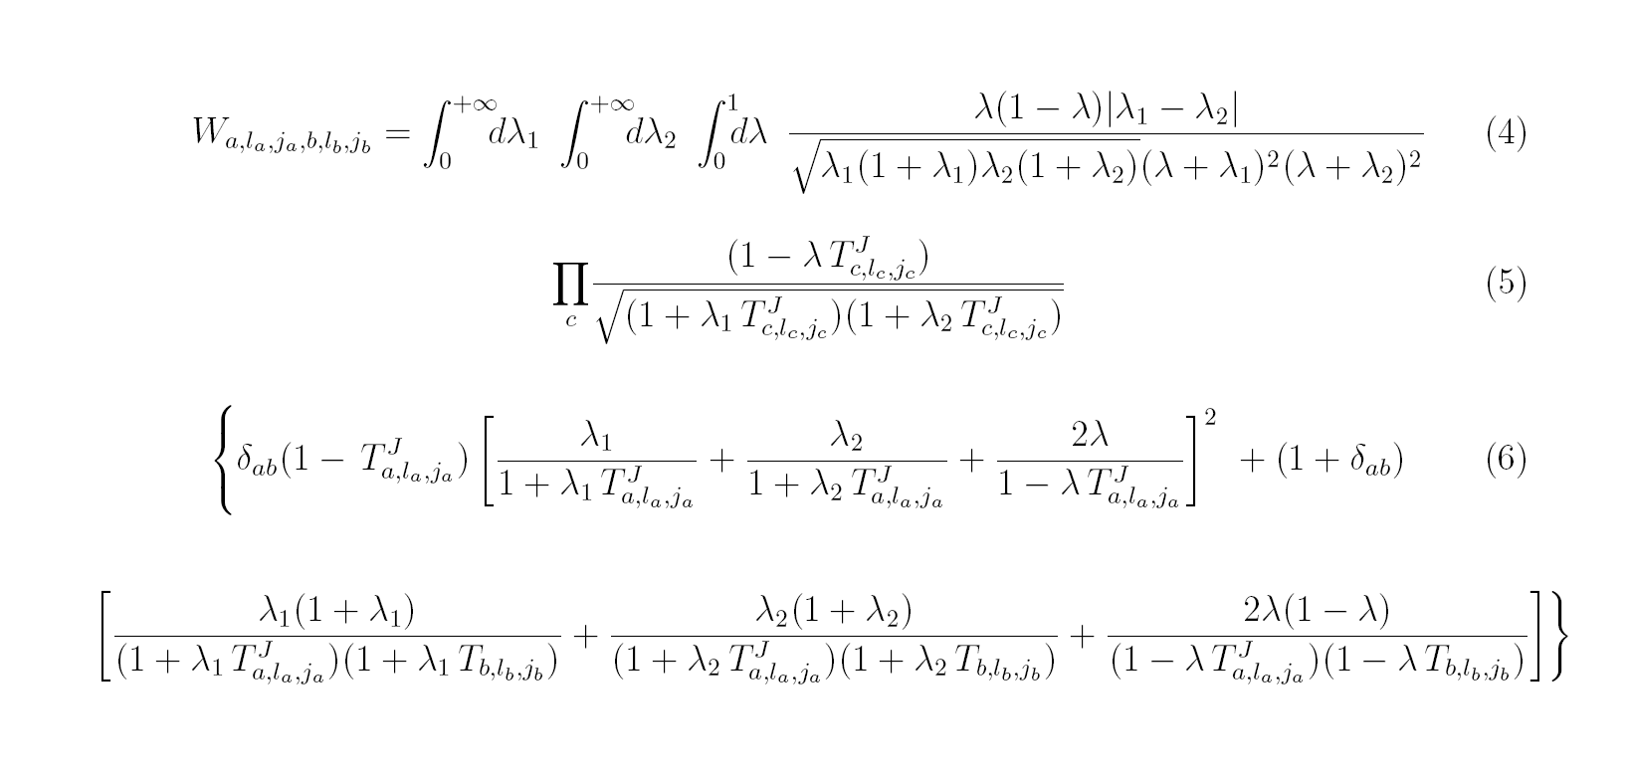
THE COMPOUND NUCLEUS MODEL
(the GOE triple integral)

Slide 57
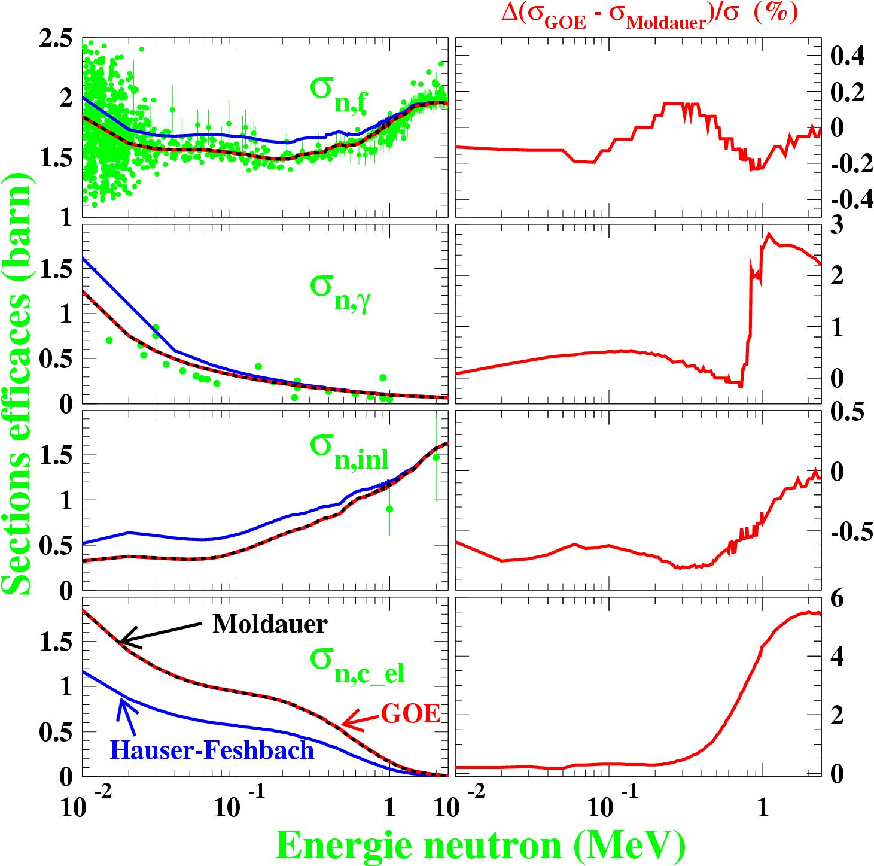
THE COMPOUND NUCLEUS MODEL
(flux redistribution illustration)

Slide 58
THE COMPOUND NUCLEUS MODEL
(multiple emission)
Target
Compound Nucleus
fission
E
S_{a}
n’
S_{p}
g
S_{a}
g
S_{p}
S_{n}
n₍₂₎
S_{a}
n’
g
S_{n}
+ Loop over CN spins and parities
n
p
S_{n}
Z
J^{p}
d
S_{p}
n
Z_{c}
S_{a}
S_{p}
S_{p}
S_{n}
S_{a}
S_{a}
S_{n}
S_{n}
a
Z_{c}-1
N
N_{c}-2
N_{c}-1
N_{c}

Slide 59
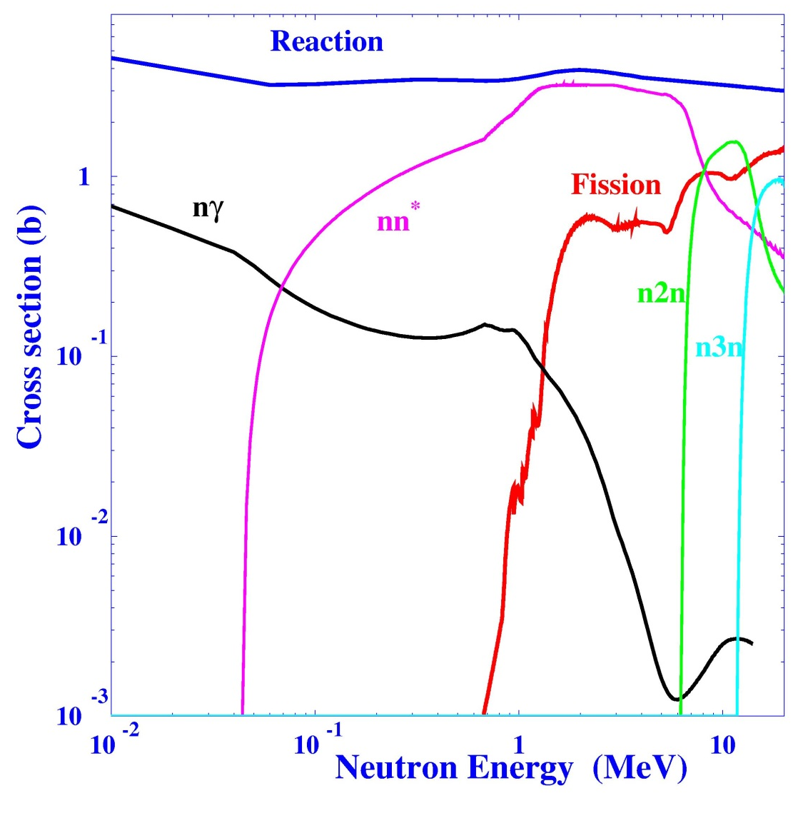
REACTION MODELS & REACTION CHANNELS
n + ²³⁸U
Optical model
+
Statistical model
+
Pre-equilibrium model
s_{R} = s_{d} + s _{PE} + s_{CN}
Cross section (barn)
= s_{nn’} + s_{nf} + s_{ng} + ...
Neutron energy (MeV)

Slide 60
THE COMPOUND NUCLEUS MODEL
(compact expression)
σ_{NC}
∑
= σ_{ab} où b = g , n, p, d, t, …, fission
b
< >
_{Jπ}
π
∑
∑
(2J+1)
_{Jπ}
T_{b} (b)
σ_{ab} =
T_{lj} (a)
W_{ab}
< >
₂
(2s+1)(2I+1)
∑
_{Jπ}
k _{a}
J,π
a,b
T_{d} (d)
_{d}
l_{a}
with
J = l_{a} + s_{a} + I_{A} = j_{a} + I_{A}
and π = (-1) π_{A}
< >
and T_{b}(b) = transmission coefficient for outgoing channel b
associated with the outgoing particle b

Slide 61
THE COMPOUND NUCLEUS MODEL
(various decay channels)
Possible decays
Emission to a discrete level with energy E_{d}
Emission in the level continuum
Emission of photons, fission
< >
Jp
T_{b}(b) = given by the O.M.P.
T_{lj}(b)
< >
∫
E +DE
T_{b}(b) =
Jp
T_{lj}(b) r(E,J,p) dE
E
r(E,J,p) density of residual nucleus’ levels (J,p) with excitation energy E
Specific treatment

Slide 62
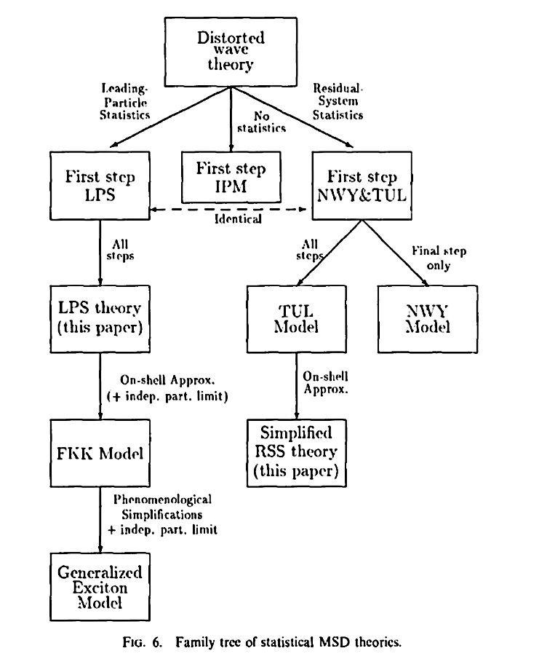
THE PRE-EQUILIBRIUM MODEL
More details in Annals of physics 208 (1991) 216.
Quantum mechanical
approaches
(complex & time consuming)
Semiclassical approaches
(easy to implement
&
analytical solutions)

